Slide 1
Shifting Information Security Landscape from C&As to Continuous Monitoring
Andrew Patchan JD, CISA
Associate IG for IT, FRB
Louis c. King, CPA, CISA, CMA, CFM, CGFM
Assistant IG for Financial & IT Audits, DOT

Slide 2
Certification & Accreditation
OMB A-130, Appendix III
The authorization/accreditation of a system to process information provides an important quality control. By authorizing processing in a system, a manager assesses and accepts the risk associated with it.
Re-authorization should occur prior to a significant change in processing, but at least every three years.
Notes:
Security of Federal Automated Information Resources, February 8, 1996

Slide 3
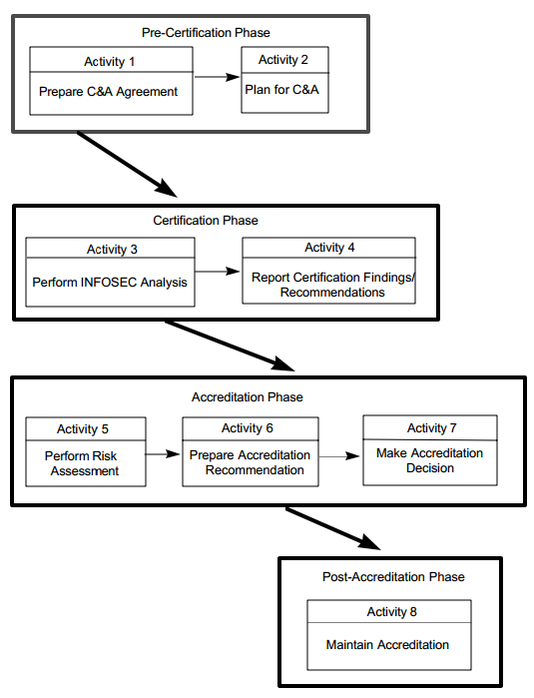
C&A Process
Notes:
Certification and Accreditation Handbook for Certifiers, July 1996, National Computer Security Center, available on NIST website.

Slide 4
C&A package
A typical package will contain:
System Security Plan
System Test and Evaluation (STE) Report
Risk Assessment
Contingency Plan
Plans of Action and Milestones (POA&Ms)

Slide 5
C&A Changing perspective
2003
“Going through the formal process of a C&A may seem cumbersome, but the results are well worth it.” – SANS Institute
2009
95% of systems accredited at a estimated cost of $300 million (about $78,000 per system)
2010
“At first, the mandate of FISMA was met by requiring C&A…While this approach provided foundational work…it did not recognize or respond to the real-time nature of the threats to Federal information systems. Large aspects of FISMA implementation became an additional compliance exercise.” --OMB
Notes:
An Introduction to Certification and Accreditation, September 21, 2003. SANS Institute Infosec Reading Room
Statement of Karen Evans, March 16, 2006
OMB FY 2010 FISMA Implementation Report
OMB FY 2009 FISMA Implementation Report

Slide 6
C&A Issues
COST
In FY 2009, the first year OMB requested cost data, an estimated $300 million was spent on C&As (about $78,000 per system)
QUALITY
In FY 2009, although 95% had C&As, IGs reported that only two-thirds of agencies had compliant processes.
EFFECTIVENESS
C&As are static; security states are not.
Ultimately, even though the vast majority of systems have been accredited, this has not prevented significant information security compromises.

Slide 7
C&A Transition
In February 2010, NIST issues Revision 1 to 800-37, Guide for Applying the Risk Management Framework to Federal Information Systems
Rev 1 transforms the C&A process into a six-step Risk Management Framework.
Categorize Information System
Select Security Controls
Implement Security Controls
Assess Security Controls
Authorize Information System
MONITOR SECURITY CONTROLS
Notes:
Replaces the Guide for Security C&A of Federal Systems

Slide 8
CONTINUOUS MONITORING
NIST 800-137 “Information Security Continuous Monitoring for Federal Information Systems and Organizations (September 2011)
To monitor system risks and security controls defined in NIST Special Publication 800-53 “Recommended Security Controls for Federal Information Systems and Organizations”

Slide 9
CONTINUOUS MONITORING (cont.)
Control CA-7 under NIST 800-53:
Reduces the level of effort required for the reauthorization of systems
Maintains security authorization over time in a highly dynamic operational environment with changing threats, vulnerabilities, technologies, and business processes
Promotes situational awareness of the security state of the system

Slide 10
CONTINUOUS MONITORING (cont.)
Control CA-7 under NIST 800-53 (cont.):
Implementation of continuous monitoring should result in updates to the security plan, security assessment report, and plan of action and milestones (the three key documents in a security reauthorization package)

Slide 11
CONTINUOUS MONITORING (cont.)
Manual Processes, e.g. assessments of adequacy of security controls/documentation, and testing
And
Automated Processes, e.g. vulnerability scanning tools, and network scanning devices

Slide 12
CONTINUOUS MONITORING (cont.)
Challenges in Implementing Continuous Monitoring:
Developing strategies, policies, and procedures for ISCM across organization components
Involvement/buy-in of system owners
Updating information on risk assessments, security plan, security assessments, and plan of action and milestones

Slide 13
CONTINUOUS MONITORING (cont.)
Challenges in Implementing Continuous Monitoring (cont.)
Establishing frequencies for monitoring and assessing security information
Sampling of controls
Analysis and reporting of findings and determining appropriate response
Output information needs to be specific, measurable, actionable, relevant, and timely
Plan of action and milestones to ensure remediation
Developing metrics to evaluate and control ongoing risk

Slide 14
CONTINUOUS MONITORING (cont.)
Status of Implementation of Continuous Monitoring:
According to March 2013 OMB report on 2012 FISMA, OIGs in the 24 CFO Act agencies found that:
30% of agencies did not have documented strategies and plans for continuous monitoring
50% had not established and adhered to milestone dates for remediating vulnerabilities or ensuring remediation plans were effective
67% did not have a fully developed patch management process and were not timely remediating findings from vulnerability scans

