Slide 1
Federal audit executive council FY2021 DATA Act working group methodology Updates
CIGIE/GAO Financial Statements Audit Conference
Pauletta Battle, deputy aiga, treasury OIG
May 17, 2020

Slide 2
overview
Digital Accountability and Transparency Act of 2014 (DATA Act)
Requires Federal agencies to report financial and award data in accordance with the established Government-wide financial data standards.
Requires IGs to:
Review a statistically valid sample of the spending data submitted by its Federal agency
Submit to Congress and make publically available a report assessing completeness, timeliness, quality, and accuracy of the data sampled; and implementation and use of Data Standards by the Federal agency
Final of the three required DATA Act reviews

Slide 3
overview
Federal Audit Executive Council (FAEC) DATA Act Working Group
Assist the IG Community in understanding and meeting its DATA Act oversight requirements
Established January 2015 and has over 250 members from over 50 IGs
Published:
DATA Act Readiness Review Guide (December 2015)
FY 2017 Inspectors General Guide to Compliance Under the DATA Act (February 2017)
FY 2019 Inspectors General Guide to Compliance Under the DATA Act (February 2019)
FY 2021 Inspectors General Guide to Compliance Under the DATA Act (December 2020)
Includes a Common Methodology Team and a Governance Team

Slide 4
The way we work
Common Methodology Team – solicits input/feedback from stakeholders and discuss lessons learned from prior audits/reviews
Identifies, reviews, & researches criteria, common issues, and anomalies that may have government-wide impact
Writes decision memos (as needed) – outline options and chosen method
Provides decision memos to Governance for concurrence/approval
Coordinates with GAO on decision memos
Communicates decision memos to IG community
Writes the audit guide
Develop and conduct trainings
Maintain and publish Frequently Asked Questions (FAQs)

Slide 5
The way WE work
Governance Team represents the working group with CIGIE, OMB, and CFO community
Governance Team reviews/approves the work of the Common Methodology Team
Decision memos
Guide and attachments
Training materials

Slide 6
About the guide
Incorporates Lessons Learned and Feedback from Stakeholders
Provides Consistent Baseline Methodology for IG Audits
May be Modified – Document Deviations
May be Updated – Per IG Community
Not All-Inclusive

Slide 7
About the guide
This guide does not replace or include all requirements of GAGAS.
Audit teams are responsible for ensuring compliance with GAGAS.
Audit teams are responsible for ensuring compliance with other applicable standards and internal IG policies.

Slide 8
Major changes
Guide Layout
Audit Scope
COVID-19 and OMB M-20-21
Assessing Quality
Comparative Results
Crosswalks

Slide 9
Guide layout
Sections – ordering changed and added sections (i.e. non-statistical COVID sample)
More detailed steps – internal controls, Federal Shared Service Providers (FSSP), data elements testing
More robust reporting section – examples of verbiage for IGs to use in creating their reports
Appendices and attachments

Slide 10
Scope
Must fall within the range of fiscal year 2020 third quarter through fiscal year 2021 second quarter. IGs must select a formal fiscal year quarter that:
Is representative of agency spending;
Includes COVID-related spending transactions, if applicable; and
Allows sufficient time to meet the mandatory audit deadline.

Slide 11
IGs DATA Act Audit Scope by Quarter

Slide 12
Covid-19 & OMB M-20-21
In April 2020, OMB issued M-20-21, Implementation Guidance for Supplemental Funding Provided in Response to the Coronavirus Disease 2019 (COVID-19), which made changes to DATA Act reporting.
Agencies that received COVID-19 supplemental relief funding must submit DATA Act Files A, B, and C on a monthly basis starting with the June 2020 reporting period.
Monthly submissions must also include a running total of outlays for each award in File C funded with COVID-19 supplemental relief funds.
Expanded use of the Disaster Emergency Fund Code (DEFC) for tracking COVID-19 supplemental funding.
Added National Interest Action (NIA) code to FPDS-NG to help identify procurement actions related to the COVID-19 response.
Now 59 applicable data elements to be tested under DATA Act.

Slide 13
Covid-19 Outlays Non-Statistical Sample
Agencies with COVID-19 funding
Non-statistical sample of COVID-19 Outlays from File C
Sample size can be determined based on amount of data
Number of records should be sufficient to provide examples within each category of the criteria (i.e., dollar amount) used to design the sample
Include results of outlay testing in IG’s report and factor into the quality determination.

Slide 14
Assessing Quality
Data that is complete, accurate, and timely, and includes statistical and non-statistical testing results.
Developed the Quality Scorecard
Provides government-wide consistency in the measure of quality
Assigns quantifiable values to non-statistical testing
Applies various weights to steps in the guide
Revised the Quality Levels

Slide 15
Quality scorecard tab
Mirrors sections in the Guide
Incorporates non-statistical testing scores for COVID-19-funded agencies
Scores are automatically populated as auditors complete input tabs
Maximum score is 100 points

Slide 16
Quality levels

Slide 17
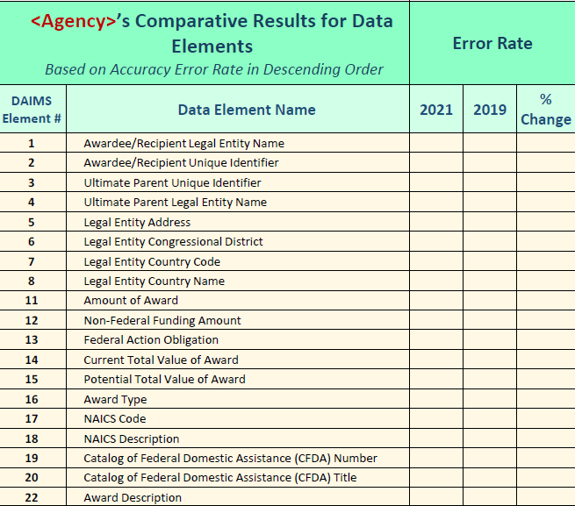
Comparative results table

Slide 18
Crosswalks – files d1/d2
Updated the File D1 Crosswalk (Procurement) to reflect changes in guidance and/or definitions
Issued the File D2 Crosswalk (Financial Assistance)

Slide 19
What’s happening
Most IGs have started their audits
Working Group meetings
Coordination meetings with GAO
Common Methodology meetings
Updates to FAQs, guide, and attachments, as needed
Coordination and engagement with with CIGIE, OMB, and CFO Council

Slide 20
What’s next
Some IGs will continue performing DATA Act audits, depending on resources and audit priorities
Other IGs will not be performing DATA Act audits absent a mandate
Continue to coordinate with OMB and CFO Council on data transparency matters

Slide 21
Contact information
DATA Act Mailbox
DataAct@oig.treas.gov
Pauletta Battle
Deputy AIGA/DATA Act WG Chair
battlep@oig.treas.gov

