Slide 1
Improper Payments Update
2017 CIGIE/GAO Financial Statement Audit Conference
Thursday, April 27, 2017
Beryl H. Davis, Director, Financial Management and Assurance

Slide 2
Improper Payments Discussion Points
Definition
Current Status
Challenges
Reduction Strategies

Slide 3
Definition of Improper Payment
According to the Improper Payments Information Act of 2002, as amended, an improper payment is any payment that should not have been made or was made in an incorrect amount (including overpayments and underpayments).
For example, improper payments include:
Duplicate payments;
Payments to ineligible recipients; and
Incorrect amounts paid.
Office of Management and Budget guidance also instructs agencies to report as improper payments any payments for which insufficient or no documentation was found.

Slide 4
Government-Wide Reported Improper Payment Estimates: Fiscal Years 2003 through 2016
Since 2003, reported improper payment estimates government-wide have totaled over $1.2 trillion.

Slide 5
Government-Wide Reported Improper Payment Estimates: Fiscal Years 2012 through 2016
The government-wide reported estimate of improper payments has increased each year since fiscal year 2013.
For fiscal year 2016, the government-wide reported estimate is $144.3 billion.

Slide 6
Government-Wide Reported Improper Payment Rate: Fiscal Years 2012 through 2016
The government-wide reported improper payment rate has increased each year since fiscal year 2013.
For fiscal year 2016, the government-wide reported improper payment rate is 5.1 percent.

Slide 7
Fiscal Year 2016 Government-Wide Reported Improper Payment Estimate
Includes 112 programs across 22 agencies, although Medicare, Medicaid, and the Earned Income Tax Credit contribute over 78 percent of the total
Does not include 18 risk-susceptible programs that did not report estimates

Slide 8
OMB Categories for Root Cause Reporting of Improper Payments
Program Design or Structural Issue
Inability to Authenticate Eligibility
Failure to Verify Data:
Death Data
Financial Data
Excluded Party Data
Prisoner Data
Other Eligibility Data
Administrative or Process Errors Made by:
Federal Agency
State or Local Agency
Other Party
Medical Necessity
Insufficient Documentation to Determine
Notes:
Prior to FY 2015, agencies categorized root causes of estimated improper payments into three general categories:
Documentation and Administrative Errors
Authentication and Medical Necessity Errors
Verification Errors

Slide 9
Reported Root Causes of Fiscal Year 2016 Improper Payment Estimates

Slide 10
11 Programs Reported Improper Payment Rates Exceeding 10 Percent for Fiscal Year 2016
Program | Agency | Reported Improper Payment Rate (percent of outlays)
VA Community Care | VA | 75.9%
Purchased Long Term Services and Support | VA | 69.2%
Earned Income Tax Credit | Treasury | 24.0%
School Breakfast Program | USDA | 22.5%
National School Lunch Program | USDA | 15.2%
Livestock Indemnity Program | USDA | 12.9%
Unemployment Insurance | DOL | 11.7%
Supplemental Revenue Assistance Payments | USDA | 11.4%
Medicare Fee-for-Service (Parts A and B) | HHS | 11.0%
Medicaid | HHS | 10.5%
Disbursements for Goods and Services | SBA | 10.4%

Slide 11
14 Programs Reported Improper Payment Estimates Exceeding $1 Billion for Fiscal Year 2016
Program | Agency | Reported Improper Payment Estimates
 |  | Dollars (in billions) | Improper payment rate (percent of outlays)
Medicare Fee-for-Service (Parts A and B) | HHS | $41.1 | 11.0%
Medicaid | HHS | $36.3 | 10.5%
Earned Income Tax Credit | Treasury | $16.8 | 24.0%
Medicare Advantage (Part C) | HHS | $16.2 | 10.0%
Supplemental Security Income | SSA | $4.2 | 7.4%
Direct Loan | Education | $3.9 | 4.0%
Unemployment Insurance | Labor | $3.9 | 11.7%
Old Age, Survivors, and Disability Insurance | SSA | $3.7 | 0.4%
VA Community Care | VA | $3.6 | 75.9%
Medicare Prescription Drug Benefit (Part D) | HHS | $2.4 | 3.4%
Pell Grant | Education | $2.2 | 7.9%
National School Lunch Program | USDA | $1.8 | 15.2%
Rental Housing Assistance Programs | HUD | $1.7 | 5.2%
Purchased Long Term Services and Support | VA | $1.2 | 69.2%

Slide 12
Improper Payment Challenges
GAO’s report on the Fiscal Year 2016 Financial Report of the United States Government continued to report a material weakness in internal control related to improper payments
The federal government is unable to determine the full extent to which improper payments occur and reasonably assure that appropriate actions are taken to reduce them
Challenges:
Risk-susceptible programs not reporting estimates
Risk assessments not accurately assessing improper payment risks
Estimation methodologies not producing reliable improper payment estimates
Continued noncompliance with legislative requirements

Slide 13
Risk-Susceptible Programs Not Reporting Estimates
Not all agencies have developed estimates for all programs and activities identified as susceptible to significant improper payments
Specifically, eight agencies did not report estimated improper payment amounts for eighteen risk-susceptible programs in fiscal year 2016
Issues include statutory limitations and resource constraints

Slide 14
Risk-Susceptible Programs Not Reporting Estimates (continued)
USDA:
Supplemental Nutrition Assistance Program
Child and Adult Care Food Program
HHS:
Temporary Assistance for Needy Families
Advance Premium Tax Credit
Cost-Sharing Reduction
DOD:
Navy Commercial Bill Pay – Singapore
HUD:
Single Family Insurance Claims
Community Planning and Development Entitlement Grants
HOME Investments Program
Treasury:
Additional Child Tax Credit
American Opportunity Tax Credit
Premium Tax Credit
VA:
Communications, Utilities, and Other Rent
Medical Care Contracts and Agreements
Prosthetics
VA Community Care Choice payments made from the Veterans Choice Fund
EPA:
Grants
CNCS:
AmeriCorps

Slide 15
Risk-Susceptible Programs Not Reporting Estimates (continued)
Example: Additional Child Tax Credit (ACTC) and American Opportunity Tax Credit (AOTC)
The ACTC is the refundable portion of the Child Tax Credit (CTC). The AOTC is a partially refundable credit to offset certain higher education related expenses.
IRS designated the ACTC and AOTC as medium risk in its 2016 AFR and did not report an estimate for either program
Treasury Inspector General for Tax Administration (TIGTA) has estimated ACTC improper payments from 25.2 to 30.5 percent, or $5.9 billion to $7.1 billion.
For the period 2009 to 2011, GAO estimated average yearly overclaims of $6.4 billion for CTC/ACTC and $5.0 billion for AOTC. GAO estimated overclaims at a rate of 12 percent for CTC/ACTC and 25 percent for AOTC over that period (GAO-16-475).

Slide 16
Risk-Susceptible Programs Not Reporting Estimates (continued)
Example: Supplemental Nutrition Assistance Program (SNAP)
In its 2016 AFR, USDA reported that based on in-depth, systematic review of all State quality control systems, it determined that it could not release a national SNAP improper payment rate
USDA is unable to calculate a national improper payment rate due to the unreliability of some State reported data.
USDA IG reported in September 2015 that USDA Food and Nutrition Services’ (FNS) two-tier quality control process was vulnerable to State abuse due to (1) conflicting interests between accurately reporting true improper payment rates and incurring penalties, or (2) mitigating improper payments and receiving a bonus for exceeding standards

Slide 17
Risk-Susceptible Programs Not Reporting Estimates (continued)
Example: Temporary Assistance for Needy Families (TANF)
HHS reported statutory limitations prevent the agency from requiring states to estimate TANF improper payments
Program outlays were $15.5 billion in FY 2016; TANF is considered by OMB to be susceptible to significant improper payments
HHS’s OIG recommended that HHS continue to work with OMB to implement one of the potential alternative approaches to reporting on TANF improper payments, as recommended by OMB

Slide 18
Risk Assessments Not Accurately Assessing Improper Payment Risks
Agencies conduct their own risk assessments to determine which programs are susceptible to significant improper payments
GAO and agency IGs have reported issues related to certain agencies’ risk assessments which call into question whether these agencies are identifying all programs susceptible to significant improper payments

Slide 19
Risk Assessments Not Accurately Assessing Improper Payment Risks (continued)
Example: General Services Administration
Fiscal Year 2015 IPERA Compliance Report noted GSA employed a qualitative approach in its fiscal year 2015 risk assessments, relying on questionnaires distributed to 32 subprograms
GSA OIG reviewed questionnaires completed by six subprograms with the greatest fiscal year 2014 disbursements and noted several issues, including:
Questionnaires did not ask if the subprograms actually experienced improper payments
Questionnaires were completed by individuals with no direct or specific knowledge of improper payments
Questionnaires included incomplete information
Use of questionnaires relies on individuals to accurately mark responses, and can be vulnerable to inherent bias and conflicts of interest

Slide 20
Audience Question
Of the 24 Chief Financial Officers Act agencies, how many did not identify programs susceptible to significant improper payments for fiscal year 2016?
0
5
9
12

Slide 21
Some Agencies Did Not Identify Programs Susceptible to Significant Improper Payments for Fiscal Year 2016
CFO Act Agencies with No Programs Reporting Improper Payments
U.S. Agency for International Development
Department of Energy
Department of State
National Science Foundation
Nuclear Regulatory Commission
CFO Act Agencies Reporting Only DRAA-Related Estimates
Department of Commerce
Department of the Interior
Department of Justice
National Aeronautics and Space Administration
DRAA = Disaster Relief Appropriations Act, 2013

Slide 22
Estimation Methodologies Not Producing Reliable Estimates
Flexibility in how agencies implement improper payment estimation requirements can contribute to inconsistent or understated estimates

Slide 23
Estimation Methodologies Not Producing Reliable Estimates (continued)
Example: Rental Housing Assistance Programs (RHAP)
HUD OIG’s IPERA compliance reports have noted issues concerning the reasonableness of HUD’s RHAP improper payment estimate
Estimates for some types of errors based on potentially outdated data
Use of a combined improper payment rate for the three components of RHAP has the potential to mask an increase in the rate of one or more of the components
In fiscal year 2016, HUD reported that it closed an OIG recommendation to obtain updated data by completing a new billing error study, and that it was continuing to work closely with its OIG on prior recommendations

Slide 24
Estimation Methodologies Not Producing Reliable Estimates (continued)
Example: TRICARE vs. Medicare (GAO-15-269)
DOD uses a less comprehensive methodology for estimating TRICARE improper payments than the methodology used in Medicare estimates
DOD did not examine medical records to support each payment
TRICARE’s methodology is likely to understate its improper payment rate compared to Medicare’s methodology
TRICARE – fiscal year 2016:
Outlays: $20.5B, Improper payment rate: 0.7%
Medicare FFS – fiscal year 2016:
Outlays: $373.7B, Improper payment rate: 11.0%

Slide 25
Estimation Methodologies Not Producing Reliable Estimates (continued)
Example: DOD’s Defense Finance and Accounting Service Commercial Pay Program
The DOD Inspector General reported that the agency was unable to demonstrate that all payments subject to improper payment estimation requirements were captured for review
Therefore, DOD’s improper payment estimates, including the estimate for its Defense Finance and Accounting Service (DFAS) Commercial Pay program, may not be reliable
While DFAS Commercial Pay’s improper payment estimate is low, its program outlays are significant—approximately $249 billion for fiscal year 2016
Consequently, a small change in the program’s estimated improper payment rate could result in a significant change in the dollar value of its improper payment estimate

Slide 26
Audience Question
Of the 24 Chief Financial Officers Act agencies, how many were determined by their Inspectors General to be noncompliant in fiscal year 2015?
3
7
15
22

Slide 27
Continued Reported Noncompliance with Legislative Requirements
In fiscal year 2015, IGs at CFO Act agencies again reported 15 agencies were not compliant with IPERIA.
The most prevalent reported reasons for noncompliance were:
(1) agencies failing to publish or meet reduction targets, and
(2) agencies failing to publish improper payment improper payment rates less than 10%
Compliance criteria:
Published required information in PAR/AFR
Conducted program-specific risk assessments
Published improper payment estimates for programs and activities deemed susceptible
Published corrective action plans
Published and met annual reduction targets
Reported an improper payment rate of less than 10% for each program and activity for which an estimate was published

Slide 28
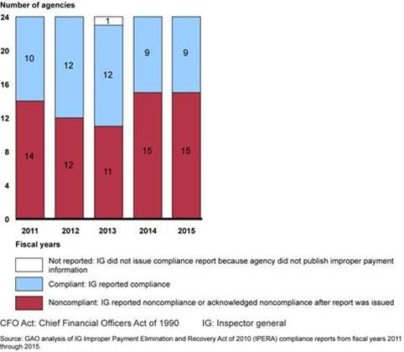
Continued Reported Noncompliance with Legislative Requirements (continued)
In fiscal year 2011—the first year of reporting by the IGs—14 agencies did not comply with at least one of the IPERA criteria
While reported compliance improved in fiscal years 2012 and 2013, IGs reported an increase in agency noncompliance to 15 agencies in fiscal years 2014 and 2015

Slide 29
Continued Reported Noncompliance with Legislative Requirements (continued)
FY 2014 | FY 2015
USDA | USDA
DOD | DOD
Education | Education
HHS | HHS
DHS | DHS
HUD | HUD
DOI | DOI
DOL | DOL
DOT | DOT
Treasury | Treasury
VA | VA
GSA | GSA
SBA | SBA
SSA | SSA
NSF | OPM
15 CFO Act Agencies Noncompliant with IPERA for fiscal years 2014-2015, as determined by IGs.
Changes for fiscal year 2015:
NSF determined to be compliant
OPM determined to be noncompliant

Slide 30
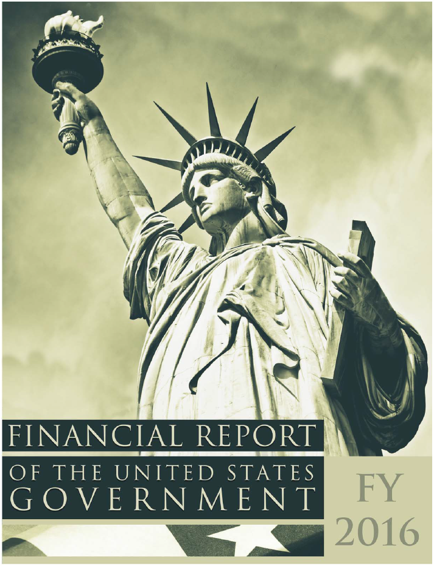
Relevant Internal Control Deficiencies
In addition to the material weakness reported in GAO’s audit of the Consolidated Financial Statements of the U.S. Government, agency auditors continue to report internal control deficiencies over financial reporting, such as financial system limitations and information system control weaknesses
Such deficiencies could significantly increase the risk that improper payments may occur and not be detected promptly

Slide 31
Moving Forward – Reduction Strategies
A number of strategies across government could help reduce improper payments
Robust root cause analysis can help agencies target effective corrective actions

Slide 32
Moving Forward – Reduction Strategies (continued)
Preventive controls – frontline defense
Up-front eligibility validation through data sharing
Predictive analytic technologies
Program design review and refinement
Detective controls – recover overpayments
Data mining
Recovery auditing

Slide 33
Moving Forward – Reduction Strategies (continued)
Preventive Controls:
Do Not Pay (DNP) Initiative
Government-wide initiative to screen payment recipients before a grant, contract award, or payment is made
DNP working system
Central data matching service allowing agencies to verify eligibility of vendors, grantee, loan recipient, or beneficiary
Strategy and Additional Actions Needed to Help Ensure Agencies Use the Do Not Pay Working System as Intended (GAO-17-15)
Legal barriers to data sharing (e.g., Social Security Act)
Challenges associated with government-wide efforts (e.g., developing guidance, monitoring and growing the system)

