Slide 1
Information Assurance Update: Cloud, Trusted Internet Connections and Continuous Monitoring
Steven Hernandez
Chief Information Security Officer HHS/OIG
September 4th 2014

Slide 2
Agenda
Introduction
Overview of terminology and concepts
  Cloud
  Continuous Monitoring and “CDM”
  Trusted Internet Connections
Cloud assurance overview
Cloud Assessment
Continuous Monitoring Challenges in the Cloud
Trusted Internet Challenges in the Cloud
Moving forward with best recommendations
Questions

Slide 3
Introduction
Who I am:
Steven Hernandez MBA, CISSP, CISA, CSSLP, CAP, SSCP, CNSS(4011-4016), HCISPP
  Director of the HHS/OIG Information Assurance Division
  Chief Information Security Officer

Slide 4
What is Cloud?
Possibilities:
  Software as a Service (SaaS)
    Vendor is responsible for the vast majority of security control implementation and operation.
  Platform as a Service (PaaS)
    Vendor is responsible for typically the operating system and hardware security controls.
  Infrastructure as a Service (IaaS)
    Customer is responsible for the Majority of Contols.

Slide 5
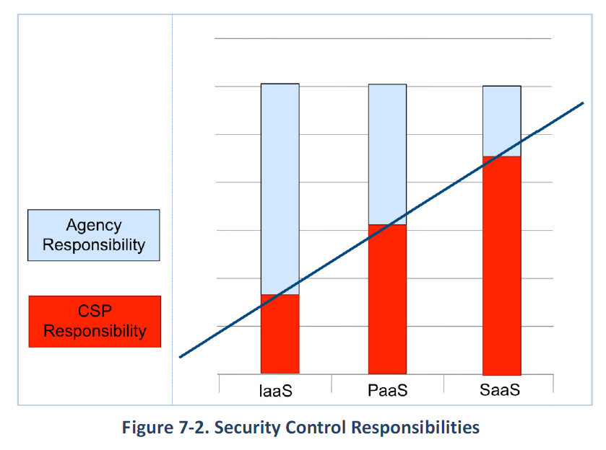
Security Control Responsibility

Slide 6
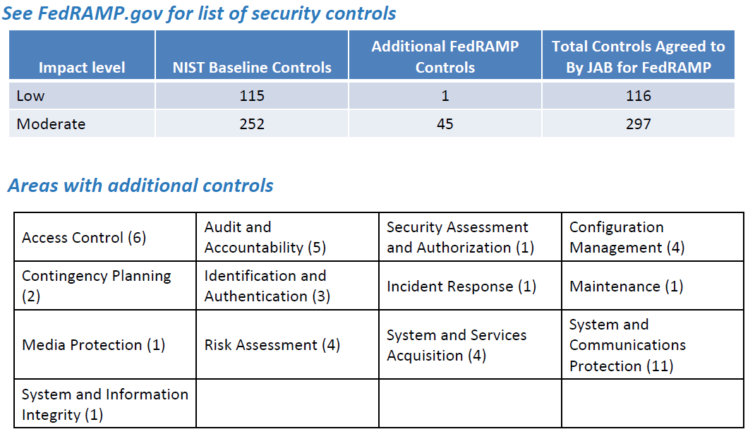
Cloud Control Req.

Slide 7
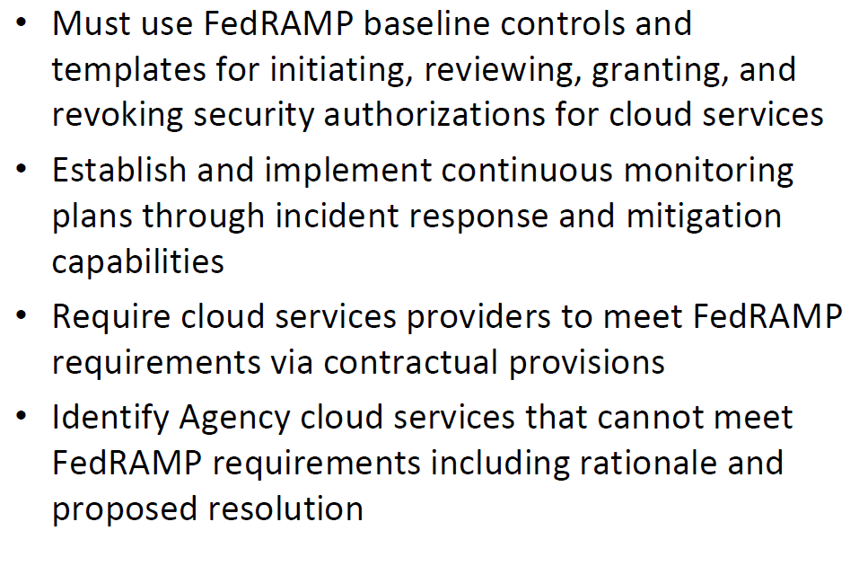
Additional Responsibility
Agency Responsibilities

Slide 8
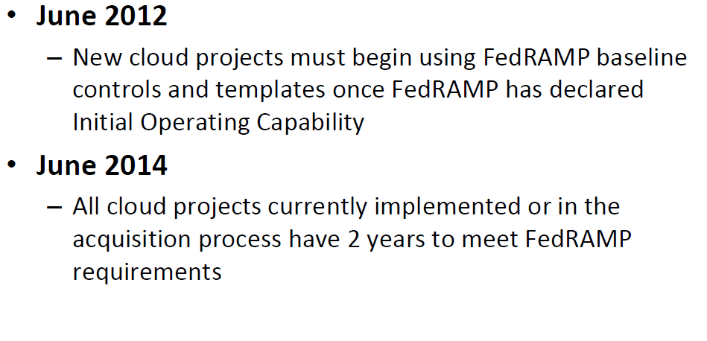
Agency Responsibilities
Agency Responsibilities

Slide 9
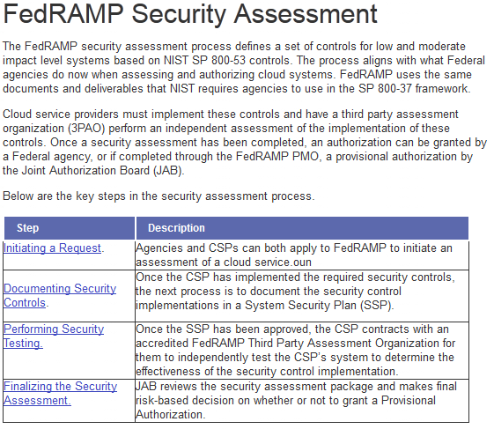
Cloud Authorization

Slide 10
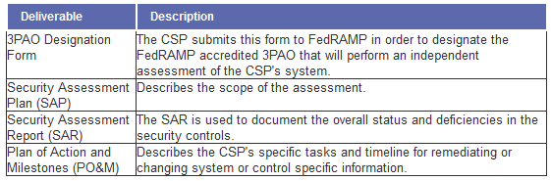
Minimum Cloud Assurance Evidence

Slide 11
Document Examples
Templates (Fedramp)
  http://cloud.cio.gov/fedramp/templates
Package Request Form Security Assessment Framework Guide to Understanding FedRAMP FedRAMP Revision 4 Transition Guide Quick Guide to FedRAMP Readiness Process FedRAMP Policy Memo Security Controls Control Quick Guide | Standard Contract Clauses Control Specific Contract Clauses Cloud Procurement Best Practices Template FedRAMP ATO Letter JAB Charter Continuous Monitoring Strategy Guide Significant Change Form Incident Communications Procedure Branding Guidance

Slide 12
Submission of Cloud to GSA
CSP contracts with an accredited 3PAO and submits a 3PAO Designation Form to the FedRAMP PMO.
FedRAMP ISSO holds a meeting with CSP and 3PAO to discuss expectations and set timeframes for deliverables.
3PAO creates and the FedRAMP ISSO approves a testing plan that ensures the assessment will cover the state authorization boundary and controls.
3PAO performs and independently tests the CSP's system and generates a Security Assessment Report (SAR) that documents findings and provides and analysis of the test results to determine the risk exposure.
CSP develops a Plan of Action & Milestones (POA&M) that addresses the specific tasks, resources, and schedule for correcting each of the weaknesses and residual risks identified.
CSP submits the SAR and POA&M to the FedRAMP ISSO for a completeness and overall risk posture review.
The Joint Authorization Board (JAB) makes a risk-based decision on whether to accept the vulnerabilities and planned fixes.
If JAB determines the risk level is too high it recommends remediation steps that the FedRAMP ISSO shares with the CSP.
CSP corrects control implementations, retests affected controls, and resubmits revised documentation
If JAB accepts the risks associated with the system, the FedRAMP ISSO notifies the CSP that they are ready to finalize the security assessment.

Slide 13
Submission of Cloud to GSA
GSA is VERY backlogged right now!
  This is good: Cloud providers are heading the warning and complying with Fedramp
  This is bad: Cloud providers will not have JAB provisional authorizations in a timely manner

Slide 14
Continuous Monitoring
Continuous Monitoring has always been part of the NIST Risk Management Framework (RMF!)
Continuous monitoring has always been part of the certification and accreditation/authorization process.
Why does Certification/Assessment and Authorization matter?
  Understanding the risk you take when using a system
  Understanding the limitations and strengths of a system
  Having a level of assurance and due diligence for a system
  Continuously monitor a system for vulnerabilities and resulting risk
  It’s the Law! FISMA requires we do this and for good reason!

Slide 15
C&A Introduction
Why does Certification/Assessment and Authorization matter?
  Understanding the risk you take when using a system
  Understanding the limitations and strengths of a system
  Having a level of assurance and due diligence for a system
  Continuously monitor a system for vulnerabilities and resulting risk
  It’s the Law! FISMA requires we do this and for good reason!

Slide 16
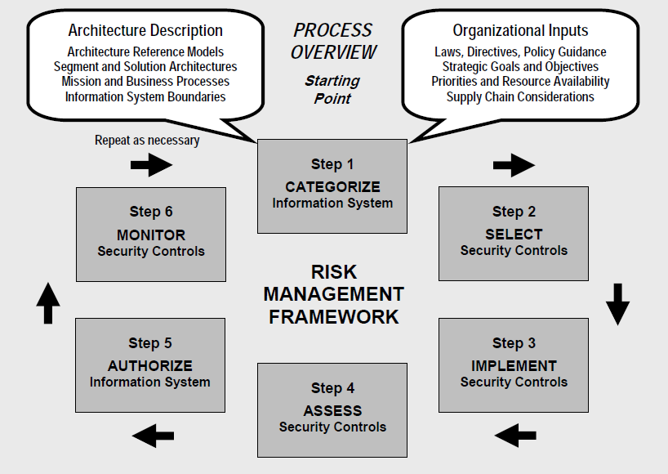
HHS/OIG C&A Process

Slide 17
DHS CDM
DHS’ Continuous Diagnostics and Mitigation
  A subset of continuous monitoring
  NOT complete or holistic security approach
  Works in coordination and compliments existing continuous monitoring

Slide 18
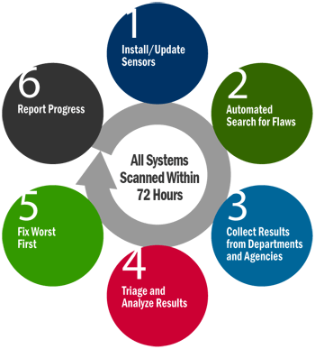
DHS CDM

Slide 19
DHS CDM
First, agencies install and/or update their diagnostic sensors and the agency-installed sensors begin performing automated searches for known cyber flaws.
Results are fed into enterprise-level dashboards that produce customized reports, alerting IT managers to the most critical cyber risks, enabling them to readily identify which network security issues to address first, thus enhancing the overall security posture of agency networks.
Progress reports that track results can be shared within and among agencies. Summary information can feed into an enterprise-level dashboard to inform and prioritize ongoing cyber risk assessments.

Slide 20
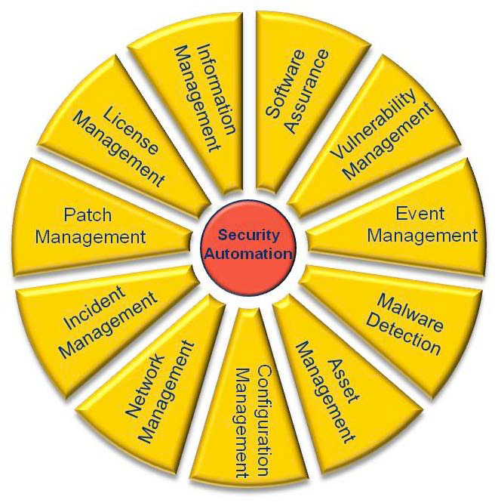
Overall Risk View
Rolling up comprehensive risk information for sound decision making!
Risk Evidence & Documents
People
Process
Technology
Environment
System Inventory and Categorization
System Assessment
POA&Ms
SAR
SAR
Risk
Risk
Risk
Decision
Continuous Monitoring Automated Process Areas
DHS/CDM
Manual Assessment
Process Areas
800-53A and Test Cases

Slide 21
Cloud Continuous Monitoring
When the vendor controls everything how can we ensure risk visibility?
Remember:
  FedRamp is going to ensure the CM capability exists for the cloud provider in three areas:
    Operational Visability
    Change Management
    Incidence Response

Slide 22
Cloud Continuous Monitoring
Operational Visibility:
    Operational visibility provides a look-in into the security control implementations of the CSP
      What contract language or clauses does the organization have for ongoing and as needed (ad hoc) security assessments?
      How much visibility through automated or manual assessments does the organization have into the cloud provider.
Change Control and Management:
    How does the cloud provider control changes and configurations? What assurance does the organization and agency have that breaches or downtime will not occur due to unintended changes or poorly tested changes?

Slide 23
Cloud Continuous Monitoring
Incident Response and Law Enforcement
  What automated scanning, patching and reporting is available to the agency?
  Is the cloud provider using SCAP compliant tools and providing DHS compliant feeds back to the agency?
  What contractual provisions are in place for internal investigations, employee monitoring and formal investigations?

Slide 24
Cloud Continuous Monitoring
Recommendations:
  Ensure contractual provisions exist which ensure the cloud provider must provide SCAP compliant configuration, asset, vulnerability and patch status for DHS CDM dashboards and feeds.
  Ensure contracts are vetted by law enforcement partners and Legal to ensure all legal actions are routed to the appropriate agency resources and when the agency needs information from the cloud provider there are no surprises.
  Ensure you have the ability to send in an independent assessment team to perform ad hoc or after action assessments.
  Ensure a full FedRamp provisional ATO is required for new contracts and consider recompeting existing contracts which do not contain the FedRamp requirements.

Slide 25
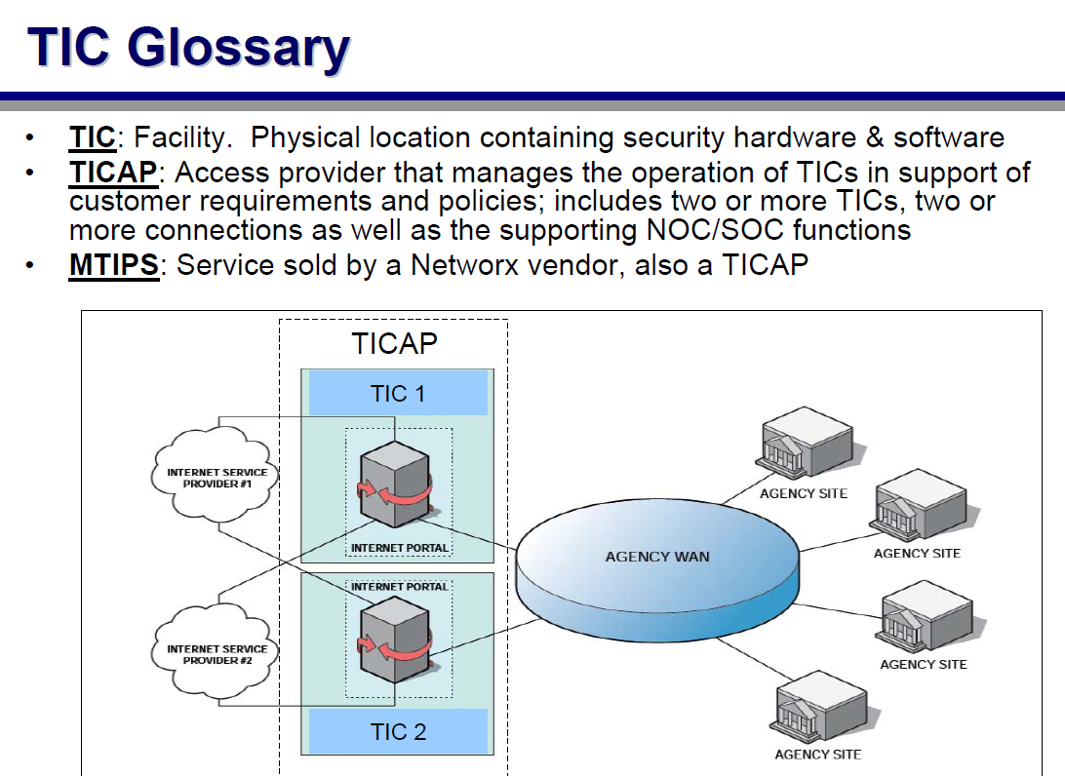
Trusted Internet Connections

Slide 26
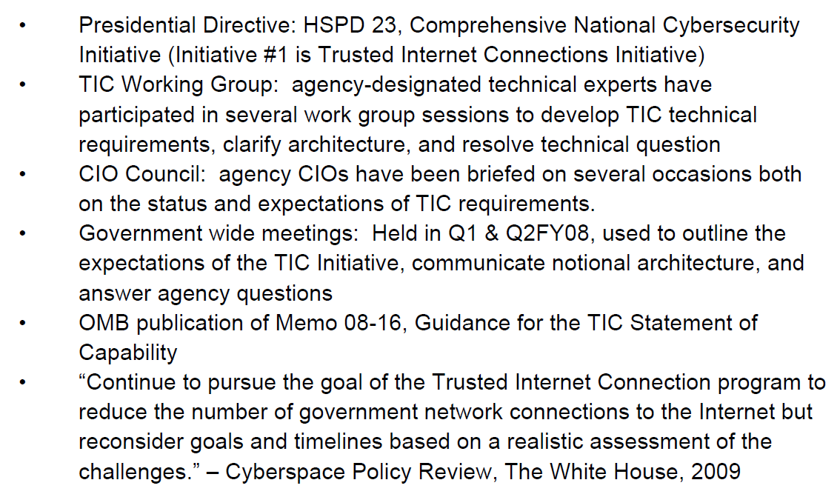
Trusted Internet Connections
Required through:

Slide 27
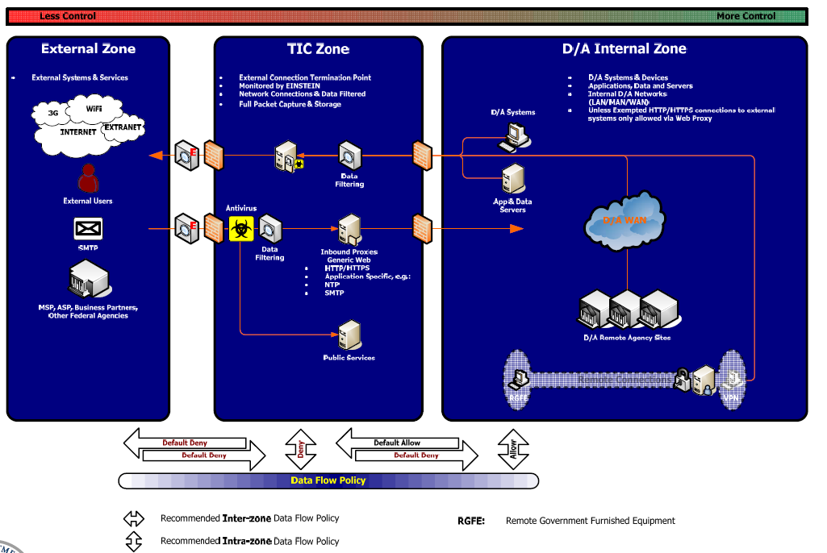
Trusted Internet Connections:

Slide 28
What about Cloud and
Trusted Internet Connections?

Slide 29
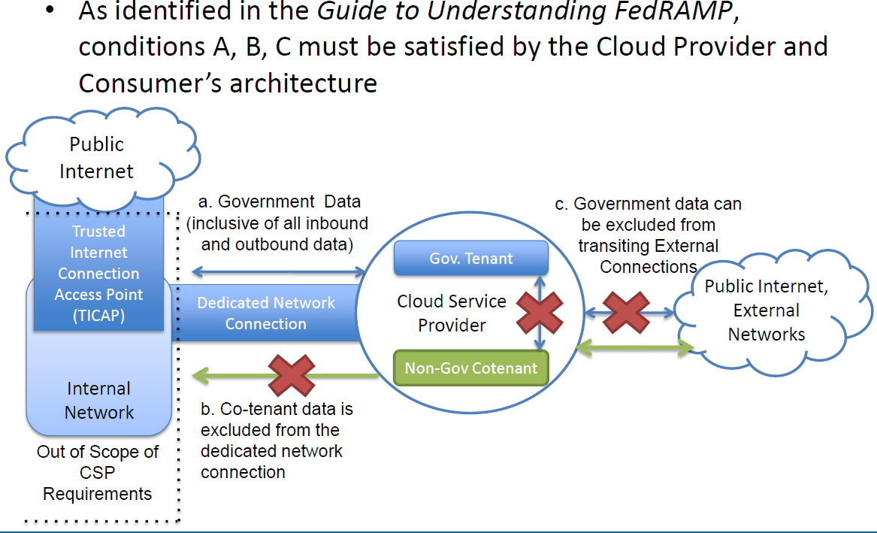
What about Cloud and
Trusted Internet Connections?

Slide 30
Trusted Internet Connections

Slide 31
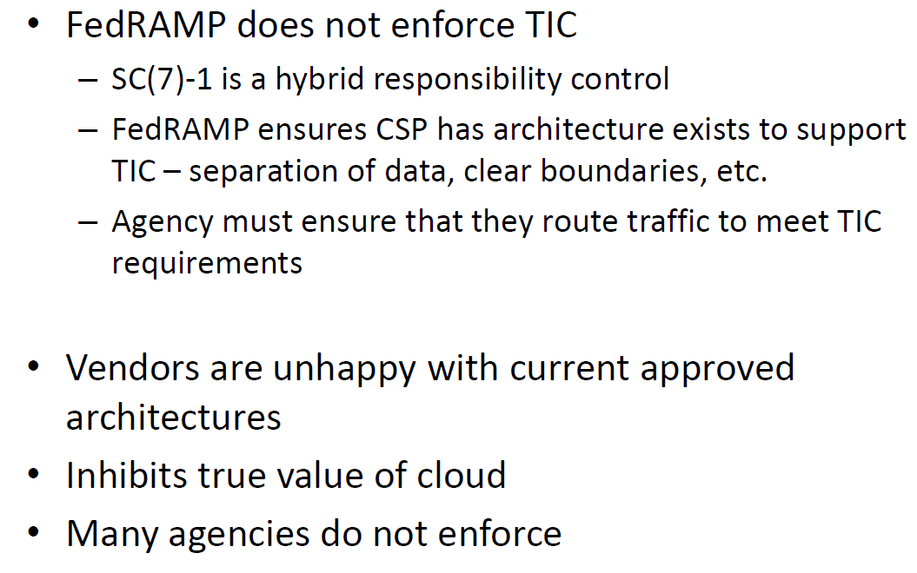
What have we learned from vendors?

Slide 32
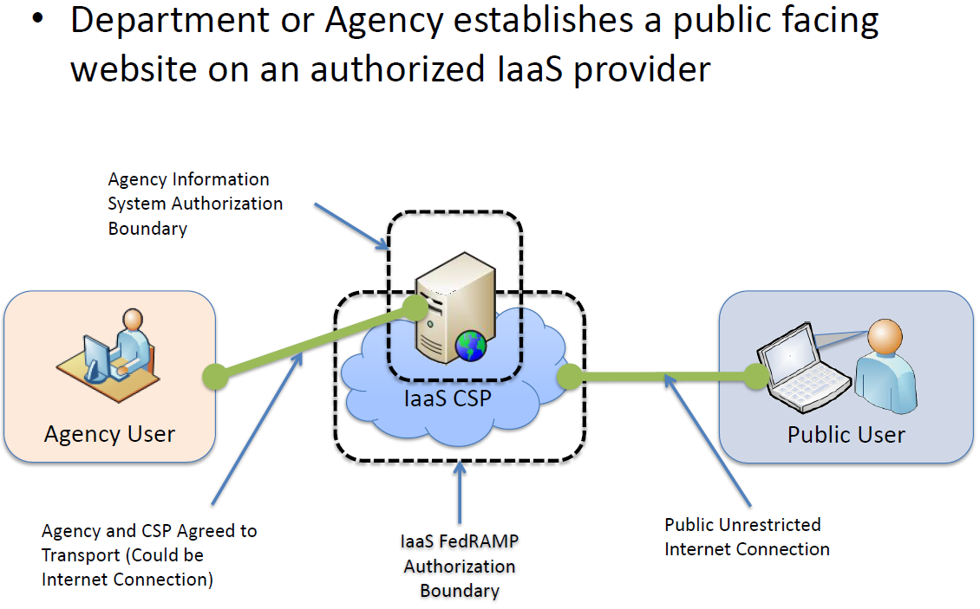
Acceptable TIC Solutions

Slide 33
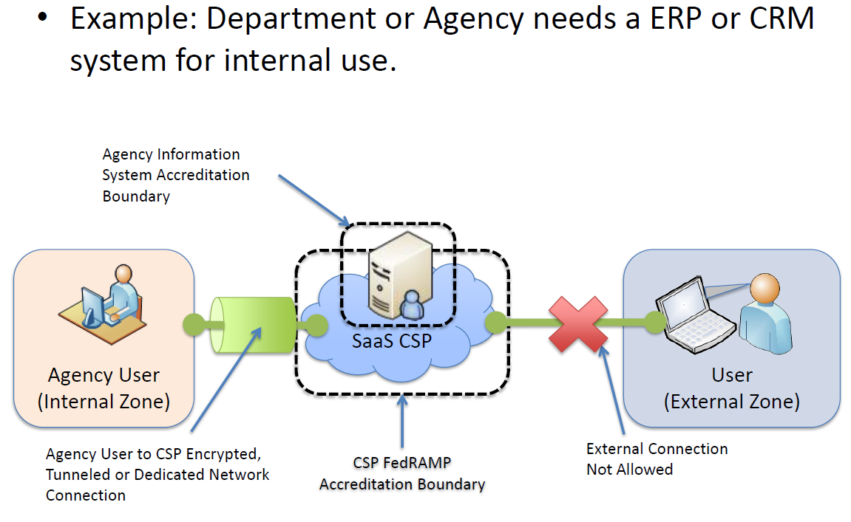
Acceptable TIC Solutions
Agency VPN

Slide 34
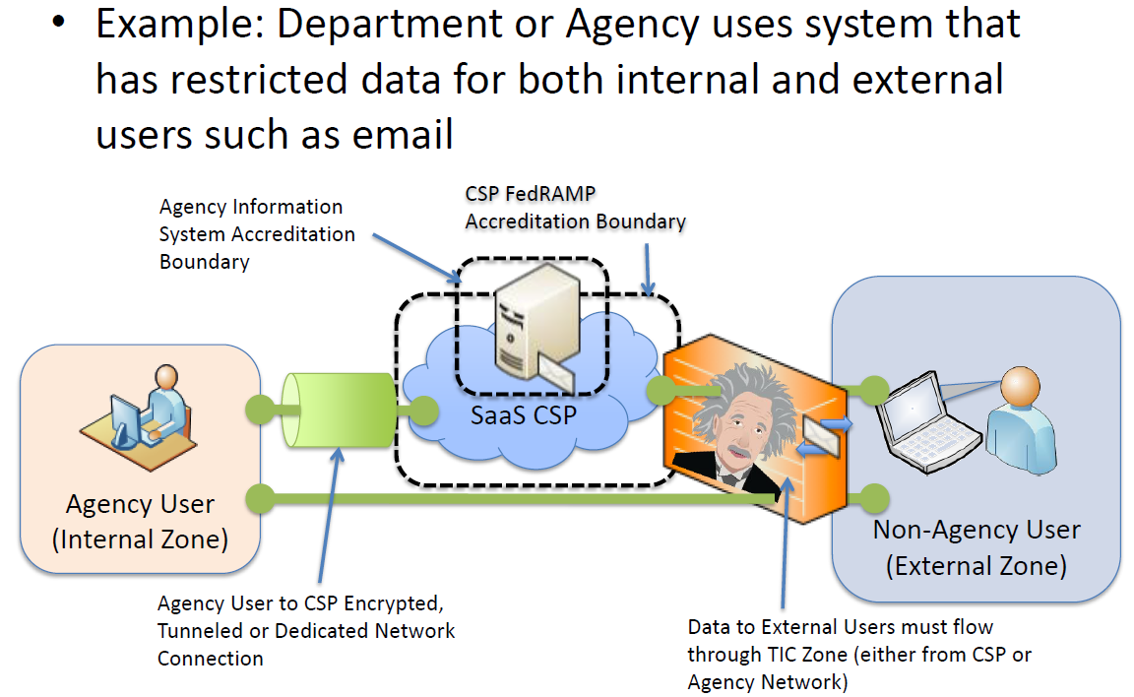
Acceptable TIC Solutions

Slide 35
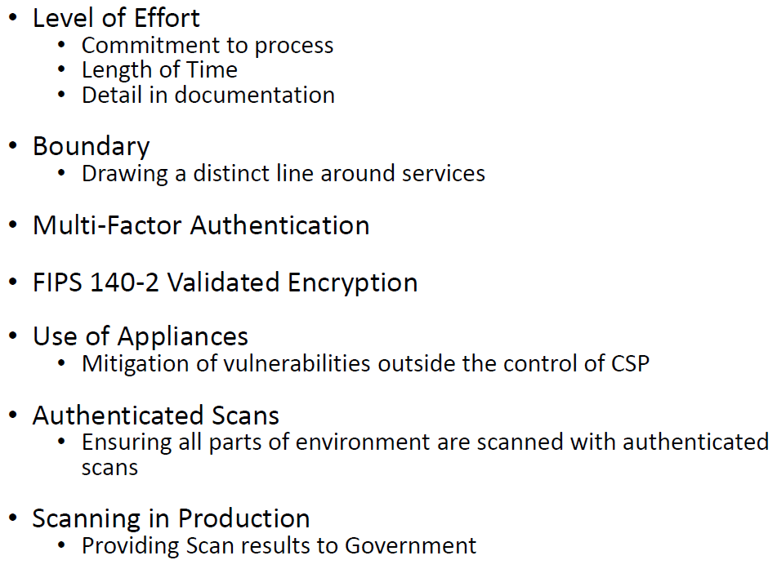
Critical issues between vendors and agencies?

Slide 36
Questions

Slide 37
Contact Me:
Thanks!!
Steven Hernandez
Steven.hernandez@oig.hhs.gov

