Slide 1
IG Empowerment Act Paperwork Reduction Act Exemption –
Implications for OIGs
Lee Giesbrecht, VAOIG
Notes:
Learning Objectives: Participants will learn the basic principles of conducting a high-quality survey and discuss the guidance developed by the CIGIE Paperwork Reduction Act working group.
Program Description:
The Inspector General Empowerment Act exempted the IG community from the Paperwork Reduction Act (PRA). The IG community expressed concern that the PRA conflicted with the statutory mission to ensure IGs were independent and affected IGs ability to carry out work in a timely and effective manner. As a result, some IGs discontinued using surveys to gather information that would otherwise enhance the effectiveness and quality of a review. Providing IGs this exemption from the PRA ensures OIGs ability to conduct surveys and other information collection activities in a timely manner while maintaining independence. However, this also leaves IGs with a responsibility to conduct high quality surveys that still meet the spirit of the OMB clearance process or risk criticism from stakeholders.

Slide 2
IG Empowerment Act
Includes several provisions that support IGs:
Exemption from the Computer Matching Act
Exemption from the Paperwork Reduction Act
Requirement that the GAO complete a study on prolonged IG vacancies during which an acting IG has served and report findings to Congress
Notes:
The Council of the Inspectors General on Integrity and Efficiency (CIGIE) has long encouraged Congress to address these and other issues and pass legislation that supports and enhances IG independence.

Slide 3
Paperwork Reduction Act
The Paperwork Reduction Act requires all Federal agencies to submit a clearance request to OMB in order to survey the public.
IGs, along with all other executive agencies, have been required to comply with the Paperwork Reduction Act.
Obtaining OMB clearance to conduct a survey is a lengthy, complex process.
The process includes two rounds of Federal Register notices for public comment and can take 6 months or longer to complete.
OMB tries to ensure that federal surveys are of high quality.
Notes:
The Inspector General Empowerment Act similarly exempted the IG community from the Paperwork Reduction Act (PRA), a reform which the IG community had recommended for over a decade. The IG community expressed concern that the PRA required that information collections, such as OIG surveys, be subject to approval from a "senior official" of the agency and then from OMB. This conflicted with our statutory mission to be independent. Furthermore, the PRA also requires a lengthy and burdensome approval process for the collection of information by a Federal agency. The protracted approval process affected our ability to carry out work required by members of Congress, through law or by request, in a timely and effective manner. In many cases, by the time the survey was approved, the character of the issue under review had changed. In some cases IGs discontinued using surveys and gathering information that would enhance the effectiveness and quality of a review. Providing this exemption ensures that IGs will be able to conduct surveys and other information collection with the requisite independence, and to do so without unnecessary delay or burdens.

Slide 4
Collecting Data from Agency Employees
Surveys can be used in audits, inspections, and investigations to collect data from program staff and management to help evaluate program functionality.
For example, in a VAOIG audit, VA COTRs were surveyed about their use of a new, web-based contract management system to determine if they were using it as designed, whether the system was user-friendly, and what improvements users would suggest.
One may also think about the less structured interviews with agency staff conducted as a part of audits as a type of survey.

Slide 5
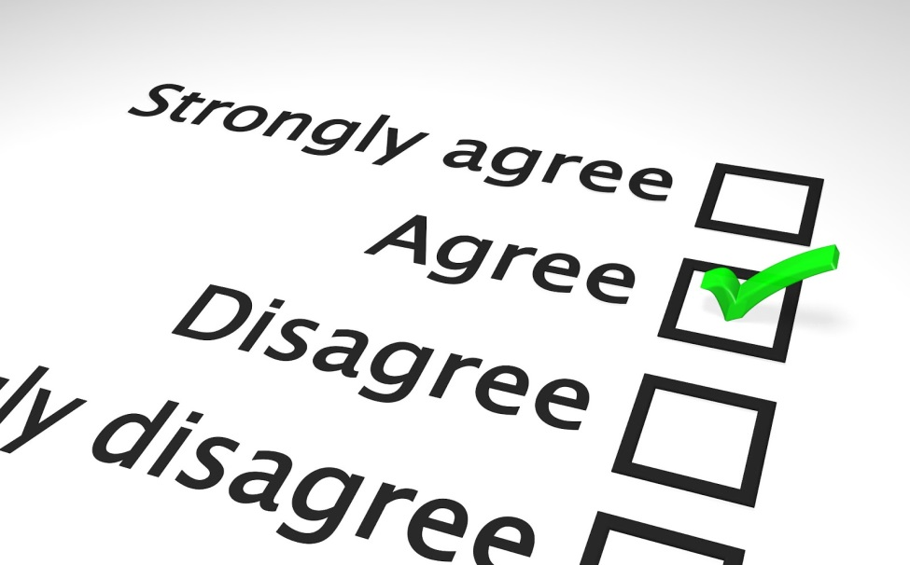
Collecting Data from the Public
Surveys can be used in audits, inspections, and investigations to collect data from those affected by an agency program.
For example, a population of veterans could be interviewed about their experiences with VA care or benefits that are subject to audits.

Slide 6
Survey Quality
A large part of what OMB aims to do in their clearance review is to ensure that agencies are conducting high quality surveys that will yield usable results.
In the new guidance, CIGIE recommends that OIGs document their survey work as if they still had to comply with the PRA to ensure OIGs maintain transparency, self-governance, and continuity.
What are the dimensions of quality in surveys?
How can OIGs ensure they conduct high quality surveys without OMB reviewing their work?
What will happen if OIGs conduct a survey that is lacking in one or more dimensions of quality?
Notes:
Kibosh

Slide 7
Dimensions of Quality
Correctly identifying analytical needs
High quality questionnaire design
Statistically sound sampling methodology
Attempts to address non-sampling error problems
Non-response bias – achieve a high (75%+) response rate
Coverage error – ensure all members of the population are included or have a change to be sampled
Measurement error – pretest questionnaire, conduct interviewer training

Slide 8
Questionnaire Design
We often take for granted what we believe respondents know.
Can respondents answer our questions?
Use clear, specific question wording.
The questionnaire is used to standardize the data-collection process.
Ask questions as worded.
Avoid explaining or interpreting questions.
Maintain neutrality.
Notes:
There is a whole body of research on this topic that covers question wording, response categories, questionnaire format “look and feel”, etc. I cannot adequately cover it with a short talk, so I am going to hit on some basic issues.

Slide 9
Interview Flow
Start with questions that are simple, non-threatening/sensitive, and engage interest.
Organize questions by topic in a logical order to make the interview more conversational.
Add transitional statements when changing topics.
Go from general to specific questions.
End with more sensitive items/demographics.
Design questionnaire to minimize burden.
Notes:
Survey interviews are infrequent events and therefore may not be familiar to respondents. They may treat it as a conversation or other social interaction.

Slide 10
Modes of Data Collection
Interviewer (auditor) administered
Self-administered paper, snail-mail
Web-based
Limit use of free public web survey tools (i.e., SurveyMonkey) – cannot maintain control of the data, safeguard PII, or promise confidentiality.
May be able to enter into contract or agreement to address these issues.

Slide 11
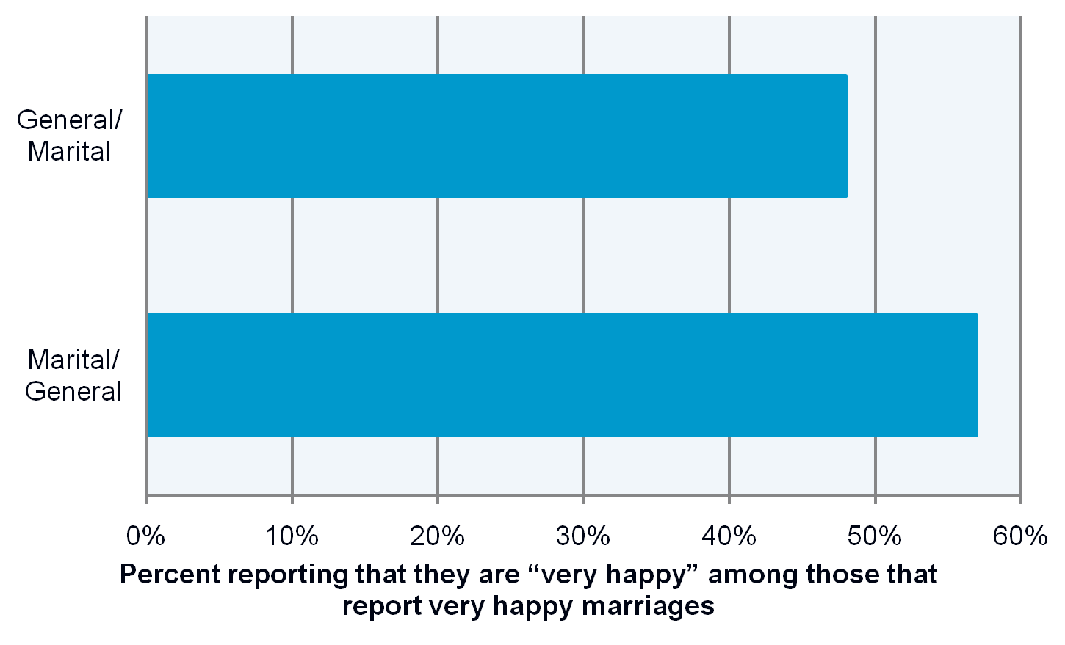
Question Order Effects
Notes:
This is just one fairly famous example among survey professionals to show you the kind of thing that may happen. It is probably more of an issue for attitudinal questions.
“Taken things all together, how would you describe your marriage? Would you say that your marriage is very happy, pretty happy, or not too happy?”
“Taken all together, how would you say things are these days? Would you say that you are very happy, pretty happy, or not too happy?”
Questions and answers in attitude surveys By Howard Schuman, Stanley Presser, 1982

Slide 12
Question Formats
Open-ended or “fill in the blank”
Respondent answers in his/her own words.
Must prepare (code) data for analysis.
Use on draft questionnaire to inform a closed-ended design.
Closed-ended
Response choices are provided.
Number of response choices.
Order of response choices.
Use balanced response scales.
Notes:
Open-ended versus closed-ended questions.
Often use open-ended if most common answers are unknown to survey designer. Use to test survey, then use results to develop closed-ended response categories.
Number and order of response choices.
Use fewer for telephone interviews where all the responses are not available for respondent to see.

Slide 13
Balancing Response Scales
Ensure responses are mutually exclusive and exhaustive.
Use balanced scales
Biased:
Poor
Fair
Good
Excellent
Balanced:
Very poor
Poor
Neither poor nor good
Good
Very good
Notes:
Use balanced response scales.
Equally represent both sides of an issue or both negative and positive responses.

Slide 14
Recall Issues
Dates are poorly recalled.
Errors increase with time since event.
Telescoping – people tend to report event occurring more recently than they actually did.
Forgetting occurs more with passage of time and with minor, non-salient events.

Slide 15
Questionnaire Design Pitfalls
“Double-negative” questions
Can be confusing for respondents.
E.g., “I cannot say that this policy is working.”
Reword to, “I think that this policy is working.”
“Double-barreled” questions
Asks about two or more issues in one question.
May be different answers for each issue.
E.g., “Are sufficient supplies available for drawing blood and setting up IVs?”
Notes:
Avoid “double-negative” questions. Example response would be agree/disagree.
When the respondent answers “agree” does it mean he or she doesn’t think the policy is working or is it that he or she cannot freely express the opinion?
Avoid “double-barreled” questions. Split into two or more questions.

Slide 16
Questionnaire Design Pitfalls
Avoid leading questions – instead, reword questions to include various responses:
“Do you agree with the agency’s policy to ________?”
“Do you agree or disagree with agency’s policy to ________?”
Acquiescence bias – some people may be more likely to agree (acquiesce) than others.
Social-desirability bias – people have a natural tendency to want to be accepted and liked, which may lead to inaccurate answers to questions on sensitive topics.
Notes:
Avoid leading questions. In this example, you would typically use this if there were no other questions about the topic. On previous slide, the question would not be the only agree/disagree item and would be grouped together with others that were worded in the negative.
“Acquiescence bias”
Tends to happen with less educated populations in lower SES. Add balance to question and remove reference to authority, if possible.
“Social-desirability bias”
May need to use special techniques to elicit honest answers to sensitive questions.

Slide 17
Sampling
In many cases a sample of the population will be sufficient to address the analytic needs rather than attempting to survey the entire population.
Probability sampling will allow measures of the precision of sample estimates as opposed to judgement or convenience sampling.
Must assemble a sampling frame that includes all members of the population to avoid coverage errors.
Complex sample designs that include stratification, clustering, and unequal sampling weights will require special calculations to obtain correct sampling error estimates.

Slide 18
Coverage Error
Part of the target population is systematically left out of the data collection.
Can lead to coverage bias if the portion of the population left out is different from the target population on a key characteristic.
Level of bias is usually unknown - difficult and expensive to quantify.
Notes:
A famous example of the possible effects of coverage error led early political pollsters to believe in the magic of random sampling. In 1936 the Republican, Alf Landon, against the Democratic incumbent, Franklin Roosevelt. This year was during the great depression. A prestigious weekly news periodical called The Literary Digest continued that year a tradition of conducting a national presidential poll through the mail. Supreme faith was placed in a humongous sample of 10,000,000 prospective voters drawn primarily from telephone directories. When the returns were tallied, an easy win for Landon was indicated. This highly respected periodical staked its reputation on this outcome. With such a huge sample how could anything go wrong?
The poll was a miserable failure. Two sources of bias that were unfortunately in the same direction raised havoc with the results. First, the poll excluded non-telephone owners and hence also included a disproportionate number in the older age groups. Since many more Republicans (the wealthy) in these depression years owned phones than Democrats (the poor), it is not surprising that the returned ballots would favor the GOP candidate. Secondly, it is a fairly well known fact that members of the party out of power are far more likely to return ballots through the mail than members of the "in" party. This again supported more Republican ballots. These two sources of bias formed a potent combination that pointed toward a Landon victory. It is interesting to note that in the actual election, Roosevelt swept all states except two and won in a landslide. It is also of historical note that several years after this debacle, The Literary Digest went out of business.
Also, the Dewey/Truman election of 1948 showed that the commonly used method of quota sampling led pollsters to incorrectly predict a Dewey win.

Slide 19
Nonresponse Error
Information not collected from all members of the population or missing from administrative records.
Missing records (unit nonresponse).
Missing fields (item nonresponse).
Results in nonresponse bias if the portion of the population that is missing or has missing data is different from others on key characteristics.
Notes:
Can quantify this to some extent based on the data in the sampling frame. However, the characteristics linked to the nonresponse bias may not be covered in the frame data. Here is where one would have to do additional data collection.
It is possible to reweight the data after collection to reduce this bias if the frame data prove predictive of the bias.

Slide 20
Measurement Error
A.k.a. Response Error
Information obtained is different than the truth.
Caused when respondent gives incorrect information or administrative records contain errors.
Leads to measurement bias if some parts of the population are affected differently than others.

Slide 21
Measurement Error - continued
Respondent reports
Memory errors
Misunderstands questions (questions poorly designed)
Order effects and other cognitive effects.
Interviewer-administered survey
Correlated Response Error - errors are correlated within interviewer caseloads.
Keeping caseloads as low as possible and training interviewers to act the same helps.

Slide 22
Measurement Error - continued

Slide 23
Measurement Error - continued

Slide 24
Measurement Error - continued

Slide 25
CIGIE Action on the Exemption from the Paperwork Reduction Act
CIGIE aims to help OIGs identify and obtain the right skills to design and implement surveys.
Established PRA working group.
Working group drafted guidance to help OIGs maintain high, consistent standards when conducting surveys.
Draft guidance addresses OMB supporting statement items that are applicable to OIGs and survey quality issues.
Draft guidance includes references to survey design resources online.
CIGIE considering training on survey design.

