Slide 1

OMB Circular No. A-123
Management’s Responsibility for Enterprise Risk Management and Internal Control
CIGIE / GAO
Financial Statement Audit Conference
April 27, 2017
From 1-2-3 to E-R-M

Slide 2

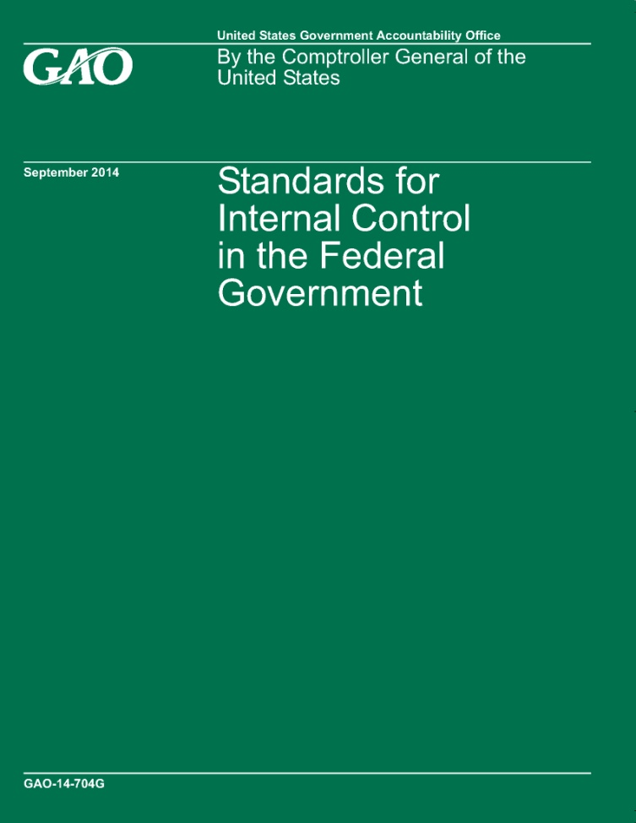
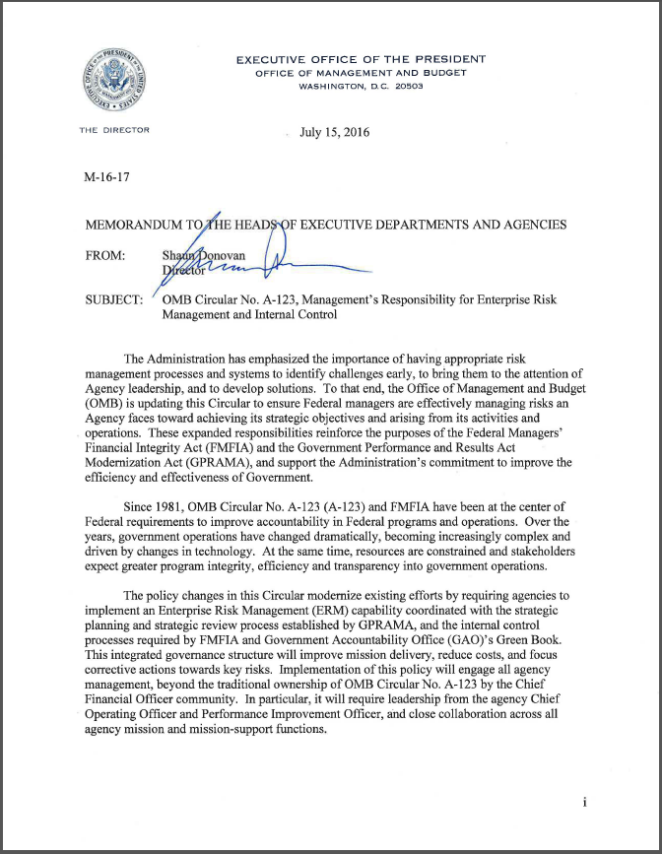
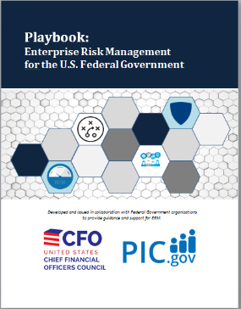
Opening Remarks
RISK
CXO/Operations Support
2

Slide 3






Current Risk Environment Facing Federal Government
The Federal government is facing greater change than at any other point in time
Current budget realities mean government agencies compete for limited resources as never before
Budgets will go to those who best show value
There is greater scrutiny and expectations from internal and external stakeholders for agencies to respond to risk faster and more effectively
The continual focus of risk management on financial areas has limited the broader considerations of risk within organizations
Major Management Challenges
Could they have been avoided?
Could the impact have been minimized and more manageable?
What will be next?
CXO/Operations Support

Slide 4

Enterprise Risk Management and Internal Control
Risk is the effect of uncertainty on objectives. It is typically addressed within functional, programmatic, or organizational silos.
Enterprise Risk Management is:
“a discipline that addresses the full spectrum of an organization’s risks, including challenges and opportunities, and integrates them into an enterprise-wide, strategically aligned portfolio view. ERM contributes to improved decision-making and supports the achievement of an organization’s mission, goals, and objectives.”
Internal Control is a process effected by an entity’s oversight body, management and personnel that provides reasonable assurance that the objectives of an entity will be achieved. (GAO Green Book)
A process to help achieve objectives
(GAO Green Book)
In other words, things you do to make sure good things happen and bad things don’t.
Internal Control System is a continuous built-in component of operations, effected by people, that provides reasonable assurance, not absolute assurance, that an entity’s objectives will be achieved.
(GAO Green Book)
CXO/Operations Support
Outcomes:
An increased likelihood of successfully delivering on agency goals and objectives.
Fewer unanticipated outcomes encountered.
Better assessment of risks associated with changes in the environment.

Slide 5
Enterprise Risk Management Model
Overview:
7 Cyclical Components
  Establish the Context
  Identify Risks
  Analyze and Evaluate
  Develop Alternatives
  Respond to Risks
  Monitor and Review
  Continuous Risk Identification and Assessment
3 Enterprise Components
  Communicate and Learn
  Extended Enterprise
  Risk Environment/Context
Illustrative Example of an Enterprise Risk Management Model

Slide 6
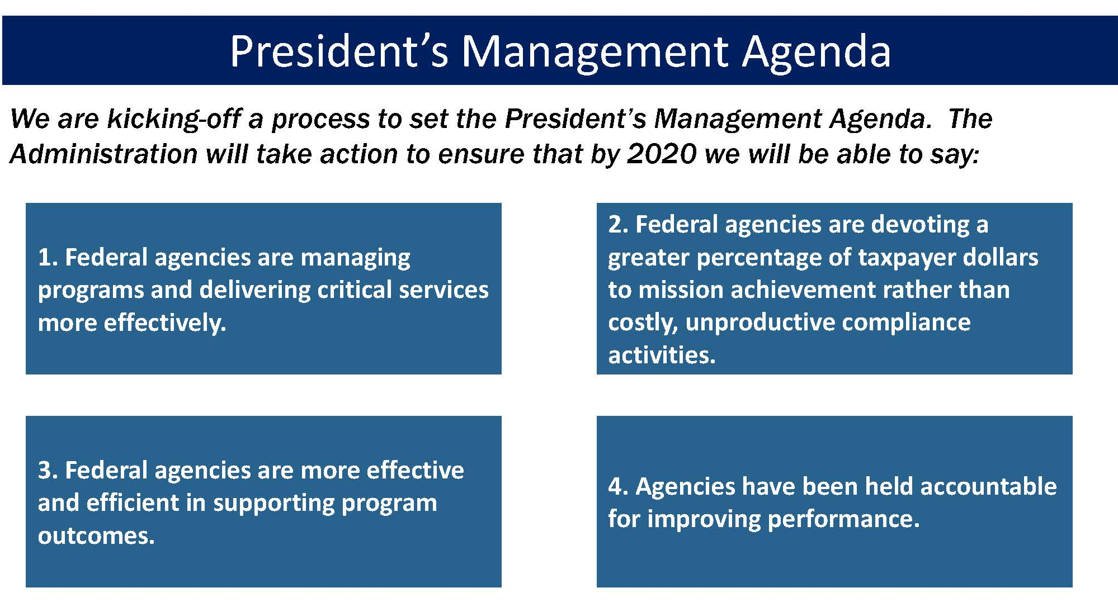
Background and Context

Slide 7
ERM and Internal Controls The Cube Version
A-123 Section III. Update
(Internal Controls)
A-123 Section II. Update
(Enterprise Risk Management)
Source: GAO Green Book
Source: Based on COSO

Slide 8
Expanding on the Green Cube To Include ERM
2017 Requirements to
A-123, Incorporating Strategic Objectives
2016 Update to A-123, Internal Controls
2017 Requirements of A-123, Expansion of Risk Assessment
The introduction and refinement of ERM components to be integrated into existing internal control processes
The inclusion of a strategic process to risk management and internal control
The organization of internal controls as introduced in the 2014 Green Book

Slide 9
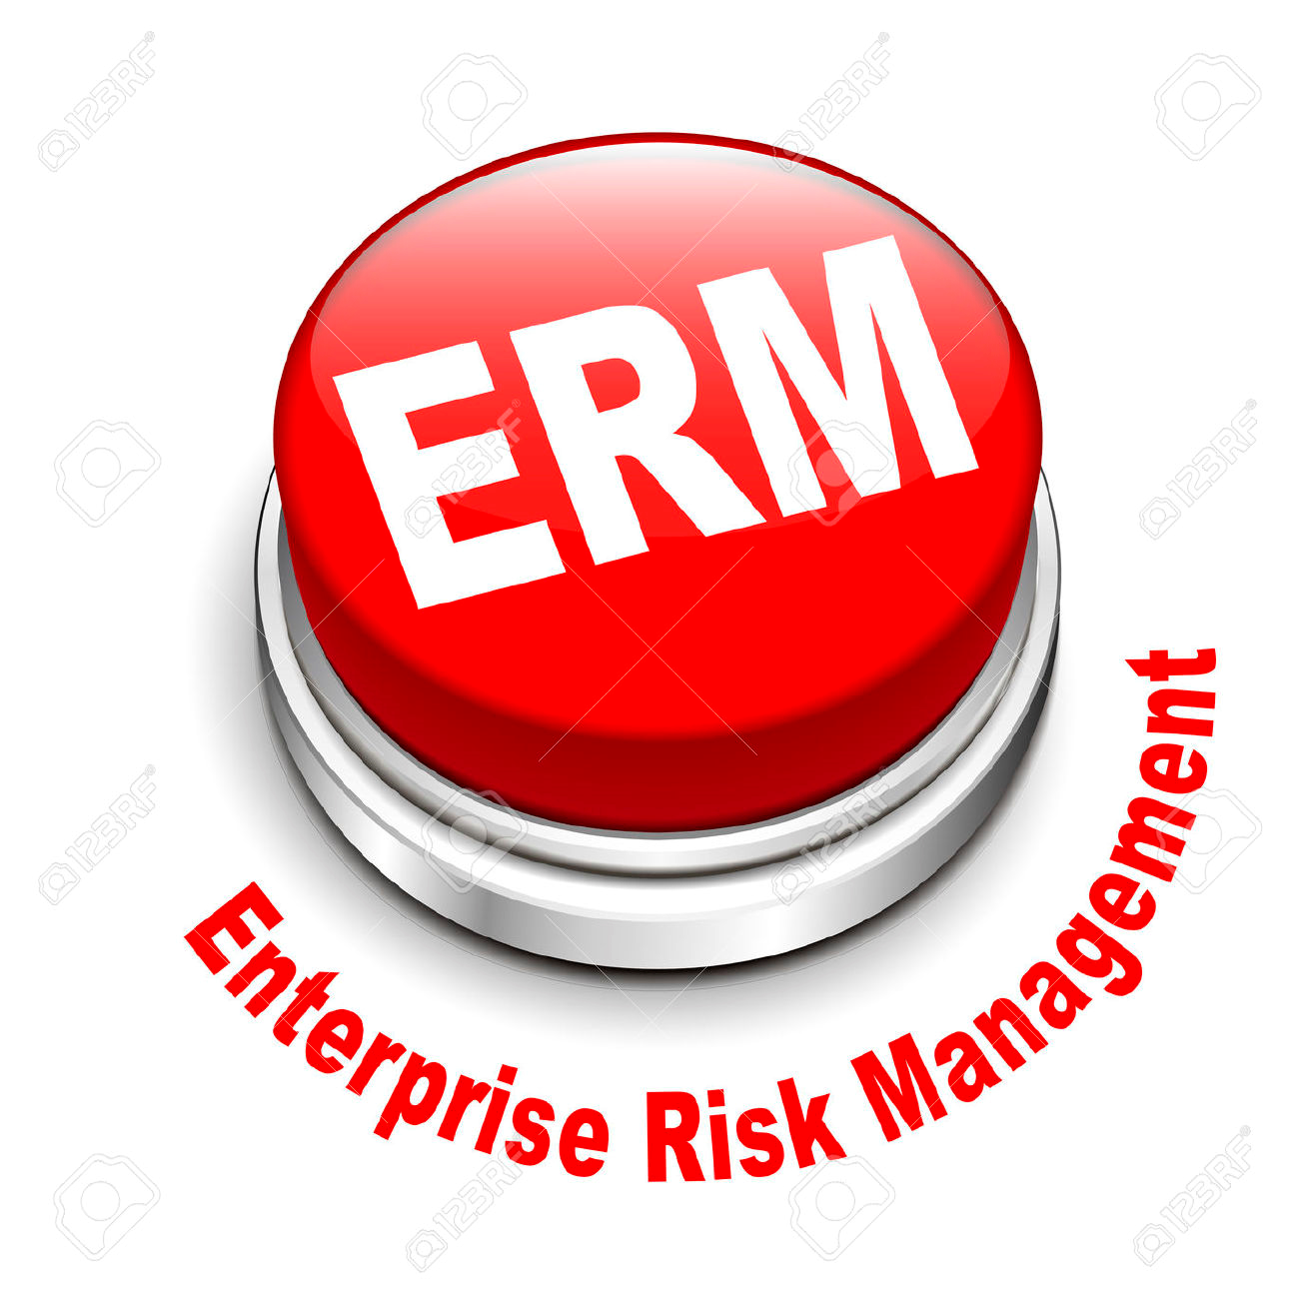
What Is Required by A-123 to Implement ERM?
Governance: Agencies must establish an ERM governance structure.
  Agencies have discretion and flexibility in overall governance structure.
  Should be led by high ranking policy official, COO or equivalent.
  Agencies may establish a Chief Risk Officer, but are not required to.
  Should include a process for considering risk appetite and risk tolerance.
Risk Profiles: Establish a “risk profile” with the following components:
    Identification of Objectives
    Identification of Risk
    Inherent Risk Assessment
    Current Risk Response
    Residual Risk Assessment
    Proposed Risk Response
    Proposed Risk Response Category
Integration: Risk profiles to be integrated with management evaluation of Internal Control (Reasonable Assurance Process)

Slide 10
Revised OMB Circular A-123
ERM Implementation
As soon as practicable, prior to June Initial Risk Profile
June ‘17
Sept ‘17
Annually, June 3, 20XX
ERM Implementation
Plans
Initial Risk Profile
Integration with Management Evaluation of
Internal Control
Updated Risk Profile
No less than annually, agencies must prepare a complete risk profile and include required risk components and elements required by this guidance. CFO Act Agencies, at a minimum, must complete their risk profiles in coordination with the agency Strategic Review. For these Agencies, key findings should be made available for discussion with OMB by June 3rd as part of the Agency Strategic Review meetings and/or FedSTAT.
Agencies are encouraged (not required) to develop an approach to implement Enterprise Risk Management.
Agencies must complete their initial risk profiles in coordination with the agency Strategic Reviews. Key findings should be made available for discussion with OMB as part of the Agency Strategic Review meetings and/or FedSTAT.
For those risks for which formal internal controls have been identified as part of the Initial Risk Profile in FY 2017, assurances on internal control processes must be presented in the Agency FY 2017 Annual Financial Report (AFR) or Performance and Accountability Report (PAR).
10

Slide 11
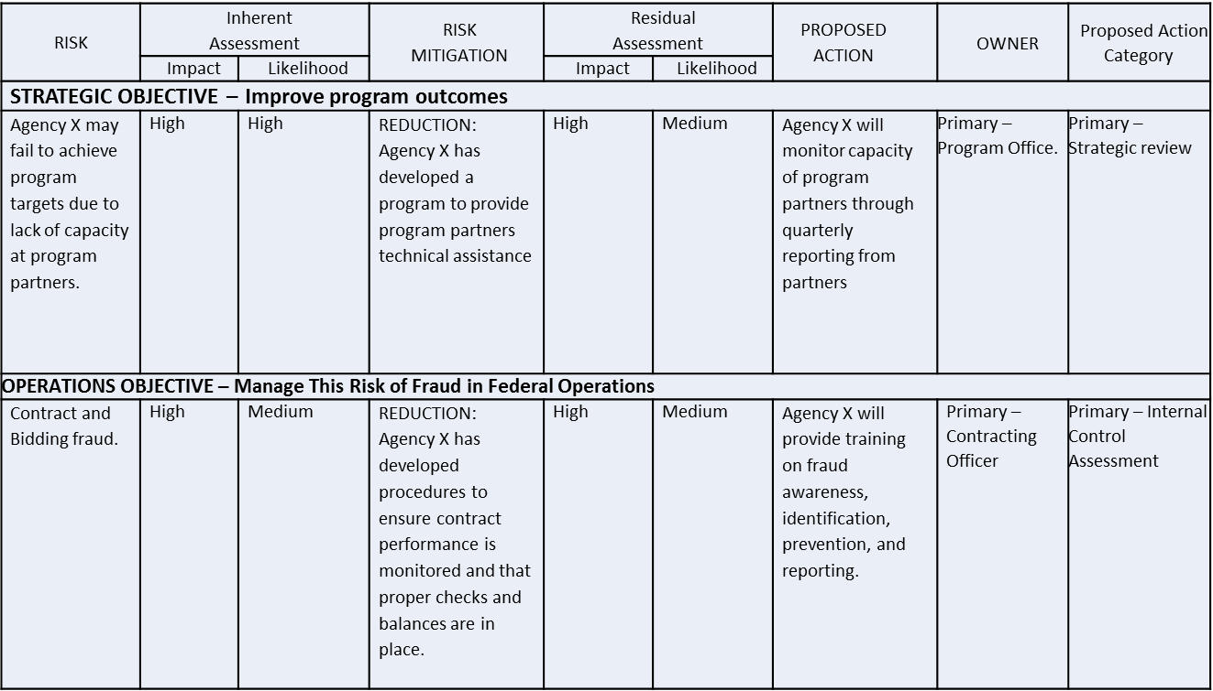
Creating an Enterprise-Level
Risk Profile
Agencies have discretion in terms of content and format for their Risk Profiles; however, in general risk profiles should include the following components:
Identification of Objectives
Identification of Risk
Inherent Risk Assessment
Current Risk Response
Residual Risk Assessment
Proposed Risk Response
Proposed Risk Response Category

Slide 12

Risk Profile: An Illustrative Example
Policy/Guidance
A-11
A-123
Green Book
Playbook
RISK
Risk Response
Strategic Objective
Management Challenge

Slide 13


ERM Implementation Playbook
Playbook Purpose: To provide an ERM Framework and practical guidance to support A-123 compliance and effective ERM implementation across agencies.
ERM Playbook Steering Committee
  Set project policy and established the timeline for the project.
ERM Playbook Working Group
  Implemented the project goals set by steering committee and keyed up decisions and recommendations for the Steering Committee.
Multi-disciplinary representation from across the federal government
Financial Management
Procurement
Risk Management
Internal Controls
Human Capital
IT
Performance Management
Grants Management
Federal Credit
Over twenty federal agencies represented
Access the Playbook at these websites
CFO Council: www.cfo.gov
AFERM: www.aferm.org

Slide 14
OMB Circular A-123 and Playbook
Outreach Efforts and Major Milestones
Apr 2016
May
June
July
Aug
Sept
Oct
Nov
Dec
Jan
2017
Feb
Mar
Apr
May
June
July
Aug
Sept
Oct



7/15 A-123 Public Release
11/8 – NRC
Release Draft President’s Management Agenda
Release A-123 Appendix A (Tentative)
3/23 - BOAC
7/29 - Release ERM Implementation Playbook 1.0



10/27 – NRC IC
3/24 - PIC

Jan – Financial Systems Summit
May – DOE
10/3 – DOE

7/15 – OMB Blog Post

May – ED
3/2 – Executive Council

10/4 – HHS
May – EPA


12/8- AGA Montgomery
/PG County
3/29 – Treas
10/5 – OPM

4/21 - NOVAGA Spring Training Event

May – VA
10/6 – NASA
4/3 – DOC



May – GSA
4/24 – Performance Leads
8/2- IICW
10/12 – SSA
May – OPM

8/8- AICPA Eastern Conference

4/5 – NASA
4/25- AGA Forum

10/14 – ED

4/6 – SBA
May – DOT

10/18 – PPS
May – NRC
5/4- AFERM Luncheon
8/9- WG of Federal
Compliance Professionals

5/5- AGA Montgomery
/PG County

10/24 – GSA
April – DOD

6/3/2017 – Initial Risk Profile (All agencies)

April – HUD
5/9- Joint Financial Management
Improvement Program
10/27 – DHS
April – SSA

6/3 – Annual discussion of Key Risk Findings as part of A-11 Strategic Reviews (24 CFO Act Agencies)

9/16 – ERM Town Hall
5/10- Partnership IG
Round Table Discussion

April – NSF

8/16- CIGIE


May – DOI
5/23- American Assoc. for
Budget & Program Analysis
8/23- Potomac Forum
11/7/8 – AFERM Summit


May – State
9/15/2017 – Integration of ERM and Internal Control (2017 Assurance Statements)

8/24- AFERM Small Agencies COP
5/24 CAOC


May – USAID
10/19 – State

8/30 – Treasury
6/2 ASMC

May – DOJ
9/7 - AGA Hawaii Chapter


May – DOL
6/15- COFAR/FACE
9/20-21 – AGA Internal Control Forum



May – DHS
*Known dates are provided.
Approximate timeframes are provided for events which are in the planning phase.
6/17- NAPA
9/21 – DOC
10/26 – HUD
May – HHS


6/22 – Small Agency
Council
9/22 – EPA
10/20 – DOI



May – USDA
6/29-Partnership A-123
Roll Out
9/23 – TSA
10/21 – DOD



4/20 - AGA New Mexico Chapter
Completed Event

9/23 – USAID
7/7 – AFERM
Luncheon/ERM Blitz

10/25- USDA
4/27- AGA Montgomery
/PG County
Major Milestones


9/26 – DCIE Audit Committee
7/14- Potomac Forum

4/27 CIGIE GAO
7/17-20 - AGA PDT Boston
9/26 – SBA
9/7 - AGA Hawaii Chapter
A-123 Deliverable

4/28 - NOVAGA Spring Training Event
7/17-20 - AGA PDT Anaheim
11/1- DOT
Government Event


9/27 – VA

Dec – CIO Council
5/8 JFMIP
Public Event
9/28 – NSF
4/25/2017
Agency Rollout
Agency Rollout

Slide 15
A-123/ERM Assessments
CURRENT MATURITY
Less Mature
More Mature
Less Mature, Higher Capabilities
Agencies are at
early stages of implementation, but have the capabilities necessary to mature
More Mature, Higher Capabilities
Agencies are on track. Look for best practices.
Higher Capabilities
CAPABILITIES NEEDED TO MATURE
More Mature, Fewer Capabilities
Agencies have some mature processes, but capabilities hinder further progress
Less Mature,
Fewer Capabilities*
Agencies are at
early stages of implementation and face significant hurdles in maturing
*Agencies in this quadrant exhibit higher levels of component autonomy.
Fewer Capabilities

Slide 16
A New Set Of Parameters
Towards a More Resilient Government
“Successful implementation of this Circular requires Agencies to establish and foster an open, transparent culture that encourages people to communicate information about potential risks and other concerns with their superiors without fear of retaliation or blame.
“Similarly, agency managers, Inspectors General (IG) and other auditors should establish a new set of parameters encouraging the free flow of information about agency risk points and corrective measure adoption.”
“An open and transparent culture results in the earlier identification of risk, allowing the opportunity to develop a collaborative response, ultimately leading to a more resilient government.”
-- OMB Circular No. A-123

Slide 17
ERM and the Role of the Auditor
Coordinating ERM activities
Consolidating reporting on risks
Maintaining & developing the ERM framework
Championing establishment of ERM
Coaching management in responding to risks
Developing risk management for board approval
Facilitating identification & evaluation of risks
Setting the risk appetite
Reviewing the management of key risks
Imposing risk management processes
Evaluating the reporting of key risks
Management assurances on risk
Evaluating risk management processes
Making decisions on risk responses
Giving assurance that risks are correctly evaluated
Implementing risk responses on management’s behalf
Giving assurance on the risk management process
Accountability for risk management
Core internal audit roles in regard to ERM
Legitimate internal audit roles with safeguards
Roles internal audit should not undertake
Source: Based on IIA model for internal audit role with ERM

Slide 18
Reviewing The Management Of Key Risks
Core Internal Audit Roles in Regard to ERM
Evaluating The Reporting Of Key Risks
Evaluating Risk Management Processes
Evaluating and Reviewing Established Risk Processes
Evaluating the agency’s established risk management processes.
Evaluating the agency’s efforts at reporting on key risks.
Providing assurances on the agency’s risk management processes.
Giving Assurance That Risks Are Correctly Evaluated
Giving Assurance On the Risk Management Process
Source: Based on IIA model for internal audit role with ERM

Slide 19
Setting The Risk Appetite
Imposing Risk Management Processes
Roles Internal Audit Should Not Undertake
Management Assurances On Risk
Making Decisions On Risk Responses
Active Management and Ownership Over ERM
Making decisions and actions typically in the purview of management.
Taking responsibility for risk decisions and responses.
Giving assurances for ERM and risk responses.
Implementing Risk Responses On Management’s Behalf
Accountability For Risk Management
Source: Based on IIA model for internal audit role with ERM

Slide 20
Developing Risk Management For Board Approval
Championing Establishment of ERM
Legitimate Internal Audit Roles With Safeguards
Maintaining & Developing The ERM Framework
Consolidating Reporting On Risks
Assisting and Improving ERM Development
Promoting ERM as a good management tool.
Working with management to identify, evaluate, and respond to risks.
Collaborating with management to develop and improve on the ERM framework.
Coordinating ERM Activities
Coaching Management In Responding To Risks
Facilitating Identification & Evaluation Of Risks
Source: Based on IIA model for internal audit role with ERM

Slide 21
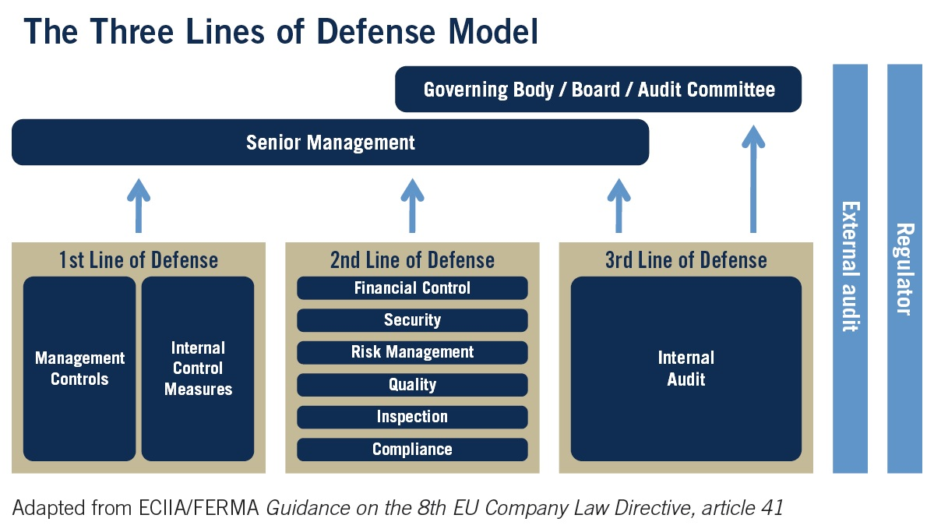
ERM and the Role of the Auditor

Slide 22

Why Do Cars Have Brakes?
“Why does a car have brakes? A car has brakes so it can go fast. If you got into a car and you knew there were no brakes, you’d creep around very slowly. But if you have brakes you feel quite comfortable going 65 miles an hour down the street. The same is true of [risk] limits.”
-- John Reed, former CEO of Citigroup to the Financial Crisis Inquiry Commission

Slide 23

Questions?

Slide 24
Please Contact
Office of Federal Financial Management (OFFM)
Personnel and Performance Management (PPM)
Dan Kaneshiro, Daniel_S_Kaneshiro@omb.eop.gov
Mark Bussow, Mark_Bussow@omb.eop.gov

