Slide 1
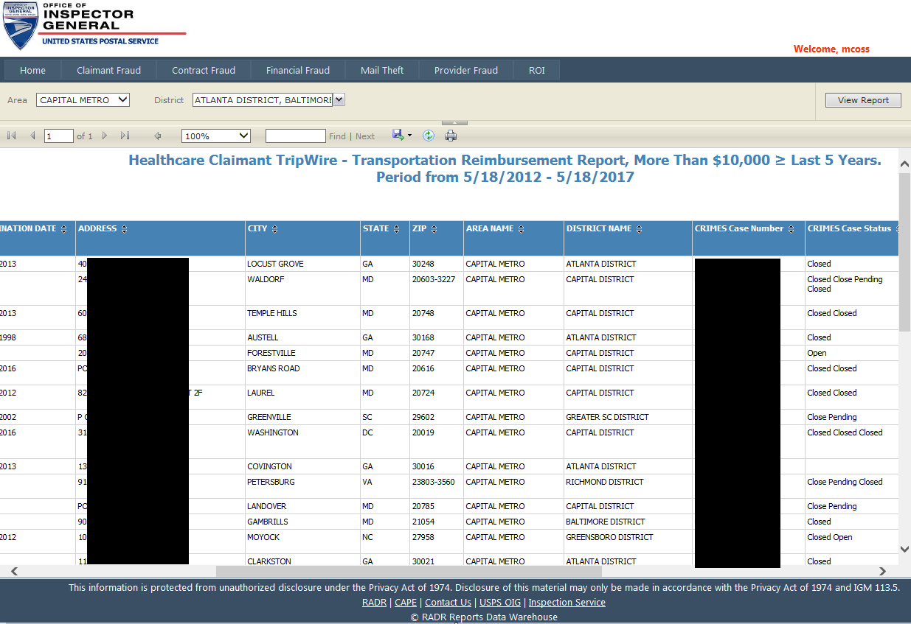
Do You Want This?
Notes:
1. Do analytics have to be fancy or expensive?

Slide 2
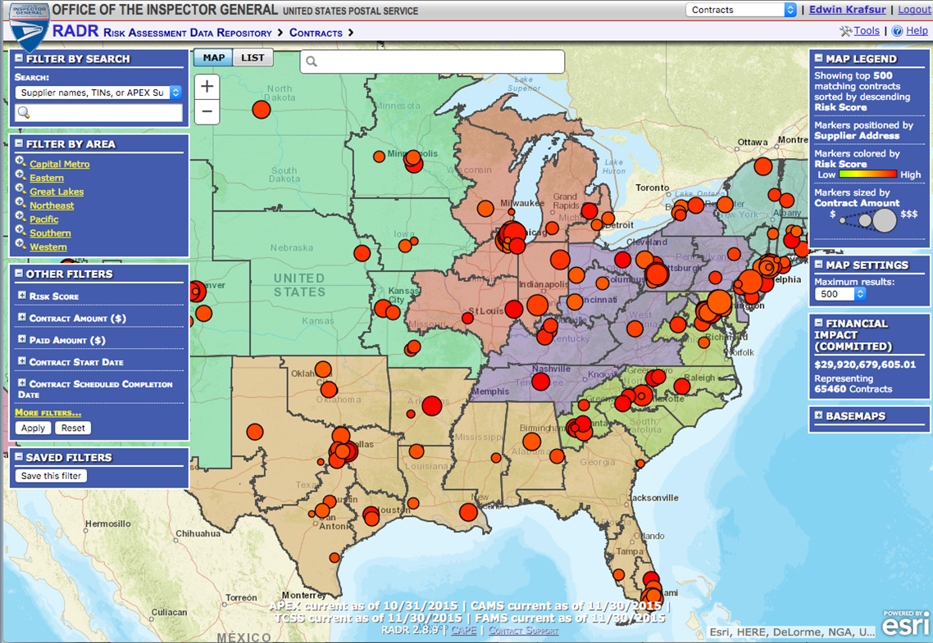
Or This?

