Slide 1
Information Assurance Update: Cloud, Trusted Internet Connections and Continuous Monitoring
Steven Hernandez
Chief Information Security Officer HHS/OIG
September 9th 2016

Slide 2
Agenda
Introduction
Cloud assurance overview
Cloud Assessment
Continuous Monitoring Challenges in the Cloud
Trusted Internet Challenges in the Cloud
Legal concerns with cloud providers
Litigation Hold and eDiscovery
Moving forward with best recommendations
Questions

Slide 3
Introduction
Who I am:
Steven Hernandez MBA, CISSP, CISA, CSSLP, CAP, SSCP, CNSS(4011-4016), HCISPP, ITIL
  Director of the HHS/OIG Information Assurance Division
  Chief Information Security Officer

Slide 4
What is Cloud?
Possibilities:
  Software as a Service (SaaS)
    Vendor is responsible for the vast majority of security control implementation and operation.
  Platform as a Service (PaaS)
    Vendor is responsible for typically the operating system and hardware security controls.
  Infrastructure as a Service (IaaS)
    Customer is responsible for the Majority of Controls.

Slide 5
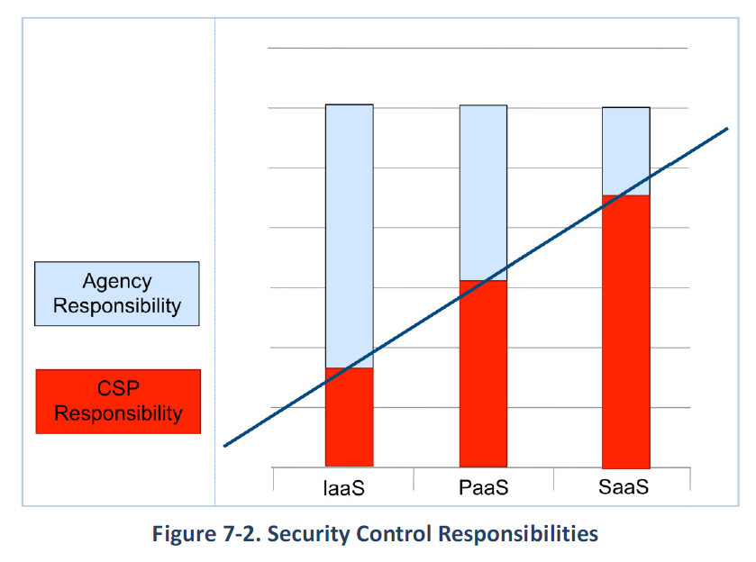
Security Control Responsibility

Slide 6
Security Controls: Low and Moderate

Slide 7
Cloud Control Req.
FedRAMP High Impact Control Baseline
  Finalized June 22nd 2016
  Implements the NIST SP 800-53 Rev 4 “High” baseline controls
  Would allow CSP’s to handle most all data with the exception of classified data and data subject to specific legal requirements
  Approx. 421 Control Test Points

Slide 8
Cloud Control Req.
FedRAMP High Impact Control Baseline
  Why? Only 20% of federal systems need this?
  Because 50% of federal spending is on High impact systems!
  Three Vendors are Piloting
    CSRA/Autonomic Resources – ARC-P PaaS
    Microsoft – Azure Government
    Amazon Web Service – AWS GovCloud

Slide 9
Agency Responsibilities 12/08/11
https://cio.gov/wp-content/uploads/2012/09/fedrampmemo.pdf

Slide 10
Agency Responsibilities
https://cio.gov/wp-content/uploads/2012/09/fedrampmemo.pdf
FedRAMP launched June 6th 2012: Agencies must be compliant since June 6th, 2014

Slide 11
Document Examples
Templates (Fedramp)
  https://www.fedramp.gov/resources/templates-2016/
Package Request Form Security Assessment Framework Guide to Understanding FedRAMP FedRAMP Revision 4 Transition Guide Quick Guide to FedRAMP Readiness Process FedRAMP Policy Memo Security Controls Control Quick Guide | Standard Contract Clauses Control Specific Contract Clauses Cloud Procurement Best Practices Template FedRAMP ATO Letter JAB Charter Continuous Monitoring Strategy Guide Significant Change Form Incident Communications Procedure Branding Guidance

Slide 12
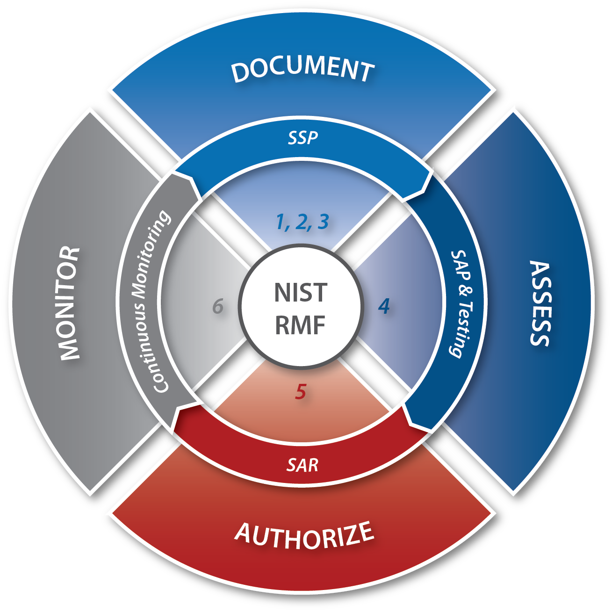
Assessment Process
The FedRAMP Agency ATO authorization process should follow the FedRAMP Security Assessment Framework (SAF)
The FedRAMP SAF is based on the NIST Risk Management Framework (RMF)
The FedRAMP SAF is available on FedRAMP.gov by navigating to the Resources -> Program Documents webpage

Slide 13
Document Check List – FedRAMP Templates
FedRAMP templates are available at FedRAMP.gov on the Resources -> Templates webpage
Agency ATO packages submitted to FedRAMP must include 14 FedRAMP templates
The PMO will check these templates for completeness, critical security control showstoppers, and quality
It’s recommended that you use the Rev 4 Security Assessment Test Cases that the FedRAMP PMO released in Excel format for public comment: https://www.fedramp.gov/files/2015/01/FedRAMP-Security-Assessment-Test-Cases-Rev-4-v1_.xlsx
FedRAMP Templates Available:
System Security Plan (SSP)
  FIPS Pub 199
  E-Authentication
  Control Implementation Summary (CIS)
  CIS Worksheet
  IT Contingency Plan (CP) and CP Test
  Privacy Threshold Analysis (PTA) / Privacy Impact Assessment (PIA)
  Rules of Behavior (ROB)
Security Assessment Plan (SAP)
  Security Assessment Test Cases
Security Assessment Report (SAR)
  Security Test Cases
Plan of Action and Milestone (POA&M)
Agency ATO Letter

Slide 14
Submission of Cloud to GSA
CSP contracts with an accredited 3PAO and submits a 3PAO Designation Form to the FedRAMP PMO.
FedRAMP ISSO holds a meeting with CSP and 3PAO to discuss expectations and set timeframes for deliverables.
3PAO creates and the FedRAMP ISSO approves a testing plan that ensures the assessment will cover the state authorization boundary and controls.
3PAO performs and independently tests the CSP's system and generates a Security Assessment Report (SAR) that documents findings and provides and analysis of the test results to determine the risk exposure.
CSP develops a Plan of Action & Milestones (POA&M) that addresses the specific tasks, resources, and schedule for correcting each of the weaknesses and residual risks identified.
CSP submits the SAR and POA&M to the FedRAMP ISSO for a completeness and overall risk posture review.
The Joint Authorization Board (JAB) makes a risk-based decision on whether to accept the vulnerabilities and planned fixes.
If JAB determines the risk level is too high it recommends remediation steps that the FedRAMP ISSO shares with the CSP.
CSP corrects control implementations, retests affected controls, and resubmits revised documentation
If JAB accepts the risks associated with the system, the FedRAMP ISSO notifies the CSP that they are ready to finalize the security assessment.

Slide 15
Is FedRAMP working?
Yes!
  Cloud providers are beginning to understand this is the minimum necessary to compete in the federal space. 82% of all cloud procurements are including FedRAMP requirements.
  73 CSPs have been deemed compliant (+28)
  4 CSPs in process for JAB PATO (-6)
  40 CSPs in process for Agency ATO (+12)
  3 CSPs are FedRAMP “ready”
  Marketplace.fedramp.gov

Slide 16
Continuous Monitoring
Continuous Monitoring has always been part of the NIST Risk Management Framework (RMF!)
Continuous monitoring has always been part of the certification and accreditation/authorization process.
Why does Certification/Assessment and Authorization matter?
  Understanding the risk you take when using a system
  Understanding the limitations and strengths of a system
  Having a level of assurance and due diligence for a system
  Continuously monitor a system for vulnerabilities and resulting risk
  It’s the Law! FISMA requires we do this and for good reason!

Slide 17
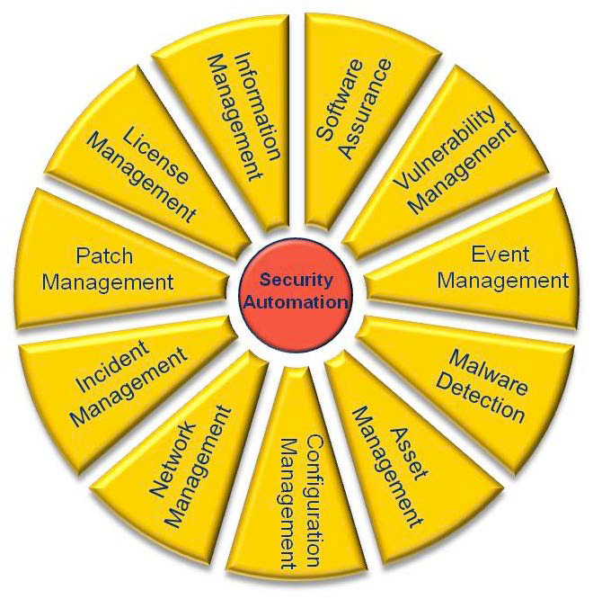
Overall Risk View
Rolling up comprehensive risk information for sound decision making!
Risk Evidence & Documents
People
Process
Technology
Environment
System Inventory and Categorization
System Assessment
POA&Ms
SAR
SAR
Risk
Risk
Risk
Decision
Continuous Monitoring Automated Process Areas
DHS/CDM
Manual Assessment
Process Areas
800-53A and Test Cases

Slide 18
Cloud Continuous Monitoring
When the vendor controls everything how can we ensure risk visibility?
Remember:
  FedRAMP is going to ensure the CM capability exists for the cloud provider in three areas:
    Operational Visibility
    Change Management
    Incidence Response

Slide 19
Cloud Continuous Monitoring

Slide 20
Cloud Continuous Monitoring
Operational Visibility:
    Operational visibility provides a look-in into the security control implementations of the CSP
      What contract language or clauses does the organization have for ongoing and as needed (ad hoc) security assessments?
      How much visibility through automated or manual assessments does the organization have into the cloud provider.
Change Control and Management:
    How does the cloud provider control changes and configurations? What assurance does the organization and agency have that breaches or downtime will not occur due to unintended changes or poorly tested changes?

Slide 21
Cloud Continuous Monitoring
Incident Response and Law Enforcement
  What automated scanning, patching and reporting is available to the agency?
  Is the cloud provider using SCAP compliant tools and providing DHS compliant feeds back to the agency?
  What contractual provisions are in place for internal investigations, employee monitoring and formal investigations?

Slide 22
Cloud Continuous Monitoring
Recommendations:
  Ensure contractual provisions exist which ensure the cloud provider must provide SCAP compliant configuration, asset, vulnerability and patch status for DHS CDM dashboards and feeds.
  Ensure contracts are vetted by law enforcement partners and Legal to ensure all legal actions are routed to the appropriate agency resources and when the agency needs information from the cloud provider there are no surprises.
  Ensure you have the ability to send in an independent assessment team to perform ad hoc or after action assessments.
  Ensure a full FedRAMP provisional ATO (or FedRAMP Ready) is required for new contracts and re-competing existing contracts which do not contain the FedRAMP requirements.

Slide 23
Audit and Inspection Clauses
A critical item for Agencies and IGs
  FedRAMP does NOT cover access for investigations and audits and reviews
    Legal Route:
      Time consuming, expensive, confrontational
    Contractual Route is much better!
      Include specific terms related to access to facilities, data and metadata
      “Yellow-Book” auditing standards
        In addition to FedRAMP Controls
        Agencies should demand Yellow-Book standards starting with the High Baseline and working back to Moderate
        Several CIGIE working groups are working through this but we need to be unified in our approach!

Slide 24
Audit and Inspection Clauses
Dept of Ed OIG
Class Deviation to Implement Policy Regarding Access to Contractor Information Systems
The purpose of this alert is to issue a class deviation that allows Contracting Officers to require contractors and subcontractors at all tiers to afford the Department, other Federal agencies, the Comptroller General of the United States, and their authorized third-party representatives, full and timely access to contractor information systems and related resources to perform privacy and information security inspections.

Slide 25
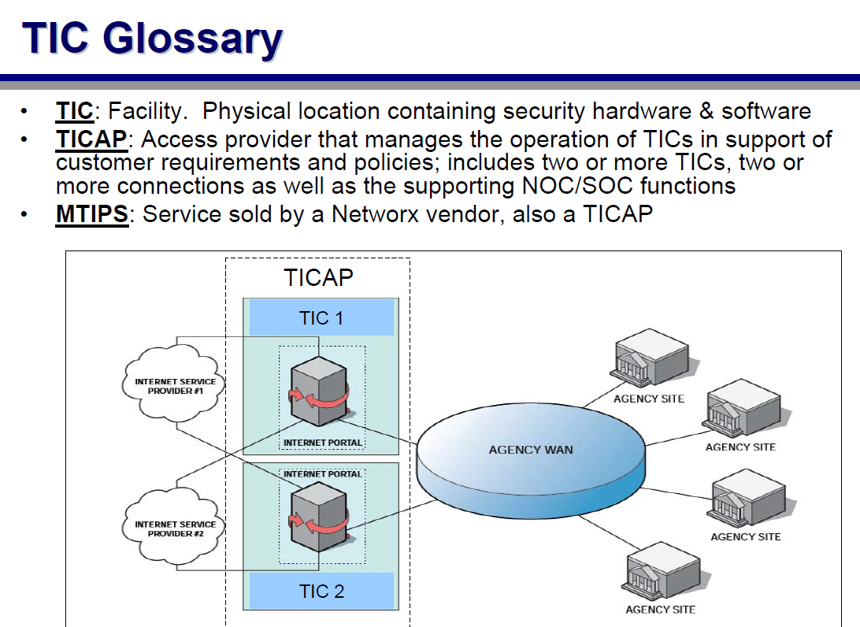
Trusted Internet Connections

Slide 26
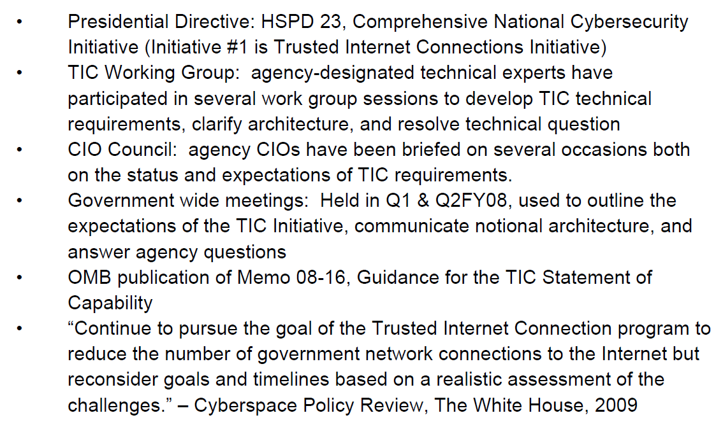
Trusted Internet Connections
Required through:

Slide 27
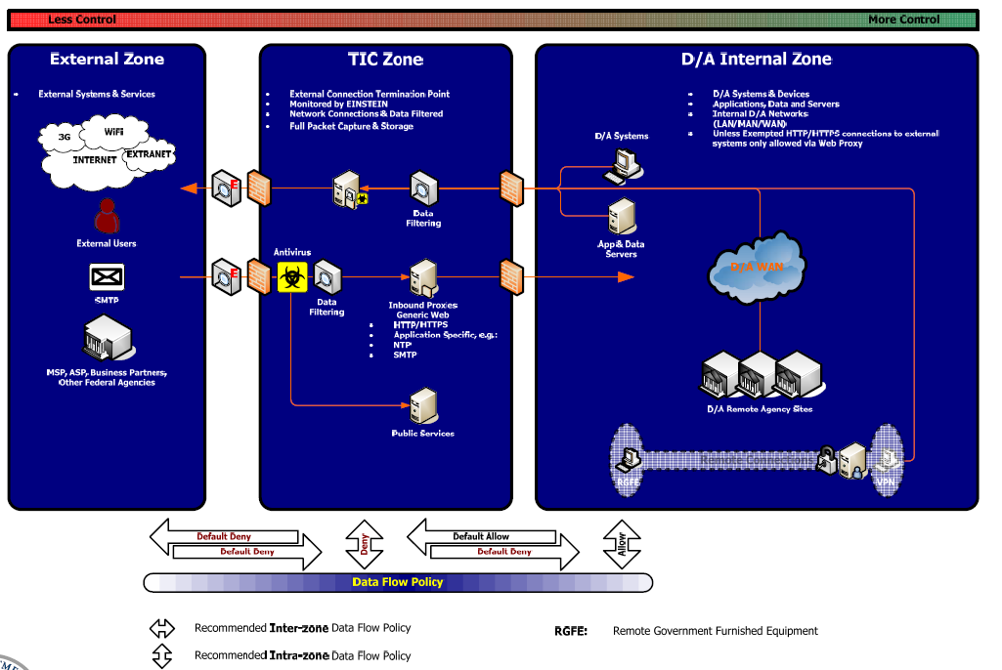
Trusted Internet Connections:

Slide 28
What about Cloud and
Trusted Internet Connections?

Slide 29
Trusted Internet Connections

Slide 30
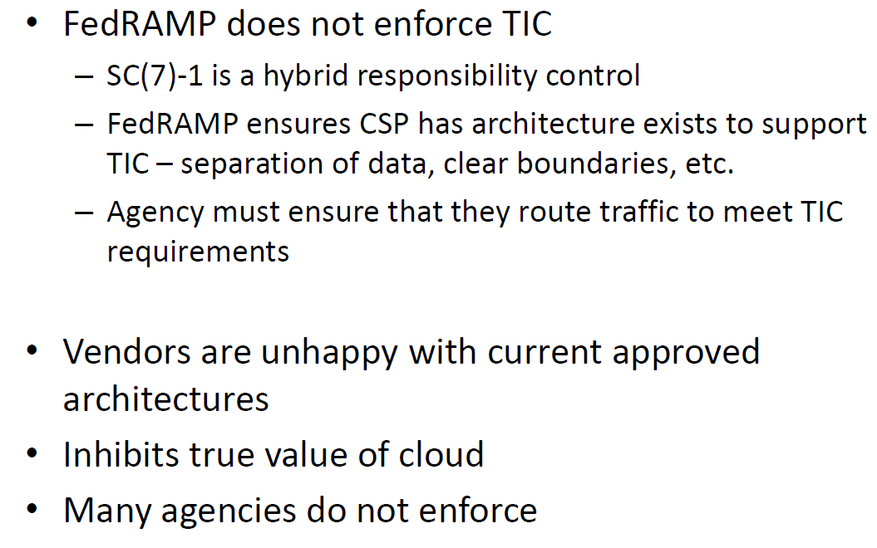
What have we learned from vendors?

Slide 31
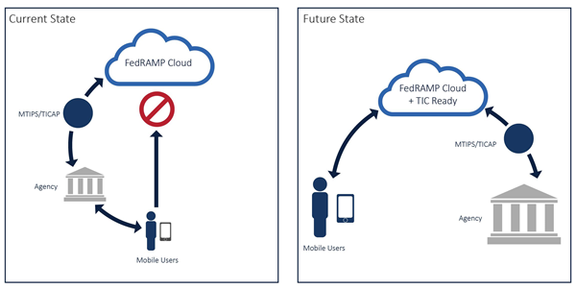
Future Resolution
(CSP TIC Overlay?)

Slide 32
Future Resolution
(CSP TIC Overlay?)

Slide 33
Future Resolution
(CSP TIC Overlay?)
Not all TIC capabilities are represented in the FedRAMP-TIC overlay as not all TIC capabilities are applicable to CSPs.
The TIC capabilities and the FedRAMP security control requirements are not a one-to-one mapping; some are one-to-many, many-to-one, or many-to-many.
The TIC Reference Architecture v2.0 defines TIC capabilities as either Recommended or Critical. For purposes of this overlay, ALL applicable TIC capabilities are considered Critical (and therefore mandatory) for external cloud service providers.
Achieve a FedRAMP security authorization by an authorizing official (agency or JAB) based on the 3PAO Security Assessment Report; and
Be deemed “TIC Ready” by DHS based on DHS’s review of a 3PAO TIC Capabilities Assessment Report
AWS Amazon completed a pilot in Feb of 2016. Results indicate a substantial amount of collaboration is necessary between agencies, providers and DHS to be successful. (https://d0.awsstatic.com/whitepapers/compliance/Guidance_for_Trusted_Internet_Connection_TIC_Readiness_on_AWS.pdf)

Slide 34
Future Resolution
(CSP TIC Overlay?)
Outlook:
  Uncertain if CSP can meet equivalent requirements of MTIPS
  Questions as to the level of integration with US-CERT and Agency monitoring capabilities
  Costs are still uncertain as the CSP may have to significantly re-engineer their networking to accommodate this model.
If successful could mean more providers of MTIPS services
  Drive down costs
  Increase competition
  Increase performance

Slide 35
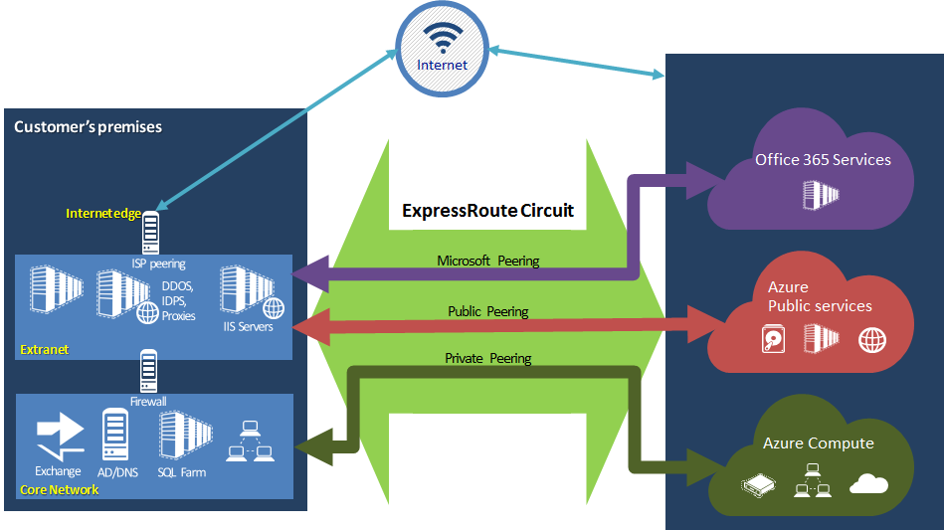
Future Resolution
(Direct Connect, ExpressRoute etc.)

Slide 36
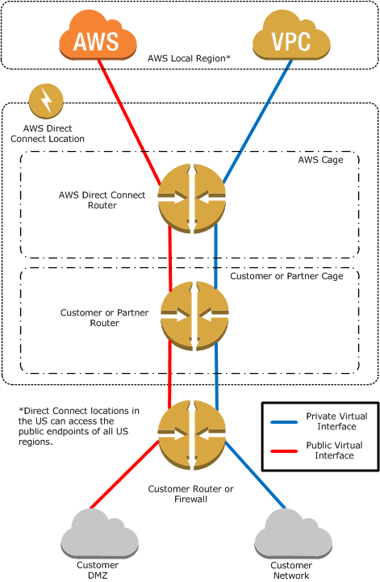
Future Resolution
(Direct Connect, ExpressRoute etc.)

Slide 37
Legal Hold, Records Retention, FOIA, eDiscovery and all this fun!
Sounds complex and our lawyer friends make a solid living around these terms:
Basically two functions:
Can you preserve information based on a criteria and a timeline?
Can you search your collections in a forensically sound manner?

Slide 38
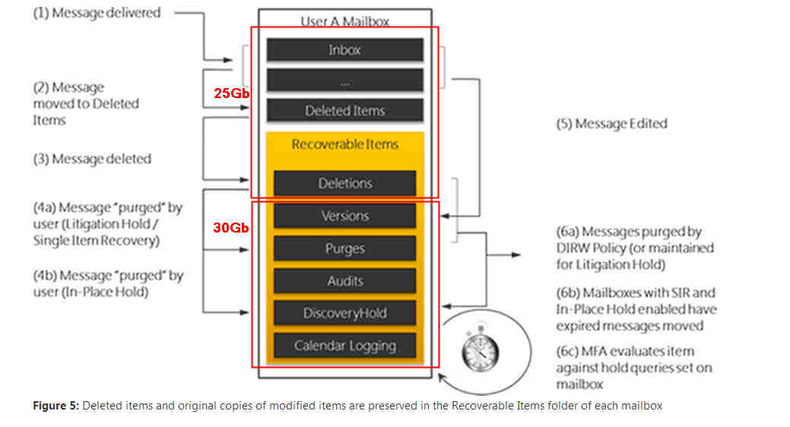
Litigation Hold Example (O365)

Slide 39
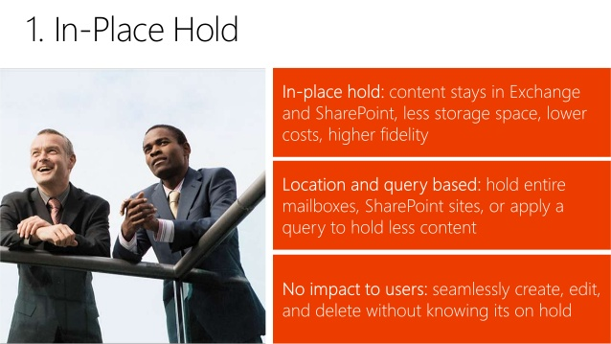
Example (O365)
Hey Bob, Didn’t we tell the lawyers we can only store 6 months worth of email?
You’re living way in the past! With our new cloud provider our legal hold is indefinat….. Uhh ohh….

Slide 40
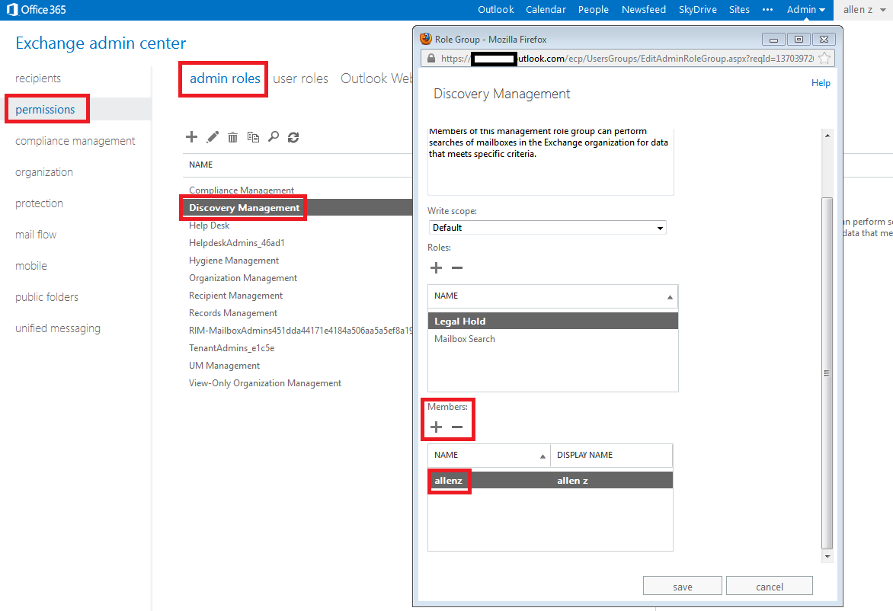
E-Discovery Example (O365)

Slide 41

E-Discovery
Remember:
Separation of duties
  E-Discovery is a powerful tool
    Admins snooping
    Mangers going on fishing trips
  Contract up-front for capability
    Storage
    Tools
    Capabilities
    SaaS most likely

Slide 42
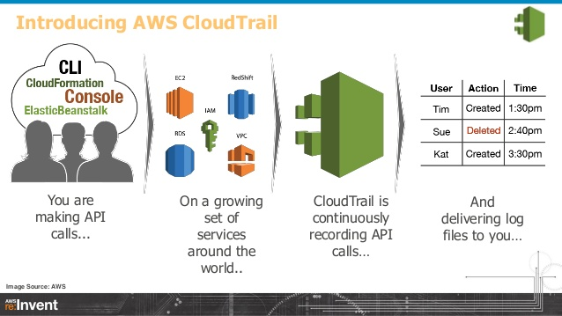
Forensic Examples
The Good:
Logging: AWS Cloudtrail

Slide 43
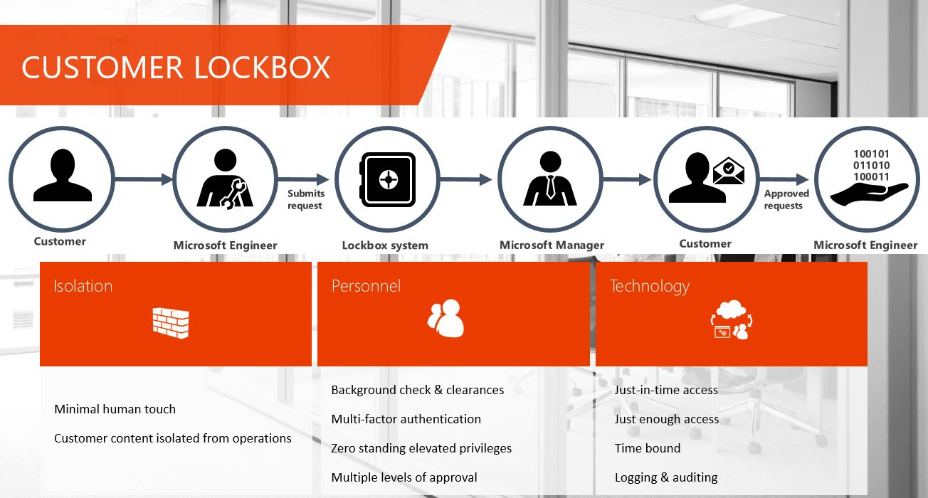
Forensic Examples
The Good:
Least Privilege: Microsoft Lockbox

Slide 44
Critical concerns contracting officers:
Pity the CO (at least at DoD for now…):
Appropriate requirements to support applicable inspection, audit, investigation, or other similar authorized activities specific to the relevant types of Government data and Government-related data, or specific to the type of cloud computing services being acquired;
Appropriate requirements to support and cooperate with applicable system-wide search and access capabilities for inspections, audits, investigations, litigation, eDiscovery, records management associated with the agency's retention schedules, and similar authorized activities; and……
WE CAN HELP!
Notes:
https://www.federalregister.gov/articles/2015/08/26/2015-20870/defense-federal-acquisition-regulation-supplement-network-penetration-reporting-and-contracting-for

Slide 45
Questions

Slide 46
Contact Me:
Thanks!!
Steven Hernandez
Steven.hernandez@oig.hhs.gov

