Slide 1
Compilation of the Financial Report of the U.S. Government
Jaime M. Saling May 2021

Slide 2
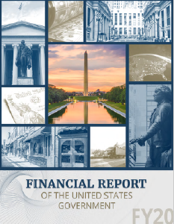
Audit Status: A Disclaimer of Opinion
Since 1997, the Bureau of the Fiscal Service has compiled agency financial data to prepare the consolidated Financial Report of the U.S. Government, and has consecutively received a disclaimer from the Government Accountability Office (GAO).
Three Primary Impediments
DoD
Compilation
IGT

Slide 3
Key Controls in the Compilation Process
Completeness
Tracing
Eliminate
Edits/Validations
Proper Disclosures
Audit Coverage

Slide 4
Completeness - Define the Reporting Entity
Ensure completeness by defining the Reporting Entity per FASAB guidance. Then we must ensure that we receive the significant amounts from the agencies.
Federal Accounting Standards Advisory Board (FASAB) Statement of Federal Financial Accounting Standard (SFFAS) No. 47 Reporting Entity
The standard provides guidance in determining what organizations to report upon and what information should be presented
Consolidated vs Disclosure
Requires information to be provided about related party relationships

Slide 5
Data Consolidation
Governmentwide Treasury Account Symbol Adjusted Trial Balance System (GTAS)
IBM Cognos (Planning Analytics and Cognos Disclosure Management)
Limited Manual Entry
Notes:
Explain that the focus is just the preparation of the FR
Focus on all entities do GTAS reporting but for the FR significant entities still have to do all modules in GFRS.
Point out the use of significant entities GTAS data throughout the fiscal year and at year end for analysis and closing audit recommendations.

Slide 6
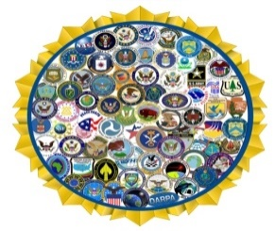
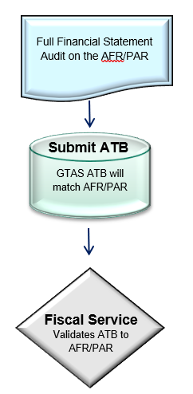
Collection of Data from Agencies
Federal Agencies In the current process, over 130 agencies publish audited financial statements. Each of these agencies submit adjusted trial balances (ATB) to GTAS that should match their audited financial statements per TFM 2-4700 guidance.

Slide 7
Tracing - ATB Matches to AFR/PAR
Ensure GTAS ATB matches to audited agency financial statements
Agency data analysis
Tracing of the top 98% and 95% of Statement/Line Amounts.
Standardized Balance Sheet
Main Financial Statement lines
Sub-categories
OMB A-136 Note 44: Reclassification of Statement of Net Cost and Statement of Changes in Net Position to Financial Report Format

Slide 8
Data Hierarchy
Fiscal Service is required to research the data elements in each note and determine the best source of data based on the Data Hierarchy.
Data Hierarchy
GTAS Crosswalks
AFR/PAR Information
Agency Collaboration

Slide 9
Eliminate – Intragovernmental Data
Ensure that intragovernmental transactions and balances are properly eliminated
Elimination is worked on throughout the year with the IGT scorecards and other tools
Intragovernmental analysis at year-end is performed to enter supported journal vouchers to eliminate items that didn’t eliminate properly through the reporting process
Identify what’s left that didn’t get eliminated to determine if we are not at risk of materially misstating the Financial Report (FR) of the U.S. Government
Notes:
Intragovernmental differences continue to be a lingering issue for the CFS. What can/should we be doing as OIGs/IPAs to assist?

Slide 10
Intragovernmental Activity and Balances
The Simplicity of the IGT Issue:

Slide 11
Edits/Validations
Ensure accuracy of data and not just matching to agencies audited financial statements
Validations and edits in GTAS
FR preparation
Process top-level journal vouchers with agency concurrence to correct the data
Financial Report and Intragovernmental Scorecard
Notes:
Intragovernmental differences continue to be a lingering issue for the CFS. What can/should we be doing as OIGs/IPAs to assist?

Slide 12
Proper Disclosure
Proper disclosures per FASAB standards
Disclosure checklist
Various working groups for new or revised standards
Independent review of the FR
Notes:
Intragovernmental differences continue to be a lingering issue for the CFS. What can/should we be doing as OIGs/IPAs to assist?

Slide 13
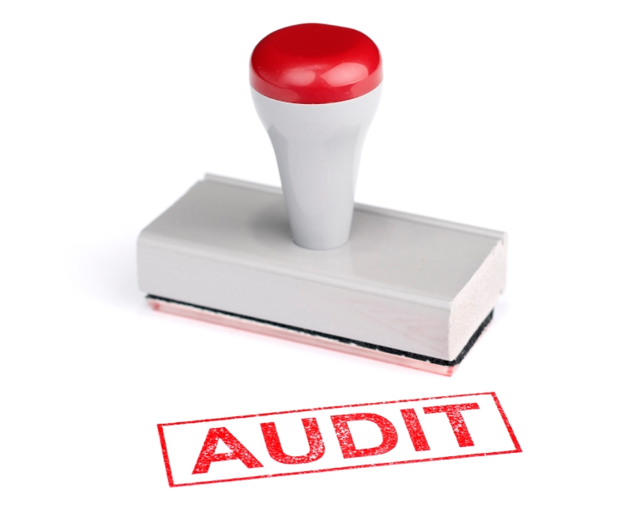
Audit Coverage
Audited versus unaudited data in the Financial Report of the U.S. Government
Risk of misstatement
$20 billion threshold
Notes:
Intragovernmental differences continue to be a lingering issue for the CFS. What can/should we be doing as OIGs/IPAs to assist?

Slide 14
Jaime M. Saling
Department of the Treasury Bureau of the Fiscal Service
Jaime.Saling@fiscal.treasury.gov

