Slide 1
2023 FAEC Procurement Conference
November 9, 2023
Civil Cyber Fraud Initiative – Holding Contractors Accountable for Cybersecurity Requirements
Jeffrey Burke, Program Manager, Cyber Crime & Intrusions, Defense Criminal Investigative Service Cyber Field Office, Department of Defense Office of Inspector General
Sean Keaney, Deputy Assistant Inspector General for Audit, Cyberspace Operations, Department of Defense Office of Inspector General
Sara McLean, Assistant Director, Civil Division, Commercial Litigation Branch (Fraud Section), Department of Justice

Slide 2
Initiative Objectives
Initiative announced October 6, 2021, by Deputy Assistant Attorney General
Part of DOJ’s response to E.O. 14028
Initiative leverages DOJ’s expertise/experience in civil fraud matters to combat new and emerging cyber-threats
Uses the False Claims Act to pursue cybersecurity related fraud by government contractors and grant recipients

Slide 3
Execution
Builds on existing False Claims Act practice and partnerships
Over a billion each year in recoveries
600-700 whistleblower suits per year
Led by DOJ’s Civil Division, Commercial Litigation Branch, Fraud Section, teamed with:
U.S. Attorney’s offices
Offices of Inspector General and other agency and law enforcement partners

Slide 4
False Claims Act’s Reach
False Claims Act effectively targets reckless disregard by corporations
Prohibits knowingly submitting or causing a false claim to the government
Falsity = broadly understood
Knowing = reckless disregard, deliberate ignorance, or actual knowledge
Recovery is treble damages and a penalty per false claim
Civil standard of proof – preponderance of the evidence, not beyond a reasonable doubt
Allows whistleblowers to file suit and share in Government’s recovery

Slide 5
Expected Benefits
Encourage resiliency and better cybersecurity practices
Hold contractors and grantees to contractual and other legal commitments
Level the playing field
Promote incident reporting
Return funds to the government

Slide 6
Experience with Cyber-Fraud Matters
Investigations initiated based on:
Government-identified targets
Qui tam suits/whistleblowers
Contractor self-disclosures
Types of cases:
Government IT Systems
Contractor/Grantee IT Systems
Supply Chain
Cloud Services
Violations of Incident Reporting Requirements
Sensitive Personal Information

Slide 7
Experience with Cyber-Fraud Matters
Allegations include:
Misrepresentations about cybersecurity practices or security posture to obtain or maintain Government contracts
Violations of material cyber requirements – for example, DFARS requirements for protecting CUI or agency requirements for protecting sensitive personal information
Corporate disregard for information security concerns raised by internal experts or outside auditors
Four settlements announced to date. https://www.justice.gov/civil/practice-areas-0#cyberfraud

Slide 8
Case Study
ABC Defense Co. develops software, firmware, and applications for DoD | Standard Practice - Nothing unconventional
ABC hires a DevOps manager that insists all development be done on a single server, and the whole codebase is pushed with every update. | This is a poor DevOps practice, but how do we recognize these kind of issues?
ABC subcontracts development work to XYZ, as building their software is a complex process with over 12 developers. | Are XYZ subcontractors U.S.-based? Is this inputted into electronic Subcontractor Reporting System (eSRS)?
XYZ quickly realizes this DevOps process is incredibly inefficient, but it is resulting in almost double billables because every time changes are made, they overwrite others and are creating weeks of error correction. | Billing fraud? Where do we draw the line? How do we distinguish between ineptitude/negligence v. recklessness/ intentional fraud?
The developers at XYZ are salaried, so they don’t realize any of the benefits ABC is. A developer quits and makes a hotline complaint. | How do the subcontractors even know? How do we investigate the contracts? How do we investigate the allegations?

Slide 9
Results at a Glance

Slide 10
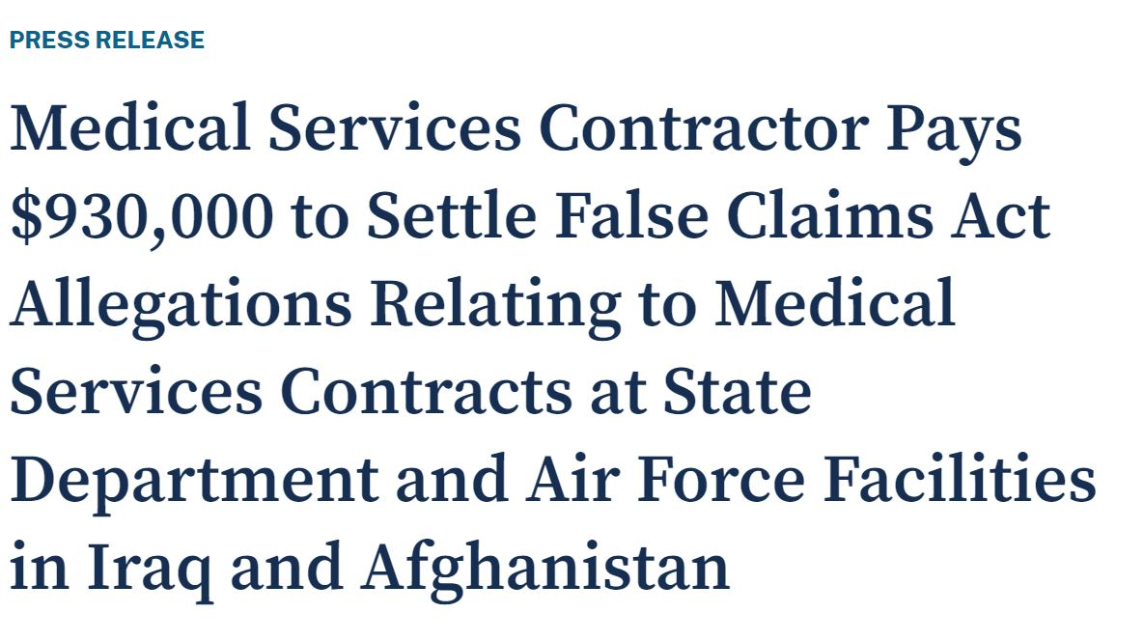
Settlement (March 2022)
Comprehensive Health Services provides medical support services at government-run facilities in Iraq and Afghanistan
From 2012 to 2019, CHS allegedly failed to disclose it had not consistently stored patients’ medical records in a secure system. Patients included Service Members, diplomats, officials and contractors.

Slide 11
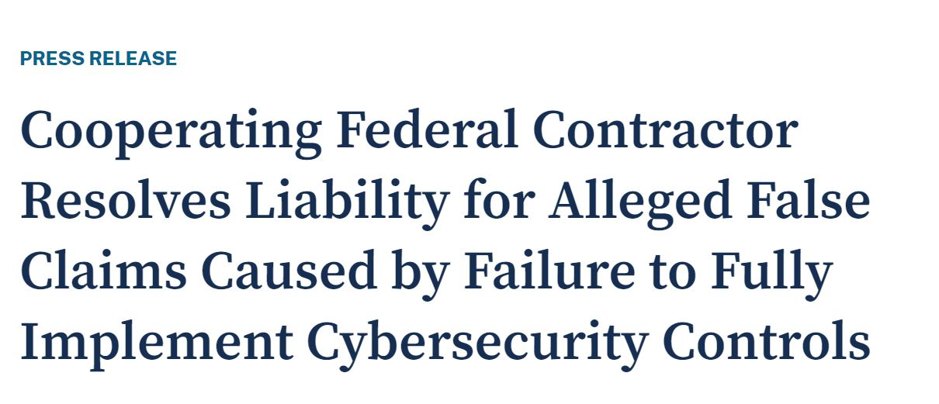
Settlement (September 2023)
Verizon Business Network Services LLC agreed to pay over $4 million to resolve allegations it failed to completely satisfy certain cybersecurity requirements on GSA IT contracts
Once Verizon identified issue, the company self disclosed and cooperated with government’s investigation.

Slide 12
Agency Contributions

Slide 13
Subject Matter and Technical Expertise
Expertise needed:
Fraud and cyber agents
Agency counsel
OIG and other agency cyber auditors
Contracts and security requirements SMEs
Technical specialists
Cyber expertise helps with:
Triaging initial allegations
Crafting subpoenas
Understanding subpoena responses
Interviewing or deposing witnesses
Evaluating and presenting evidence to potential defendants
Assessing potential defendant responses
Litigation support (if the case does not settle)

Slide 14
Identifying and Referring Matters
Avenues for referrals
Hotline tips?
Reports?
Audits?
Assessments?
Past or parallel investigations?
Areas for collaboration as to reviewing/revising contractual or regulatory language
Other? All ideas are welcome...

Slide 15
Contacts for Questions, Resources, Referrals, and Ideas
Special Agent Jeffrey Burke
Program Manager, Cyber Crime & Intrusions
Defense Criminal Investigative Service Cyber Field Office
Department of Defense Office of Inspector General
Jeffrey.burke@dodig.mil
(703) 699-9939
National Cyber Investigations Task Force (NCIJTF)
JGBurke@fbi.gov
Sean Keaney
Deputy Assistant Inspector General for Audit, Cyberspace Operations
Department of Defense Office of Inspector General
(703) 601-5849
Sean.Keaney@dodig.mil
Sara McLean
Assistant Director, Commercial Litigation Branch (Fraud Section)
Civil Division, Department of Justice
(202) 307-0475
sara.mclean@usdoj.gov

