Slide 1
Data Analytics Forum Analytics 101: Setting the Stage for a Common Understanding
Dr. Brett M. Baker, AIG for Audit, NRC OIG
Manuel J. Mireles, Forensic Auditor, NGA OIG
Shiji S. Thomas, Forensic Accountant, NSF OIG

Slide 2
Analytics 101 Outline
UNCLASSIFIED
At the end of this session you will be able to understand:
What is Data Analytics? (15 minutes) - Manny
The Audit Perspective (20 minutes) – Dr. Baker
The Investigation Perspective (15 minutes) – Shiji
We’ll also time for:
Questions and Group Discussion (10 minutes)
UNCLASSIFIED

Slide 3
What is Data Analytics? (Definition)
UNCLASSIFIED
The AICPA defines audit data analytics as:
The science and art of discovering and analyzing patterns,
identifying anomalies, and extracting other useful information in data…
…through analysis, modeling, and visualization…”
http://www.aicpa.org/interestareas/frc/assuranceadvisoryservices/downloadabledocuments/auditanalytics_lookingtowardfuture.pdf
UNCLASSIFIED
Notes:
…underlying or related to the subject matter of an audit …
The AICPA continues to say that …data analytics includes methodologies for identifying and analyzing anomalous patterns and outliers in data; mapping and visualizing financial performance and other data across operating units, systems, products, or other dimensions for the purpose of focusing the audit on risks; building statistical (for example, regression) or other models that explain the data in relation to other factors and identify significant fluctuations from the model; and combining information from disparate analyses and data sources for the purpose of gaining additional insights.
A simple definition of data analytics from the Association of Certified Fraud Examiners is “…the use of analytics software to identify trends, patterns, anomalies, and exceptions in data.”
http://www.acfe.com/uploadedFiles/ACFE_Website/Content/review/da/01-intro-to-data-analytics.pdf
The Federal Law Enforcement Training center defines Data [Analytics] as “the use of tools to discover previously unknown, valid pattern relationships in large data sets.”

Slide 4
Where is the OIG Community?
Analytical Maturity
Leadership
Passion for analytical competence
Analysts
World-class pro analysts
Highly capable analysts in networked org
Support for analytical competence
Beginning to recognize importance
Only at process level
No awareness/interest
Analysts in key target areas
Isolated pockets of analysts
Few skills attached to specific functions
Stage 5 Analytical Competitors
Stage 4 Analytical Organizations
Stage 3 Analytical Aspirations
Stage 2 Localized Analytics
Stage 1 Analytically Impaired
?
Davenport, Thomas H, Jeanne G Harris, and Robert Morison. Analytics At Work. 1st ed. Boston, Mass.: Harvard Business Press, 2010. Print.

Slide 5
What are the potential benefits from Data Analytics?
The AICPA reports that “CPAs now often find themselves performing tasks that require skills in data analytics:
Both internal and external auditors are using data analytics to enable practices such as continuous monitoring, continuous auditing, and analysis of full data sets in situations where [previously] only samples were audited.
Potential improvements include producing higher-quality audit evidence, reducing repetitive tasks, and better correlating audit tasks to risks and assertions.”
http://www.journalofaccountancy.com/issues/2016/aug/data-analytics-skills.html
Notes:
My team at NGA differentiated itself from Audit by highlighting that we “harness computer processing power to perform tests on entire data sets and do not rely on sampling techniques.”

Slide 6
What software is available?
Excel
Auto-Filter and Sorting using Table function (Outlier Detection),
Conditional Formatting (Data Visualization),
Charts (Data Visualization)
Pivot Tables (Cross-Tabulation),
V Lookup (Data Matching),
Visual Basic Scripting (Automation).
Notes:
1 Sort: You can sort your Excel data on one column or multiple columns. You can sort in ascending or descending order.
2 Filter: Filter your Excel data if you only want to display records that meet certain criteria.
3 Conditional Formatting: Conditional formatting in Excel enables you to highlight cells with a certain color, depending on the cell's value.
4 Charts: A simple Excel chart can say more than a sheet full of numbers. As you'll see, creating charts is very easy.
5 Pivot Tables: Pivot tables are one of Excel's most powerful features. A pivot table allows you to extract the significance from a large, detailed data set.
6 Tables: Tables allow you to analyze your data in Excel quickly and easily.
7 What-If Analysis: What-If Analysis in Excel allows you to try out different values (scenarios) for formulas.
8 Solver: Excel includes a tool called solver that uses techniques from the operations research to find optimal solutions for all kind of decision problems.
9 Analysis ToolPak: The Analysis ToolPak is an Excel add-in program that provides data analysis tools for financial, statistical and engineering data analysis.

Slide 7
What software is available?
Access
Everything Excel does plus
Database Normalization & Queries
Greater Scalability
Increased Data and Referential Integrity
Notes:
Time & Attendance/Labor Mischarges Reporting, Telephone Analytics, Locality Pay, Mass Transit Benefit Program:
1 Sort: You can sort your Excel data on one column or multiple columns. You can sort in ascending or descending order.
2 Filter: Filter your Excel data if you only want to display records that meet certain criteria.
3 Conditional Formatting: Conditional formatting in Excel enables you to highlight cells with a certain color, depending on the cell's value.
4 Charts: A simple Excel chart can say more than a sheet full of numbers. As you'll see, creating charts is very easy.
5 Pivot Tables: Pivot tables are one of Excel's most powerful features. A pivot table allows you to extract the significance from a large, detailed data set.
6 Tables: Tables allow you to analyze your data in Excel quickly and easily.
7 What-If Analysis: What-If Analysis in Excel allows you to try out different values (scenarios) for formulas.
8 Solver: Excel includes a tool called solver that uses techniques from the operations research to find optimal solutions for all kind of decision problems.
9 Analysis ToolPak: The Analysis ToolPak is an Excel add-in program that provides data analysis tools for financial, statistical and engineering data analysis.

Slide 8
What software is available?
IDEA
Easier Data Acquisition (Importing)
Works like spreadsheets but protects data like databases (integrity)
Has Pre-Built Analytics
Increased Data and Referential Integrity
Repeatable and continuous monitoring functions
Tutorials included
Notes:
Has Database functions like: append/merge, join/relate
Has spreadsheet functions like cross tabulate, filter, index/sort, calculated fields and functions
Pre-built analytics include sampling, aging, Bedford's law, duplicate id, and gap analysis
Has traditional statistical functions like sampling and stratify.
Can perform Text Analytics

Slide 9
What software is available?
ACL
Similar to IDEA
Includes focus on Fraud management
Lists 31 fraud tests specific to the public sector plus 100’s more general fraud tests.
Lists 17 Text Analytics for Fraud Detection
Notes:
SSN death list Verify the validity of insurance eligibility by identifying any claims submitted for deceased individuals
Prison matching Identify any claimants who are also currently being held in a federal or state prison
Textual Analytics
From the ACL website: “By assessing only the numbers in data files, we are excluding a vast amount of data. By summarizing and trending textual data, you can identify context and insights within a specific population to build a story which would have been hidden otherwise. Keyword analysis can be completed and trended to identify red flags (e.g. concerning words related to corruption), or even assess the tone of the language used (e.g. positive, negative, or neutral).”

Slide 10
Audit Perspective
Dr. Brett Baker

Slide 11
Risk Identification for Oversight
Why look for risk?
Helps ensure programs are working and funds are being used properly
General risks
What an institution is….
E.g, smaller institutions tend to have weaker internal controls
Activity-based risks
What an institution does….
E.g, large drawdown on a single date – end of a fiscal year
Challenges
General risks can be more obvious
Activity-based risks are more revealing,
but can be harder to see
Dr. Brett Baker, AIGA, NRC OIG

Slide 12
Automated Oversight
Improved risk identification
100% transaction review – limited statistical sampling
Automated business rules based on risks
Focus review on higher risks
Key data analytics software techniques
Join databases (need linking field)
Summarize data (many transactions into few categories)
Apply risk indicators using computed fields
Develop risk profiles by institution, award-type, transaction-type
Summarize risk into one number
Dr. Brett Baker, AIGA, NRC OIG

Slide 13
Forensic Audit Approach
Structured brainstorming with subject matter experts
Identify indicators of potential fraud and ways to find in data
Work with Investigations
Map out the end-to-end process
Identify systems, key processes, and key controls
Identify and obtain transaction-level data
Record layout
1000 record dump
Modern analytics software can read virtually any data format
Build targeted business rules and run against data
Examine anomalies
Dr. Brett Baker, AIGA, NRC OIG

Slide 14
Comparing Data Files (Three Bucket Theory)
Vendor Table
(Valid vendors)
Disbursing File
(Payments to vendors)
Vendors
Not Paid
Yet
Vendors
Paid and
In Vendor
Table
Vendors
Paid but not
In Vendor
Table
Vendor Table | ID | Disbursing Table | ID | Amt
ABC Company | 123
LMN, Inc | 456 | LMN, Inc | 456 | 123.45
XYZ Limited | 789 | XYZ Limited | 789 | 234.57
 |  | Easy Road, LLP | 999 | 999.99
Dr. Brett Baker, AIGA, NRC OIG

Slide 15
Framework for Data Analytics
Award-level Data
Grants, Contracts
Transaction-level Data
Contract line items, Invoice No.. Payment Amt, Date
Award
Systems
Payment
Systems
Disbursing
Systems
Federal Reserve
System
Commercial
Bank
Data Download
Data Download
Data Download
Data Download
Contract Invoices
Grant Pmt Req’s
Data Analytics
Join databases
Apply risk indicators
Risk rank transactions
Identify anomalies for testing
Oversight
Review by
Auditors
Investigators
Agencies
Data Download
Data Download
Data Download
SAM
(CCR, EPLS)
Federal Audit
Clearinghouse
CPARS, FPDS
Dr. Brett Baker, AIGA, NRC OIG

Slide 16
Different Levels of Knowledge
Data
Facts, numbers
Information Summary Reports
Dashboards and
financial reports
Knowledge
Descriptive Analytics
Statistics and automated
business rules
Wisdom
Predictive Analytics
Neural networks
Decision trees
Kohonen Networks
Classification
Dr. Brett Baker, AIGA, NRC OIG

Slide 17
Case Study - Excessive Shipping Charges
Excessive shipping charges in a materiel payment system
Materiel payment system paid $30 billion per year
Audit of payments included testing for reasonability of claims
Materiel (often parts) paid from contract funding lines
Shipping costs paid from an open allotment
Materiel costs generally between $1,000 to $5,000 per order
Transportation costs average less than $150 per order

Slide 18
Case Study - Excessive Shipping Charges
Vendor’s
Choice?
High dollar shipping
Paper
Invoice
Invoice No.
999999
Materiel
Washers (2)
Materiel Cost
$0.38
Transportation
$999,999
Data scrutinized
by technicians
Materiel
Pay System
Disbursing
System
Federal Reserve
System
Commercial
Bank
Value Added
Network
Over 6 years of abuse
Top offender $20M
53 other offenders $90M
Formats electronic invoices
No edits
Dr. Brett Baker, AIGA, NRC OIG

Slide 19
Investigation Perspective
Shiji Thomas

Slide 20
Overview
Investigations are a mile deep and an inch wide
How can you use data analytics in your investigation?
Subpoena productions: bank statements, payroll, company and award ledgers, etc.
Agency data: drawdown history, award history, etc.
Your analysis is only as good as your presentation. You should know your audience and what they want.

Slide 21
[Case Study]
bank accounts
transactions
$19
M
4
6,188
29
1
employees
withdrawals
day

Slide 22
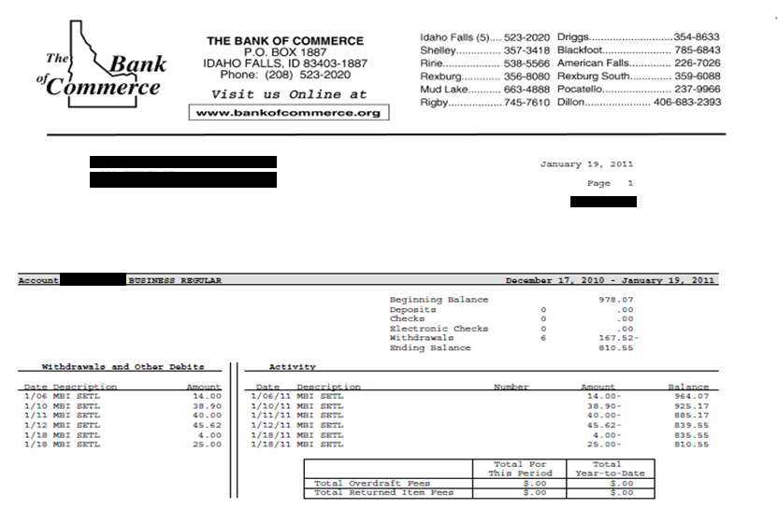
corporate bank statements

Slide 23
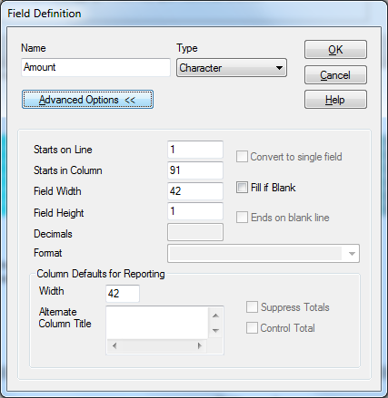
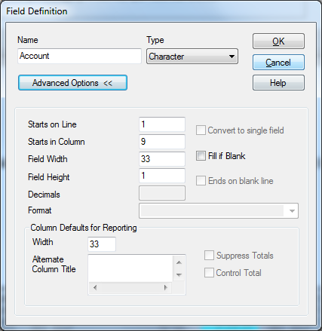
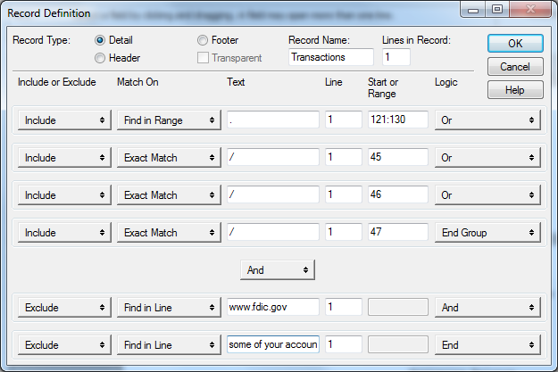
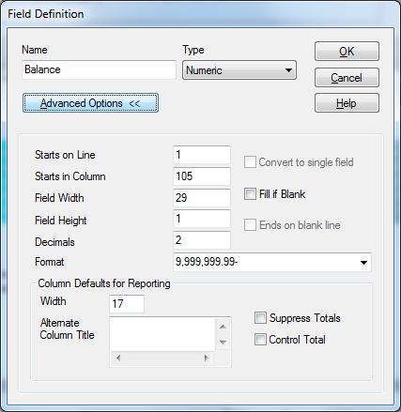
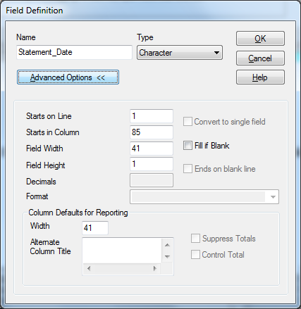
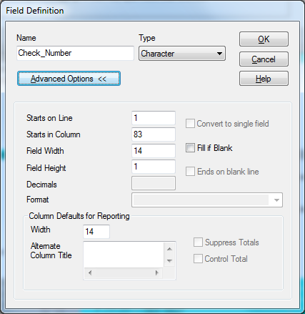
[data extraction]

Slide 24
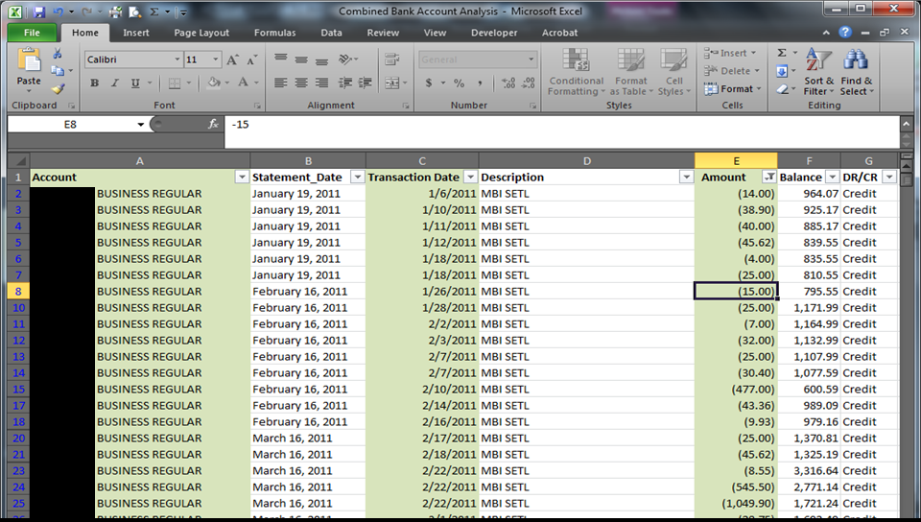

Slide 25
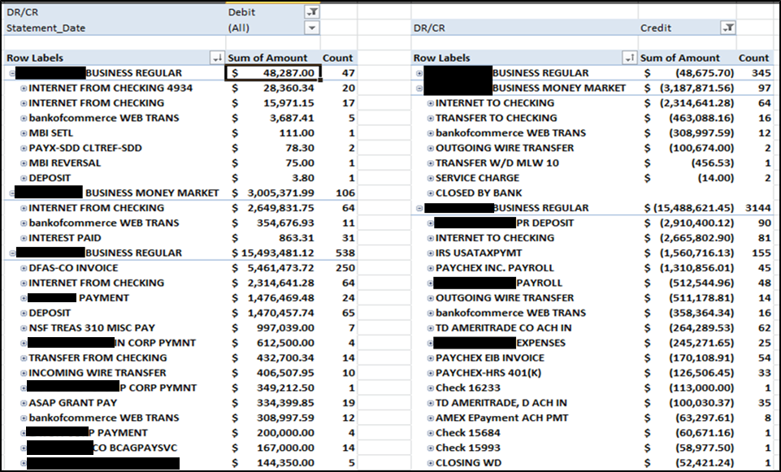
[track movement of funds]

Slide 26
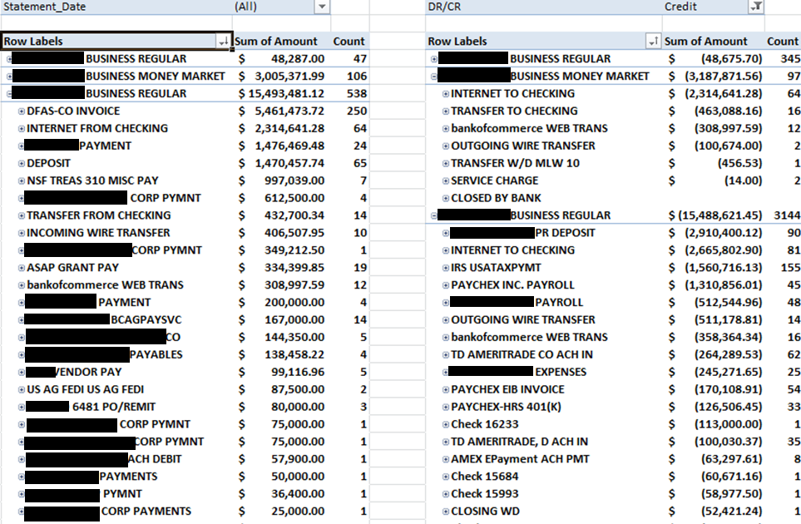
[identify sources of revenue]
Department of Defense
National Science Foundation
Department of Energy

Slide 27
[search for
specific transactions]
i.e. checks,
wire transfers,
tax payments, etc.

Slide 28
[review account balances
and identify anomalous activity]
what’s
going on here…
huh?!
and here…
missing data?

Slide 29
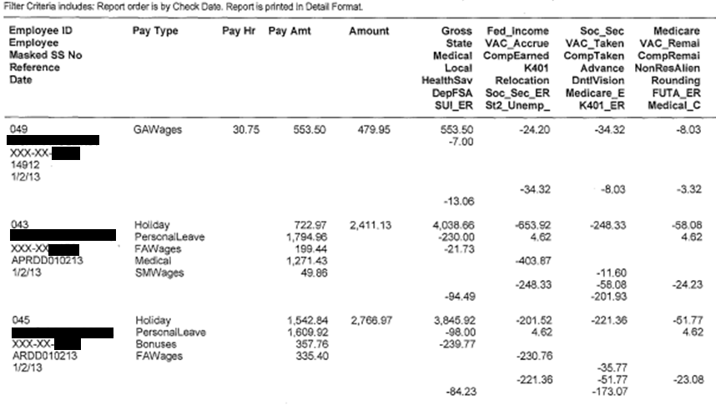
corporate payroll

Slide 30
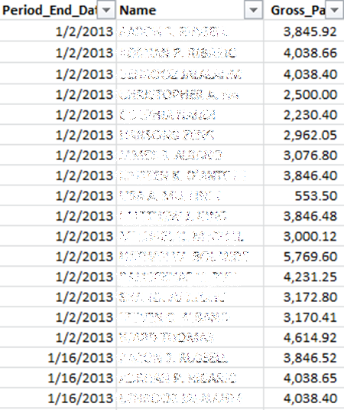
[converted payroll data]
can be used to annualize
gross pay, benefits, tax obligations, etc.

Slide 31
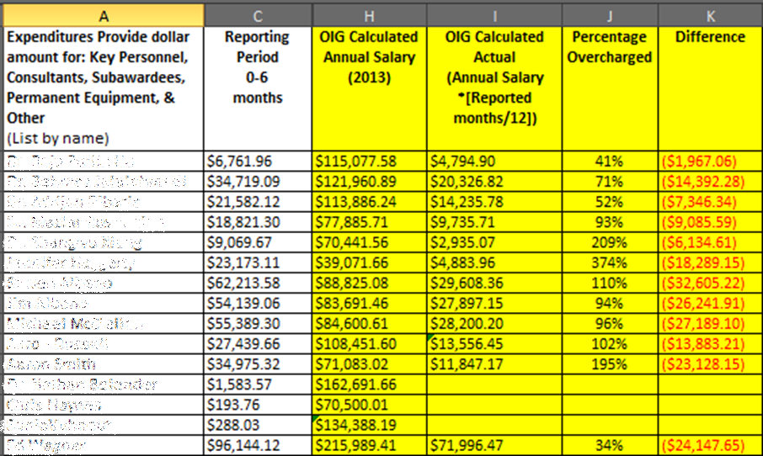
[labor overcharges]

Slide 32
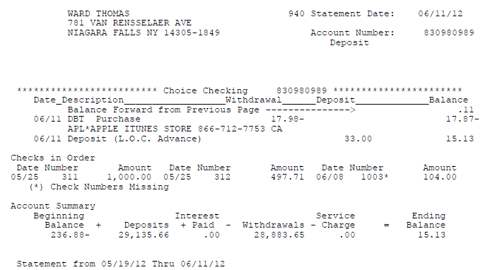
personal bank statements

Slide 33
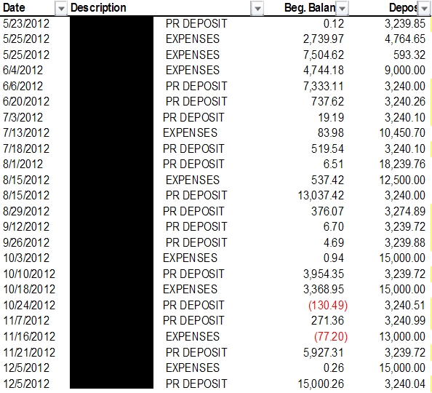
[excessive number of deposits]
83 deposits were made to the CEO’s account, but there were only 57 pay periods in this timeframe.

Slide 34
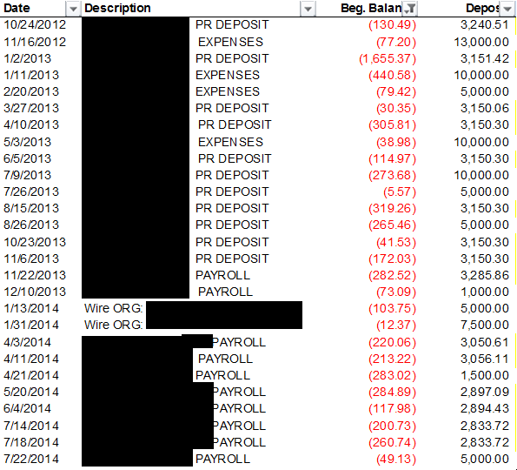
[insufficient funds]
49 of 83 (59%) deposits were made when the account balance was below $100 and 27 of 83 (33%) deposits were made when the account was below $0

Slide 35
[excessive sum of deposits]
Payroll Analysis between 05/23/2012 and 07/22/2014
Estimated Bi-weekly Pay (after tax): | $3,333.93
Bi-Weekly Pay Periods: | 57
Total Received from Company: | $424,497.20
Estimated Pay (after tax): | $190,034.04
Difference: | ($234,463.16)

Slide 36
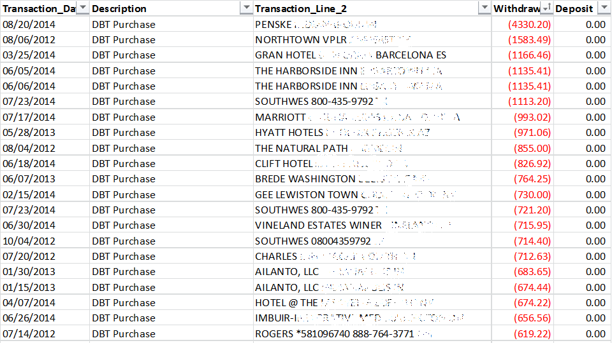
[analyze spending habits]

Slide 37
[assess financial health]

Slide 38
Keys to Success
Planning
Critical Thinking
Presentation

Slide 39
Group Discussion

Slide 40
Contact Information
Dr. Brett Baker, NRC OIG, Assistant Inspector General for Audit
Email: brett.baker@nrc.gov
Phone: 301-415-3485
Manny Mireles, NGA OIGI, Chief, Forensic Analysis Support Team
Email: manuel.j.mireles@nga.mil
Phone: 571-278-9827
Shiji Thomas, NSF OIG, Forensic Accountant
Email: ssthomas@nsf.gov
Phone: 703-292-4569

