Slide 1
Establishing A Comprehensive Data Analytics Capability Across the IG Community
Presented by
June 2017
Council of the Inspectors General on Integrity and Efficiency (CIGIE)
Data Analytics Options Working Group (DAOWG)

Slide 2
OIG Common Data Analytics Framework and Guidelines
Making Data Available and Actionable Against Fraud, Waste & Abuse
Analysis of data is a process of inspecting, cleaning, transforming, and modeling data with the goal of discovering useful information, suggesting conclusions, and supporting decision-making.
Five Principles of DA within an OIG Office.
Data Analytic Phases.
‘To Do’ Components of a Successful DA Function.
Project Selection ~ Best Practice within an OIG Office.

Slide 3
OIG Data Analytic Framework and Guidelines
Making Data Available and Actionable Against Fraud, Waste & Abuse
Five Principles
in the establishment of a
Data Analytics Capability within an OIG Office.
Data Analytic Mandate – must be relevant and focused on OIG’s mission and vision.
Reliable Return on Investment – expand OIG coverage with minimal (or no) incremental cost by identifying control issues/fraudulent activities in near real time, thereby shortening audit/investigation cycles.
Cost Effectiveness – reduce audit and investigative costs while increasing effectiveness by conducting continuous, broader, more proactive reviews.
Executive Champion – supporting executive champion/sponsor who has an agreed vision of the value and strategic direction of a data analytic function is a crucial component for its successful implementation.
Agile Development Approach – adopt Agile project management modular approach that combines controlled system development with rapid prototyping techniques that establishes and delivers realistic, timely and doable Audit/Investigator products.

Slide 4
OIG Data Analytic Framework and Guidelines
Making Data Available and Actionable Against Fraud, Waste & Abuse
Data Analytic Phases
Data Information Knowledge Actions Outcomes
Build consolidated Auditor/Investigator focused Foundation DA Systems.
Allow Audit/Investigation users to quickly identify what they expect and need to see.
Establish a continuous evolving product identifying where they should Investigate/Audit.
Provide discovery tools to reveal areas of risk and patterns of fraud previously unknown.
Analysis Capability to allow the analyst the ability to distinguish between correlations, coincidences and causes and find clear, deep understanding of complex situations. These analytic tools will allow the analyst to get beyond the what and to fully understand the where, the when, and the why for each flagged anomaly. Audit and Investigation analysts are the connection between data and insight.

Slide 5
OIG Data Analytic Framework and Guidelines
Making Data Available and Actionable Against Fraud, Waste & Abuse
Fundamental ‘To Do’ Components
of a Successful Data Analytic Function
Benchmark other organizations who have been successful and take advantage of “Best Practices and Lessons Learned”.
Determine what skill sets would be needed ‘over time’ and then establish an effective interview and selection methodology.
Research Legal & IT security requirements (SORN, CMA, FISMA, etc. …)
Seek program experts to help develop your data analytics projects.
Establish dynamic planning approaches using risk based analysis.
Audit – establish cause and effect risk models reflecting how best to allocate limited audit resources that focus on critical operational areas.
Investigations – develop data analytical models looking for known fraudulent patterns within key operational areas that have the highest return on investment for investigation resources.

Slide 6
OIG Data Analytic Framework and Guidelines
Making Data Available and Actionable Against Fraud, Waste & Abuse
Project Selection
~
Best Practice
Canvass senior audit and investigations management for those business areas of priority and interest.
Identify that project whose objective is readily doable in a limited period of time AND has known low hanging fruit for immediate impact.
Set expectations and secure resources - don’t expect to get a Cadillac on VW budget.
Rule Based analytic systems will generate False Positives, ‘If It Looks Like Fraud, and Smells Like Fraud, It May Still Not Be Fraud’. Develop within the analytic process, filtering mechanisms to exclude the low probable anomalies.
Deliver on time and don’t miss milestones; otherwise jeopardize losing the “Champion” supporters.
Be prepared for unintended consequences/results.

Slide 7
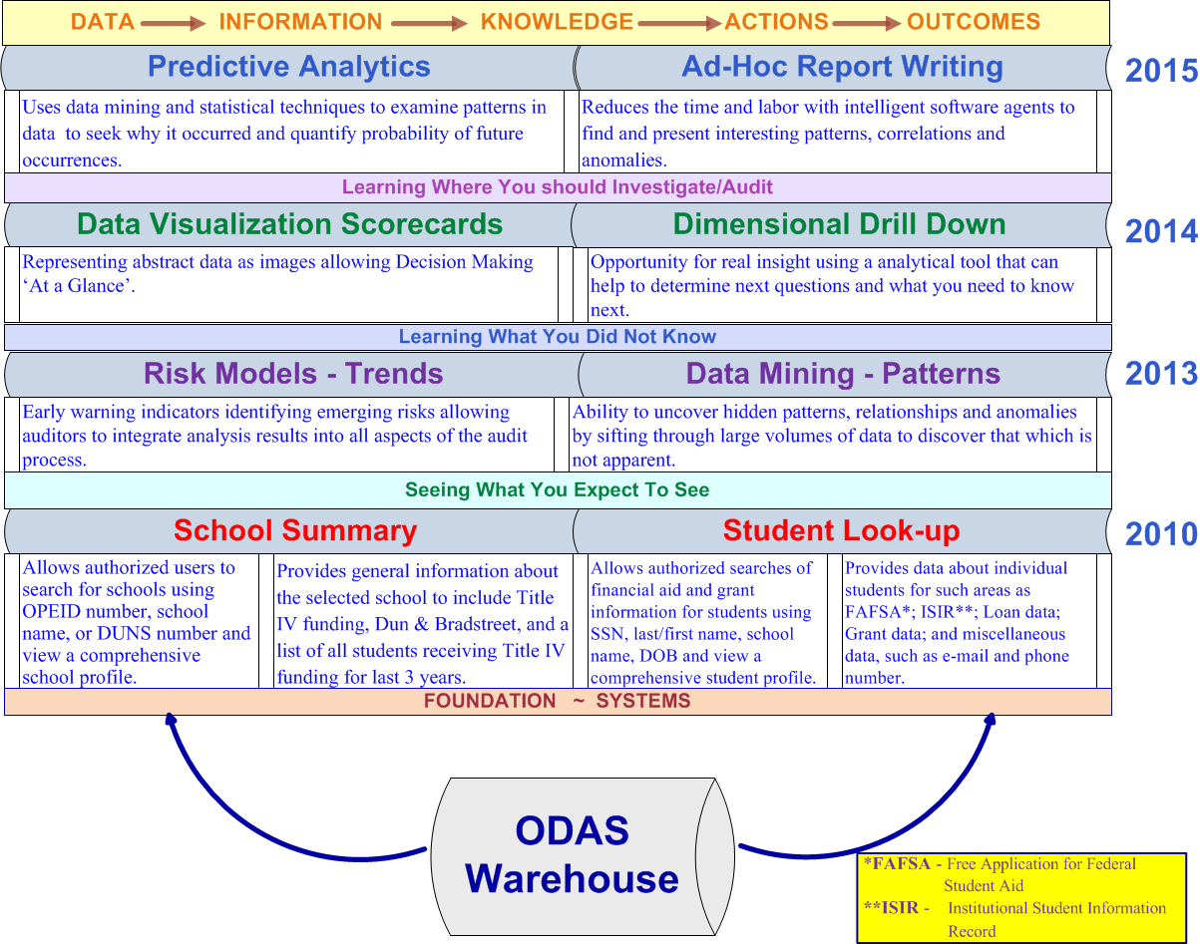
5

