Slide 1
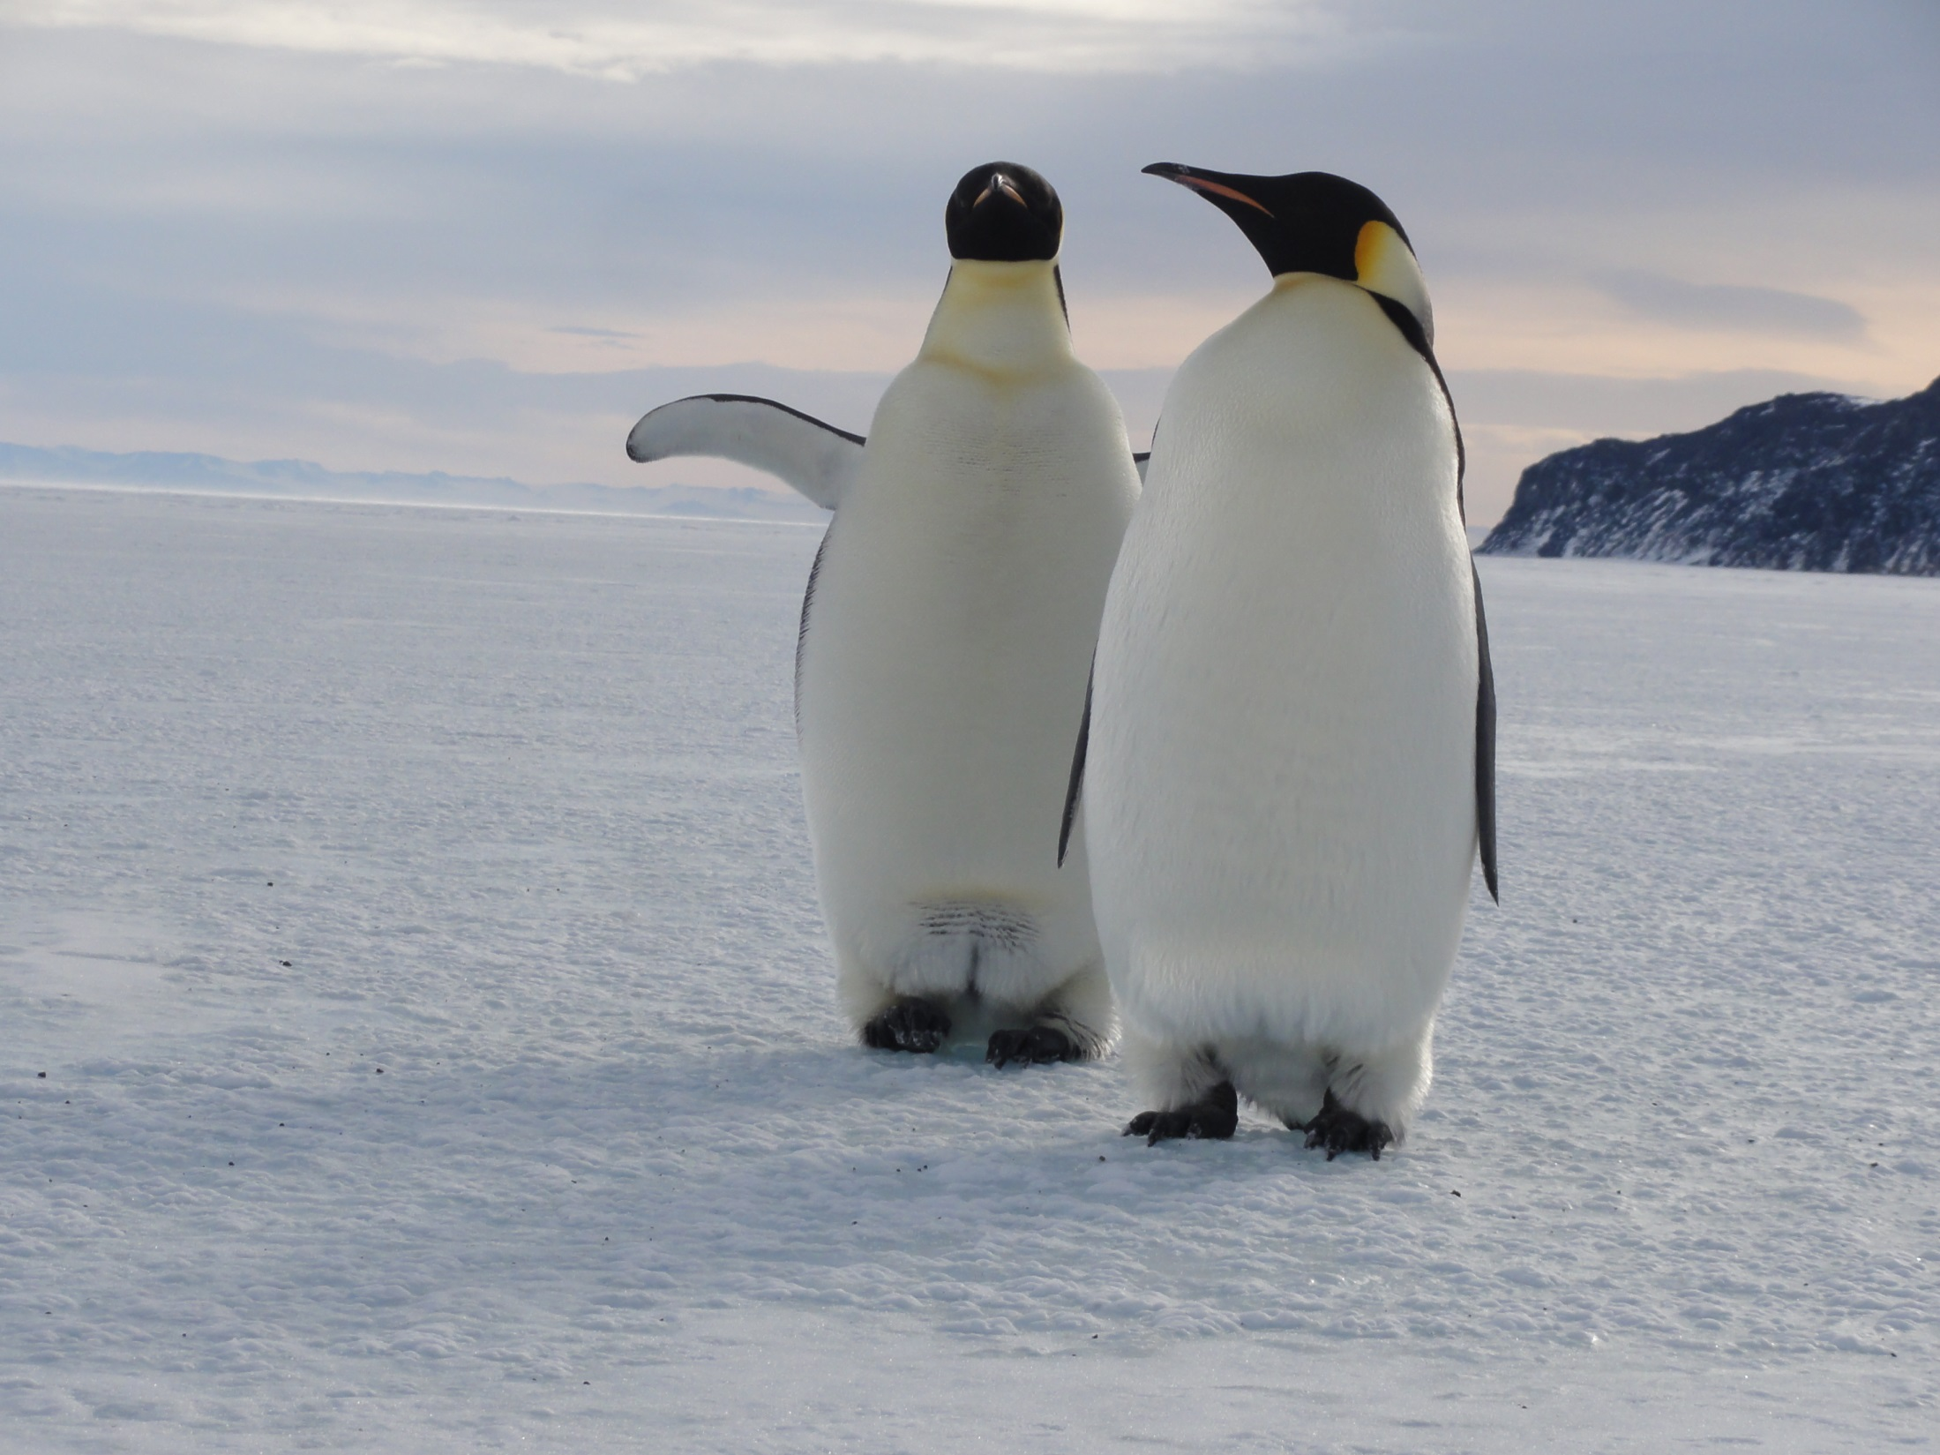
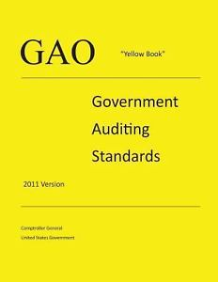
Oh The Places You’ll Go with the Yellow Book in Tow!
Kelly Stefanko & Jeff Stitz
Audit Managers
Office of Inspector General
National Science Foundation
Notes:
Kelly

Slide 2
What is the National Science Foundation?
Independent federal agency created by Congress in 1950
$7.6 billion budget
Issue limited-term grants -currently about 11,000 per year
Funding source for approximately 24 percent of all federally supported basic research conducted by America's colleges and universities
Guardian of the Antarctic for the U.S.
Notes:
Kelly

Slide 3
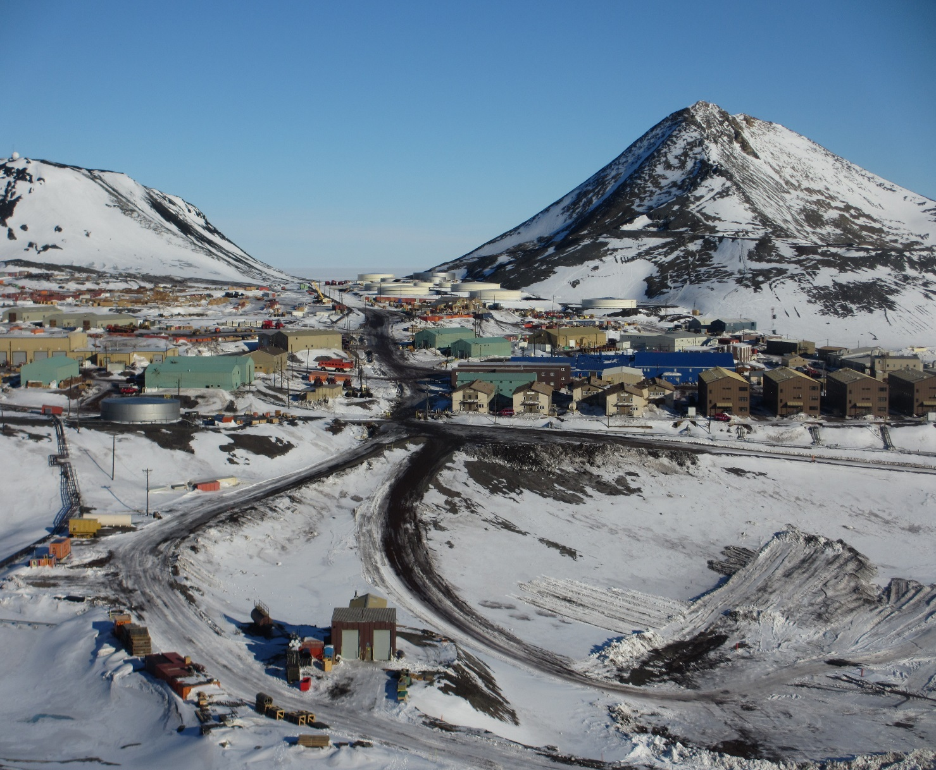
Why Audit in Antarctica?
NSF’s largest contract is for Antarctic Support ($2 billion over 13.5 years if all options are exercised).
NSF pays its Antarctic Support Contractor (ASC) roughly $174 million a year to operate and maintain U.S. Antarctic facilities to support science that is conducted in Antarctica.
3,200 people travel to Antarctica annually as part of the U.S. Antarctic Program (USAP), spending between a few days and up to an entire year at or transiting through one of three year-round research stations – McMurdo, Amundsen-Scott South Pole, and Palmer.
Allegations of misconduct received.
Unique environment provides unique challenges.
Notes:
Jeff

Slide 4
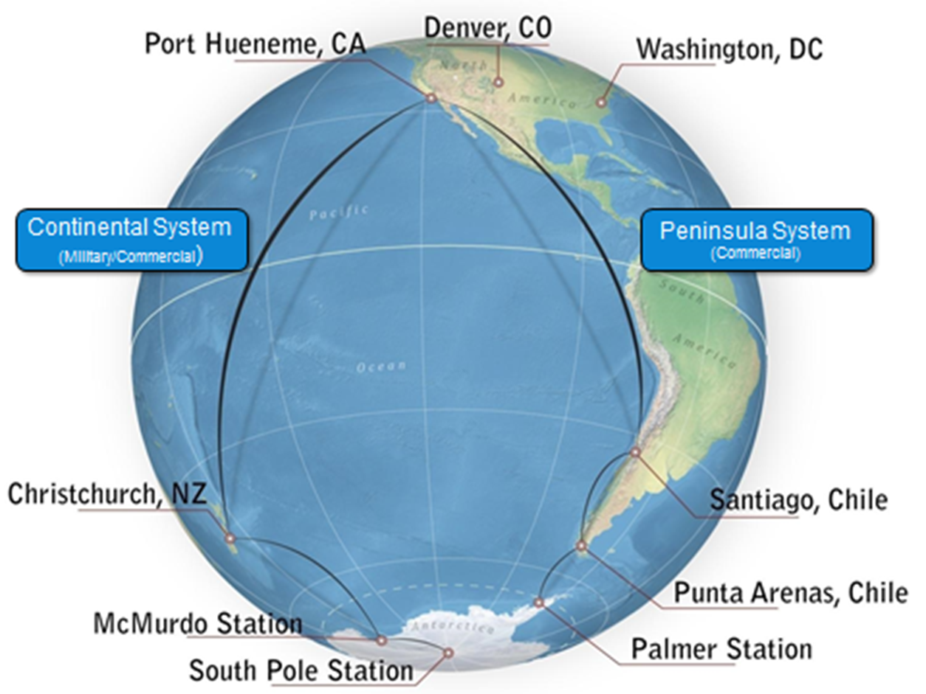
What is Antarctica like?
Remote - Roundtrip from Washington, DC to South Pole involved 10 flights and 60 hours of flying.
Barren - No bugs, no pets, no kids, no cellphones! The only wildlife seen were a handful of seals at a distance and the native skua bird (comparable to a hawk). Due to time of year we missed the penguins.
Surreal – We landed in a U.S. Air Force C-17 on million dollar snow skis on an ice shelf.
Beautiful – It was mostly clear, minimal wind and sunshine…all day every day (the sun never set).
Station Temperature Ranges –
McMurdo: -58°F to 46°F
South Pole: -76°F to -18°F
Palmer: 14°F to 36°F
Notes:
Jeff

Slide 5
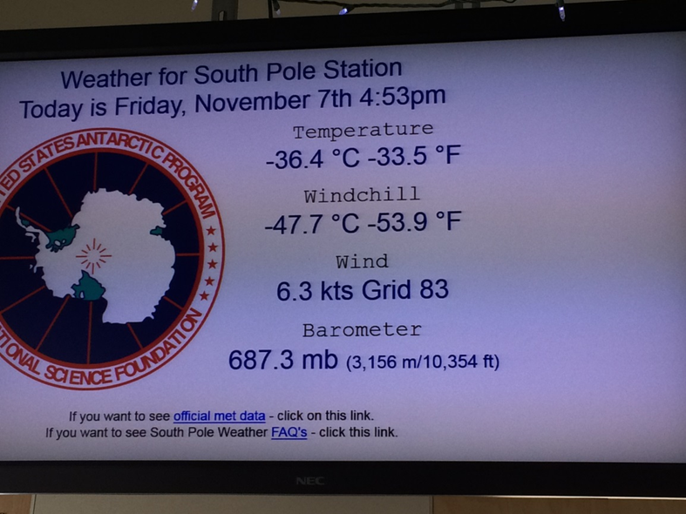
Logistical Challenges
Antarctica is the coldest, windiest, driest, and most remote continent on earth. Average elevation is more than 6,500 feet and 98% is covered by ice.
South Pole elevation is 9,300 feet (altitude sickness is a concern).
Because of the harsh and isolated environment, effective health and safety practices are critical to protecting the people working there.
Notes:
Jeff

Slide 6
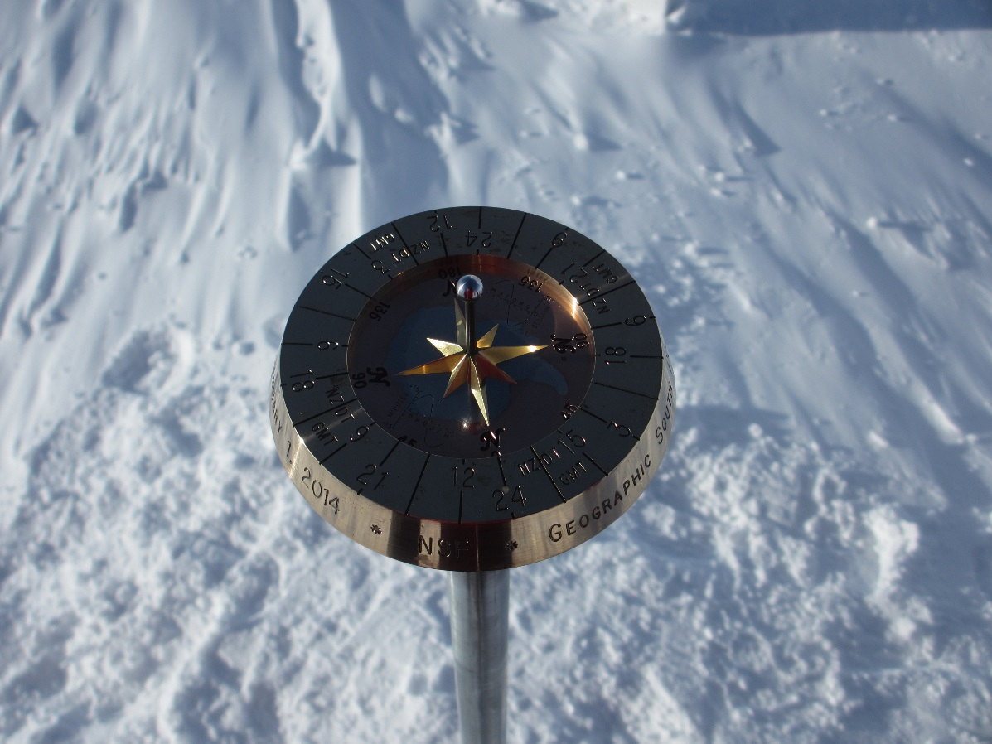
Constraints
Short duration of time to complete fieldwork in Antarctica (5 days).
The need to be flexible due to potential for weather related flight cancellations to and from McMurdo and South Pole stations.
Only four hours to perform work at South Pole Station.
Compete with other priorities of limited military flights getting U.S. and other nation’s staff in/out and around Antarctica.
Limited internet connection and capability
Notes:
Jeff

Slide 7
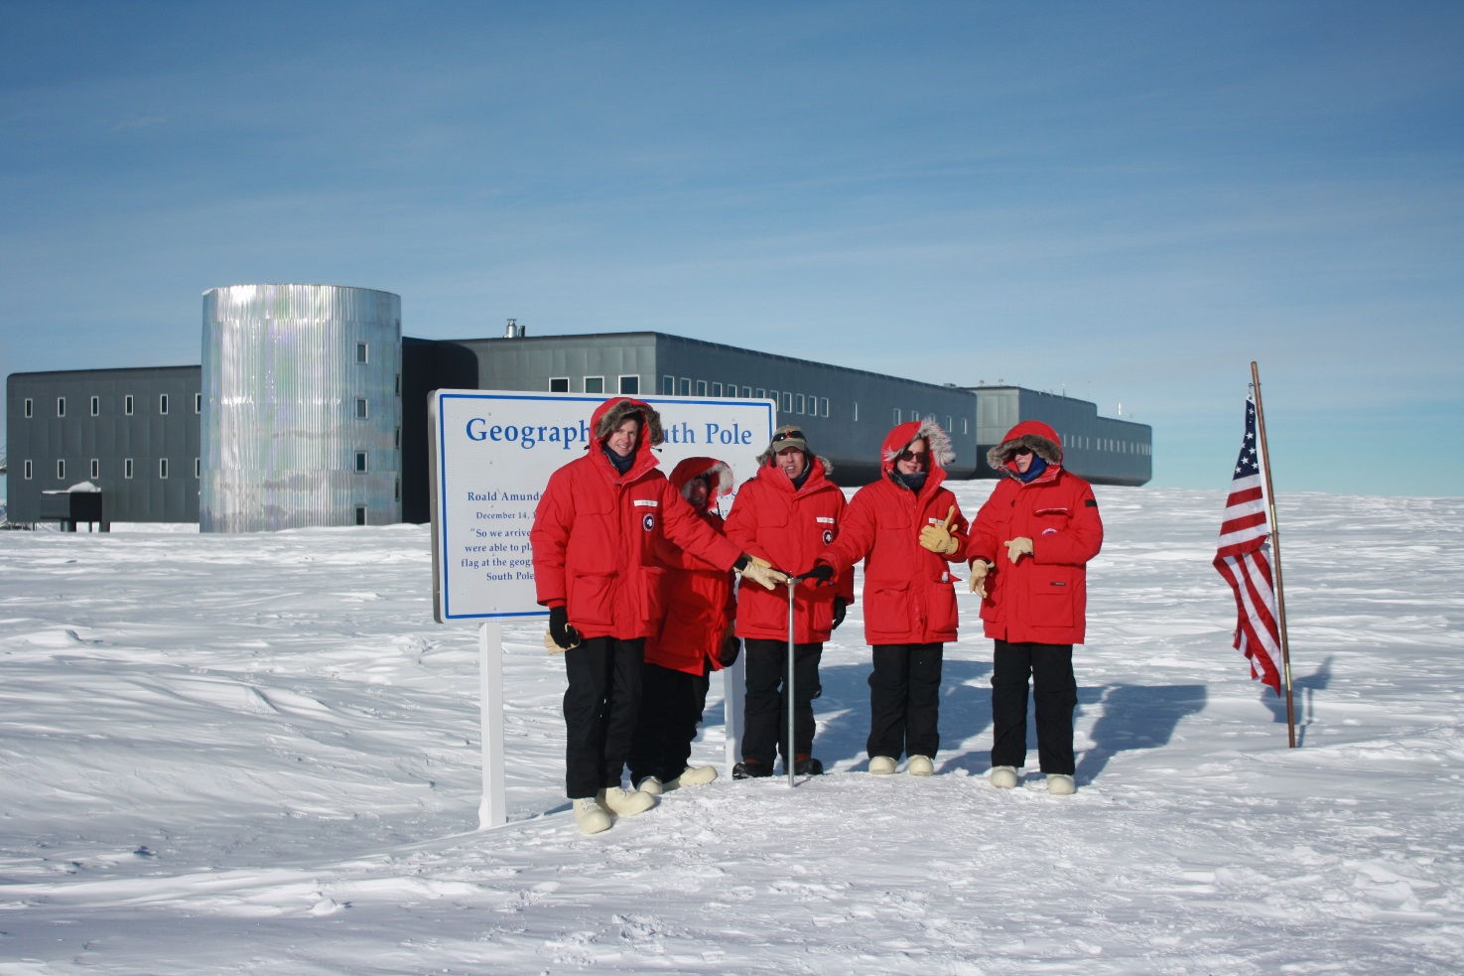
Audit Objective
Objective: To assess the effectiveness of NSF’s oversight and the Antarctic support contractor’s performance to ensure the overall health and safety of USAP participants.
Notes:
Kelly -

Slide 8
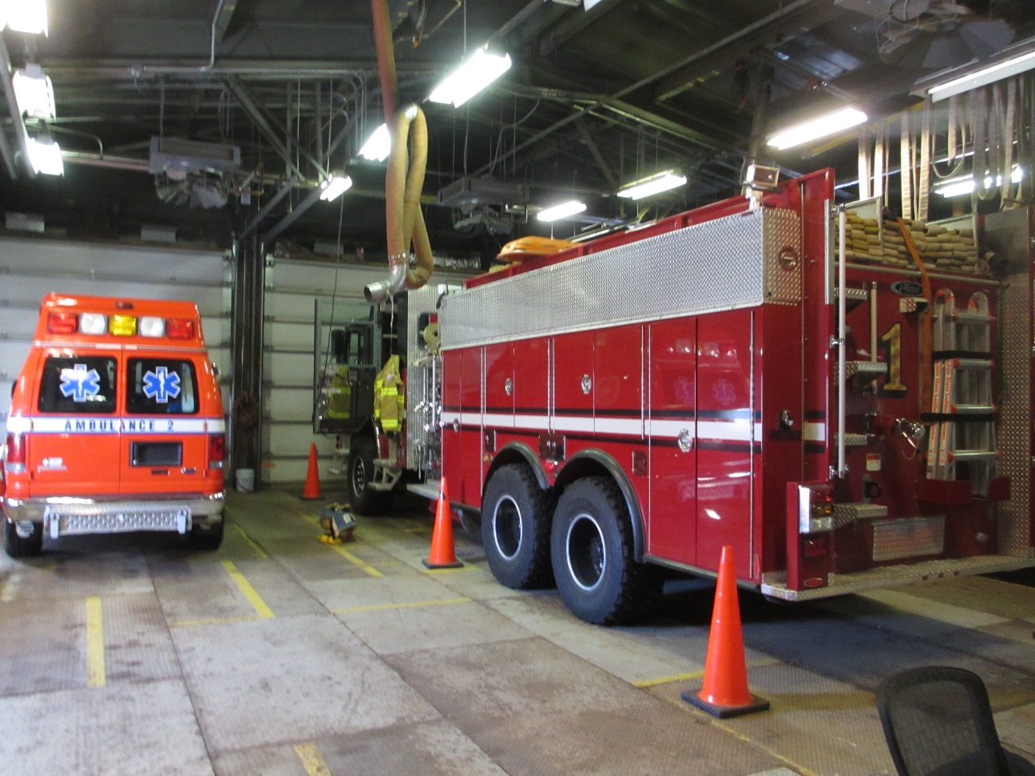
What We Did
Conducted 22 formal interviews and more than 12 informal conversations with participants. People interviewed included scientist; science lab, medical, and fire staff, HR managers, a chaplain, and beverage/bar and shop managers.
Toured fire, medical, and recreation operations as well as the science lab at both McMurdo and South Pole stations. Also toured the New Zealand support operation.
Established an anonymous tip line.
Held office hours for people to talk with us when they were off duty.
Due to seasonal limitations, work hours are 10 hours per day, provided more time to hold meetings and interviews.
Notes:
Kelly

Slide 9
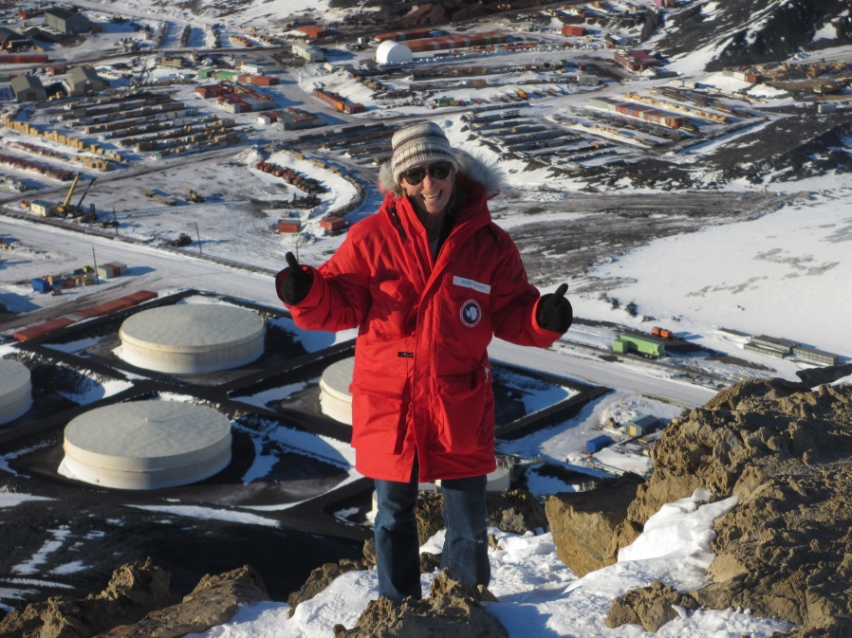
What We Found
In general, NSF’s oversight and the contractor’s performance were effective in ensuring adequate health and safety.
We did identify four areas for improvement.
Notes:
Kelly

Slide 10
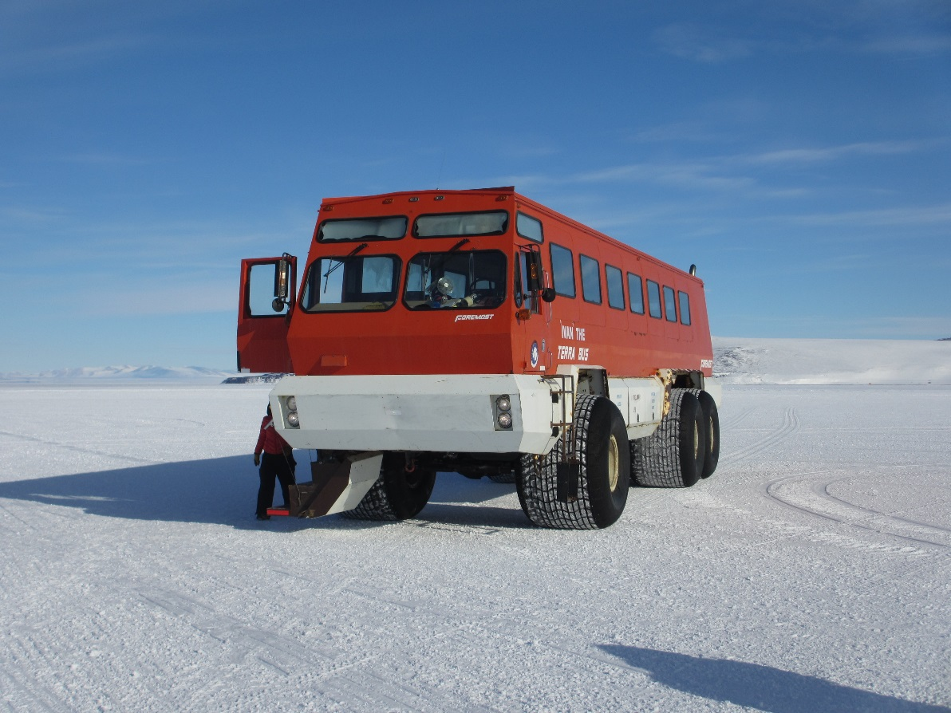
1. Tracking and Reporting Misconduct
All USAP participants are required to agree to the Code of Conduct.
No USAP-wide log or list of misconduct incidents.
Ensure consistent discipline of USAP participants.
Recommendation.
Notes:
Kelly

Slide 11
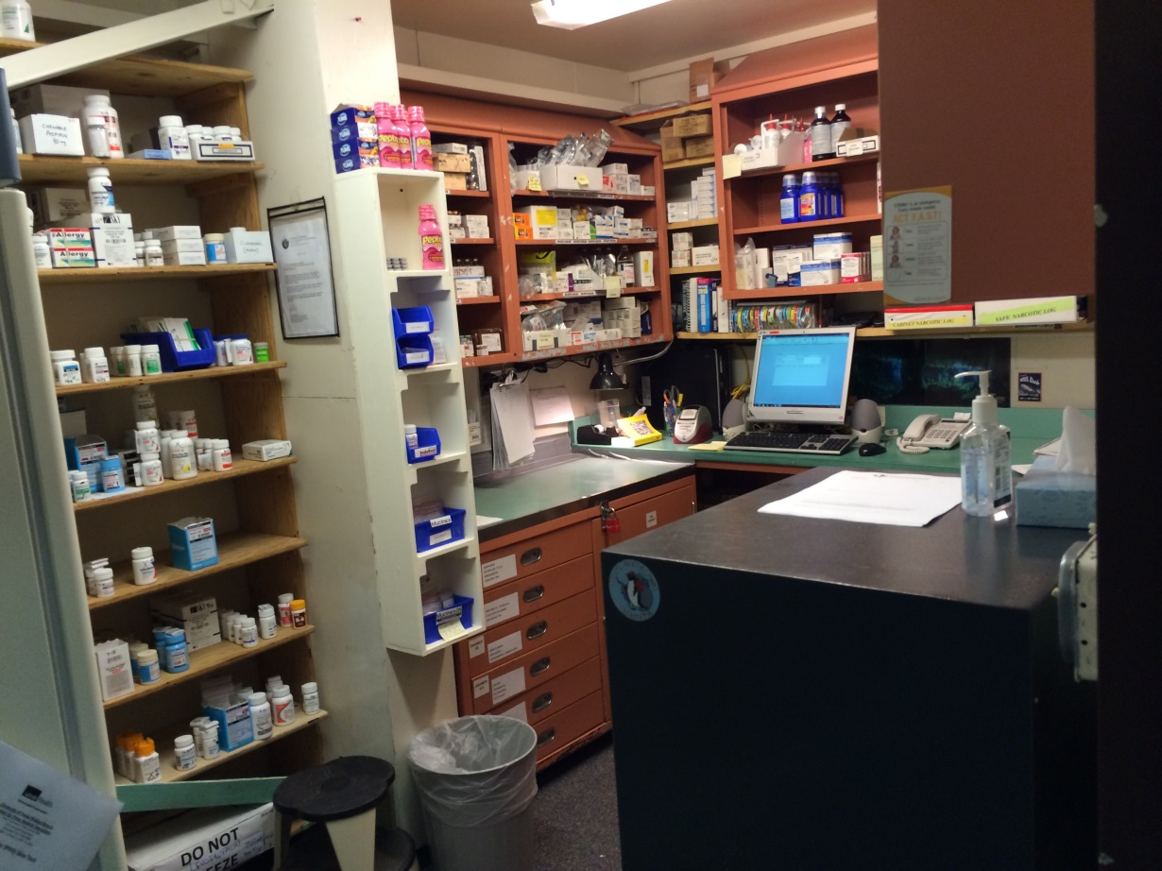
2. Pharmacy Operations
Notes:
KELLY

Slide 12
3. Law Enforcement Tools & Training
Station managers appointed as Special Deputy U.S. Marshals
Raised urgency of a site visit
Recommendation
Notes:
KELLY

Slide 13
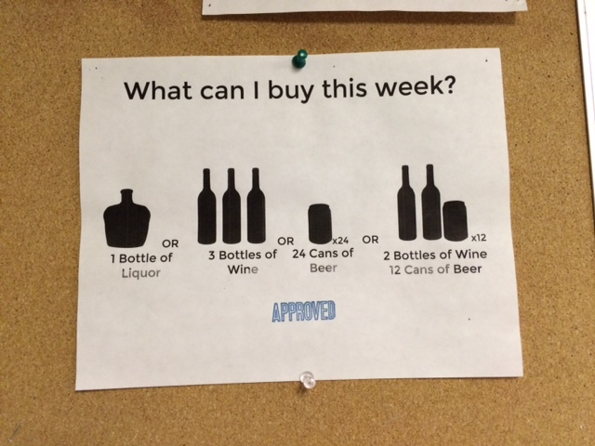
4. Use of Breathalyzers
Alcohol Limits enforced
Concern with employees operating heavy machinery
Breathalyzers not calibrated or considered reliable
Recommendation
Notes:
JEFF

Slide 14
Brewing Beer at the South Pole
IG found beer on tour of science lab.
Informal conversation to identify contractor.
Violation of Antarctic Treaty – need yeast, a living organism to brew beer.
Violation of USAP Alcohol Policy.
Notes:
JEFF

Slide 15
Media Attention
Article headlines written from our audit report:
The Atlantic, “On Getting Drunk in Antarctica”
U.K. Daily Mail, “Scientists in Antarctica drink so much they get into fights and it’s a growing problem”
GEEK, “Scientists getting drunk in the South Pole is becoming a problem”
WIRED, “Scientists in Antarctica Drink A Lot. Maybe Too Much”
LiveScience, “Cold Comfort: Why People in Antarctica Are Such Boozehounds”
Notes:
JEFF

Slide 16
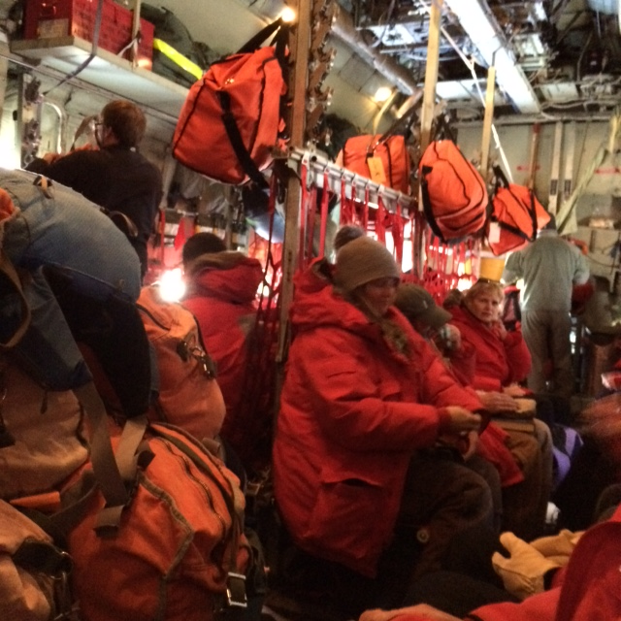
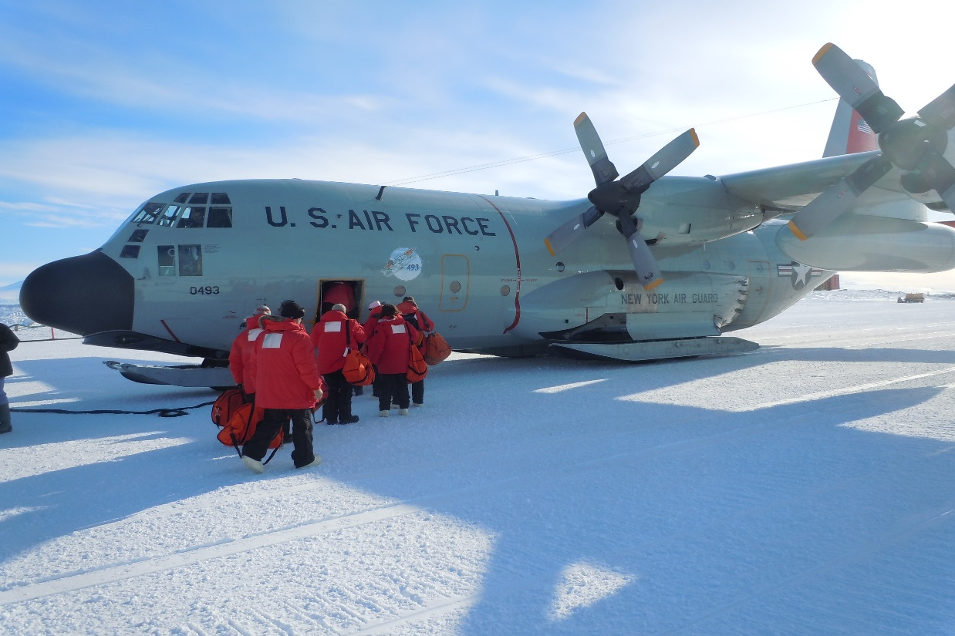
Unique Experiences
Military transport
Giving orders to the IG and AIGA - being audit team players.
Being part of the rumor mill.
Practice what you preach (safety and moderation)!
Everyone adapts
Everyone plays a valuable role in supporting the mission.
Notes:
Jeff

Slide 17
Questions?
Notes:
Jeff/Kelly

