Slide 1
U.S. Department of Justice Office of the Inspector General
Audit of the Drug Enforcement Administration’s
Aviation Operations With the
Department Of Defense In Afghanistan

Slide 2
U.S. Department of Justice Office of the Inspector General
DEA and DOD spent more than $86 million on an aircraft to fly surveillance operations in Afghanistan; over 7 years after the purchase, the aircraft has never flown in Afghanistan.

Slide 3
DEA’s Mission in Afghanistan
Deny narcotic-generated funding to terrorists and insurgents.
Break the nexus between the insurgency and drug trafficking.
Promote the rule of law and diminish the overall drug threat from Afghanistan.
U.S. Department of Justice Office of the Inspector General

Slide 4
Allegation that DEA misused DOD funds that were intended to support DEA’s counternarcotic aviation operations in Afghanistan by misdirecting, diverting and spending the money for purposes unrelated to the DEA’s Afghanistan Aviation Operations.
U.S. Department of Justice Office of the Inspector General

Slide 5
Objective
To assess DEA’s Global Discovery program and its compliance with the MOUs that DEA entered into with the DOD for supporting DEA’s aviation operations in Afghanistan.
U.S. Department of Justice Office of the Inspector General

Slide 6
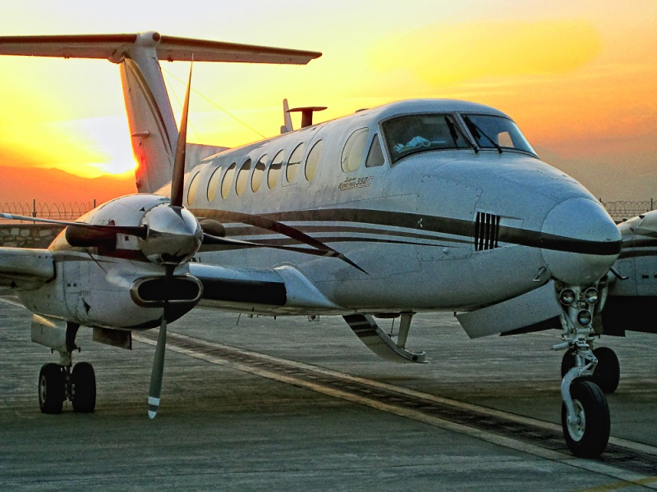
DEA’s Aviation Operations in Afghanistan
Based at Camp Alvarado since 2008
1 Supervisor, 3 Special Agent Pilots, and 8 contractors
(3 pilots and 5 mechanics)
Operated 2 Beech King Air 350 aircraft
DEA removed all aviation assets in July 2015
U.S. Department of Justice Office of the Inspector General
Notes:
DEA reopened Kabul Country Office in 2003
2013 – 97 authorized permanent positions and 13 contractor positions
DEA personnel augmented by Counternarcotic Police of Afghanistan
39 drug trafficking organizations disrupted, 10 organizations dismantled.
Budget of $58.6 Million (FY 2013)

Slide 7
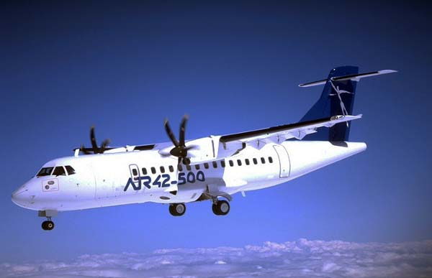
Global Discovery Program
Joint Project between the DOD and DEA to modify a DEA transport aircraft with advanced surveillance capabilities for use within the combat environment of Afghanistan.
U.S. Department of Justice Office of the Inspector General
Notes:
1. the ability to perform precision geo-location operations;
2. electro-optical infra-red video capability, utilizing two MX‑20 cameras;
3. the integration of data within the DOD’s Distributed Command Ground System architecture to improve information sharing among the DEA and DOD;
4. ground search synthetic aperture radar with the ability to interface with the aircraft’s sensors;
5. air to ground radios providing up and down link of data and radio transmissions to and from the aircraft; and
6. self-protection, threat adaptive countermeasures dispenser system.

Slide 8
Global Discovery Program Funding
Fiscal Year (s) | Source of Funding/Purpose | Expended
2008 | DEA Direct Appropriation to purchase ATR 500 | $8,572,638
2010 - 2014 | DOD Direct Appropriations for ATR 500 Modification and Hangar | $67,854,232
2012 – 2015 | DEA MOUs with DOD for ATR 500 parts & Aviation Operations in Afghanistan (Unallowable charges $1,664,699) | $10,132,290
Total |  | $86,559,160
U.S. Department of Justice Office of the Inspector General

Slide 9
Procurement of the Global Discovery Aircraft
DEA solicited for either an ATR 42-320 or an ATR 42-500:
capable of accommodating 4 crew members and 42 passengers;
provide a cargo opening;
FAA certified; and
in serviceable condition with not more than 25,000 hours total time on the airframe and either engine.
The DEA estimated spending $5.8 million on the aircraft purchase and received six offers from two different companies.
U.S. Department of Justice Office of the Inspector General

Slide 10
DEA’s Technical Evaluation for Procurement of the Global Discovery Aircraft
Company | Aircraft Offered | Offer Price | Factor 1 Technical Evaluation Score | Pass/Fail based on Factor 1
Nordic Aviation Contractor A/S | Used ATR 300 | $2,600,000 | 9 | Fail
CSI Aviation Service, Inc. | Used ATR 320 | $4,834,375 | 19 | Fail
Nordic Aviation Contractor A/S | Used ATR 320 | $4,300,000 | 21 | Fail
Nordic Aviation Contractor A/S | Used ATR 300 | $5,200,000 | 24 | Pass
CSI Aviation Services, Inc. | Used ATR 500 | $8,588,965 | 29 | Pass
CSI Aviation Services, Inc. | Used ATR 500 | $9,997,680 | 30 | Pass
U.S. Department of Justice Office of the Inspector General
Notes:
ª The score is the average of the two Technical Evaluators scoring based on Factor 1.
^{b} CSI’s offer for aircraft MSNs 139 and 549 were provided to the DEA during negotiations that occurred prior to the technical evaluations and after the DEA’s solicitation had closed on August 7, 2008. The original offer price of ATR MSN 549 was reduced by $16,327 to the DEA’s final purchase price of $8,572,638.

Slide 11
We found that the DEA did not fully comply with the FAR and its own solicitation in purchasing the aircraft.
Specifically, DEA:
did not ensure that legitimate needs were identified and trade-offs evaluated to ensure that the aircraft being purchased met operational needs in the most cost‑effective manner.
failed to evaluate, as required by the FAR, each bid received on all the factors it listed in its solicitation.
U.S. Department of Justice Office of the Inspector General
Notes:
1. As a result, the Aviation Division did not take into account, when purchasing the ATR 500, the time and cost it would incur to establish an infrastructure of pilots, mechanics, trainers, and spare parts required to operate the aircraft compared to the cost of leveraging its existent fleet infrastructure.
2. Therefore, the DEA ultimately awarded a contract for the purchase of an aircraft that cost $3 million more than it had estimated, even though that aircraft potentially did not best meet the DEA’s technical needs and performance requirements.
Given these issues, we question the DEA’s procurement of the aircraft for $8,572,638 because it did not fully adhere to federal acquisition regulations and was never used for the purposes for which it was procured.

Slide 12
ATR 500 Missions Flown
Between October 2008 and March 2012
Date | DEA Support Provided | Purpose of Flight Missions | Missions Flown
10/01/08 – 09/31/10 | Flight Logs | Transport personnel; evidence; equipment; and prisoners. | 119
10/01/10 – 03/19/12 | Mission Reports |  | 108
Total |  |  | 227
U.S. Department of Justice Office of the Inspector General

Slide 13
We found that the DEA …
transferred its second most expensive aircraft to the DOD’s contractor without any documentation of the transfer;
had no formal agreement with the DOD and its contractors documenting the parameters of the ATR 500’s modifications;
and spent $8,467,591 on spare parts for ATR 500 that is still un-flyable.
U.S. Department of Justice Office of the Inspector General

Slide 14
Office of the Deputy Assistant Secretary of Defense for Counternarcotics and Global Threats
Global Discovery Program Office
May 2010 – January 2013
Naval Surface Warfare Center
(NSWC Crane)
Global Discovery Program Office Since February 2013
Army Research Laboratory (ARL)
Contractor
Concurrent Technologies Corporation (CTC)
Contractor
Sierra Nevada Corporation (SNC)
Subcontractor
Summit Aviation
U.S. Department of Justice Office of the Inspector General

Slide 15
DOD’s Funding for the Global Discovery Program
Fiscal Year (Funds Budgeted) | DOD Program Office | Expended | Cumulative Expended
2010 | NSWC Crane | $26,840,076 | $26,840,076
2011 | NSWC Crane | $11,825,071 | $38,665,147
2012 | NSWC Crane | $5,489,531 | $44,154,678
2013 | ARL | $18,365,049 | $62,519,727
2014 | ARL | $3,478,515 | $65,998,242
Total |  | $65,998,242
U.S. Department of Justice Office of the Inspector General

Slide 16
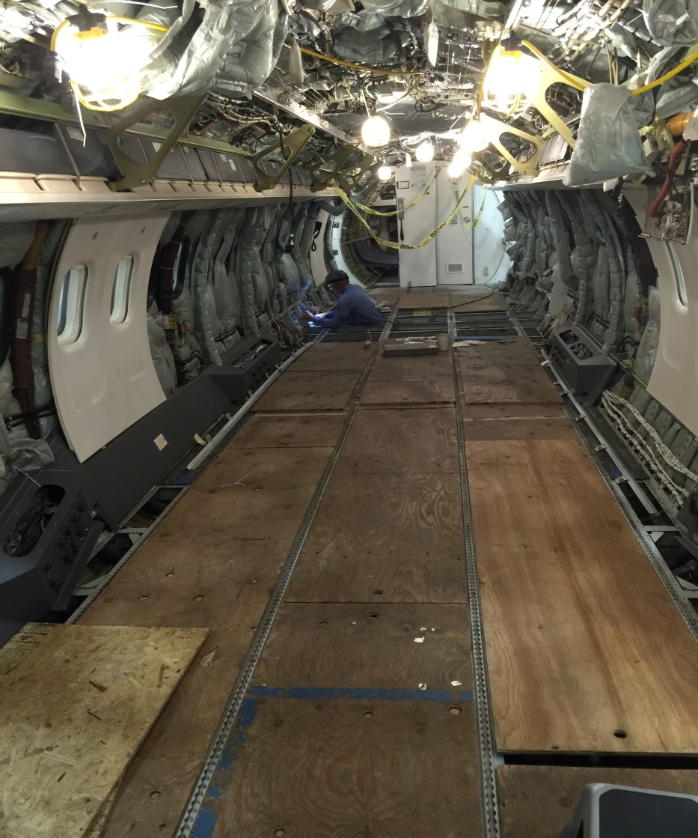
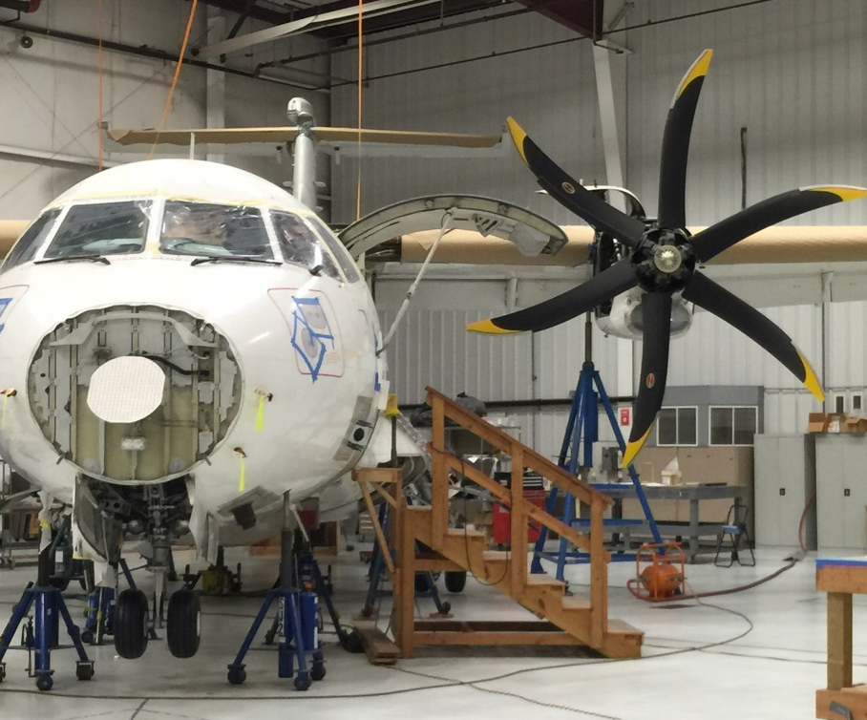
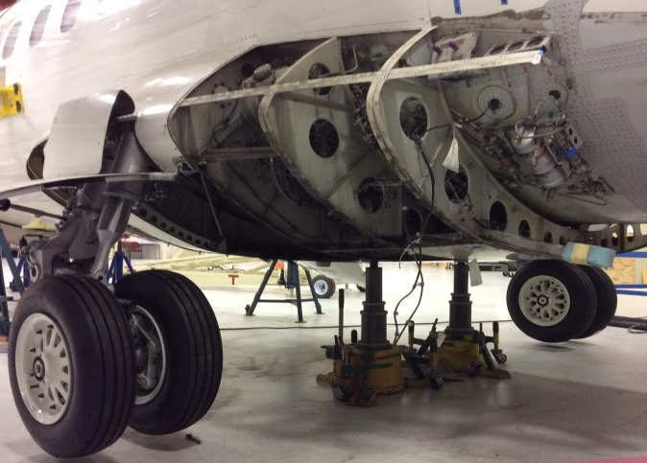
Global Discovery Program Problems, Delays, and Overages
U.S. Department of Justice Office of the Inspector General

Slide 17
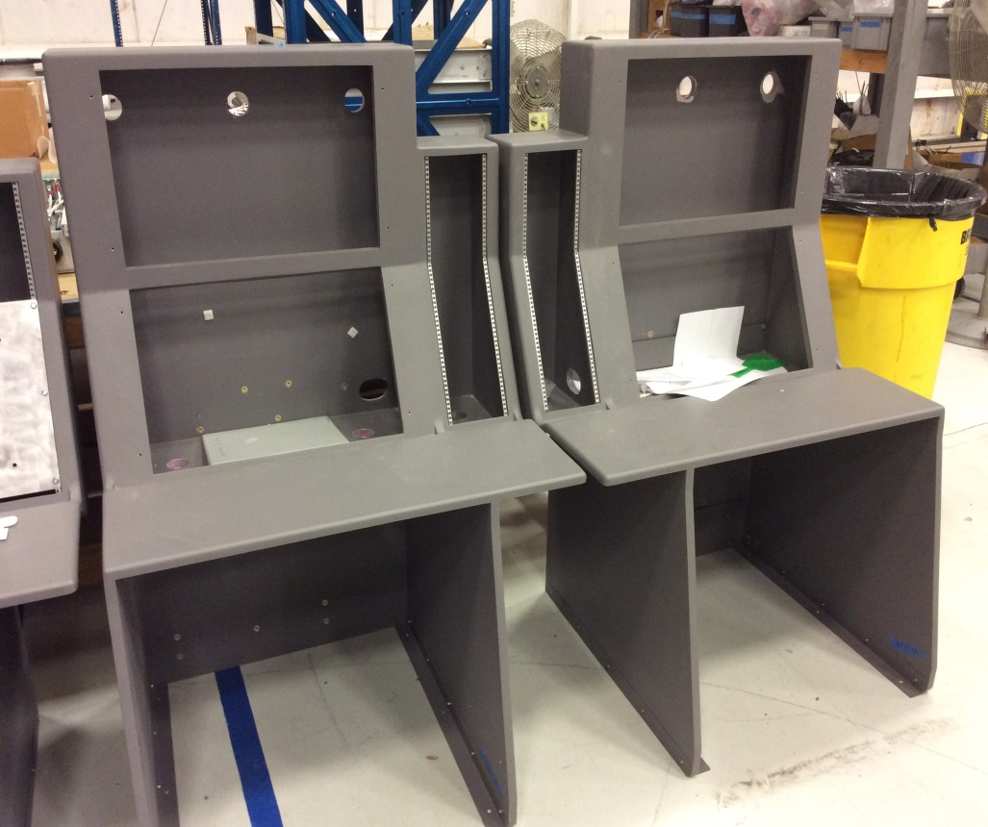
Global Discovery Program Problems, Delays, and Overages
U.S. Department of Justice Office of the Inspector General

Slide 18
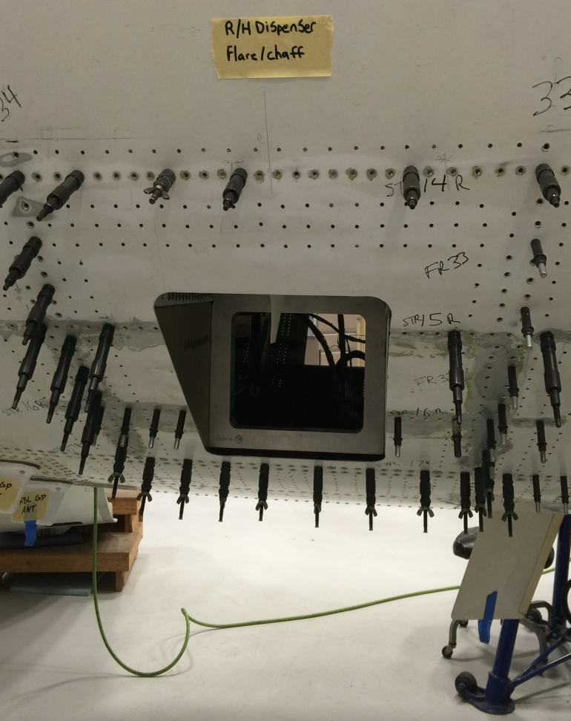
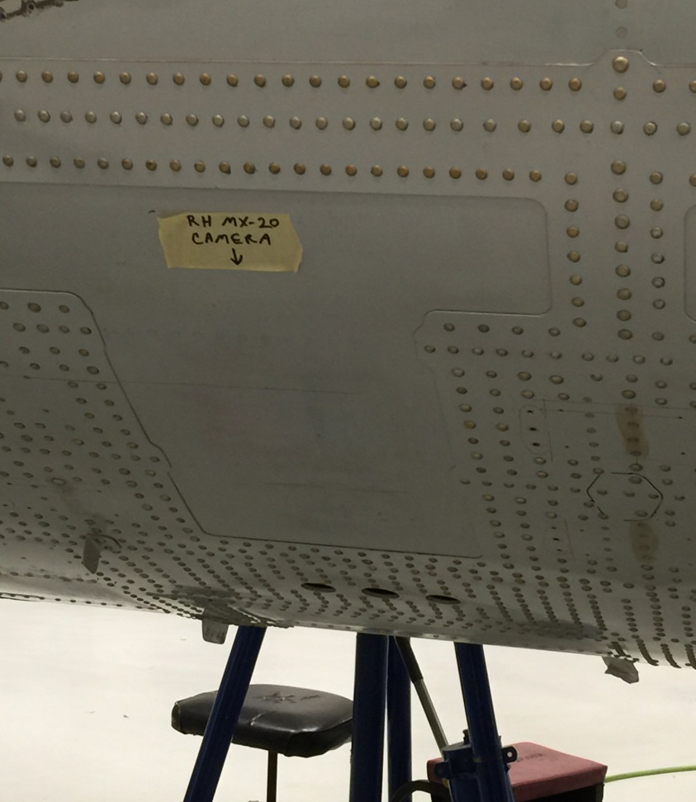
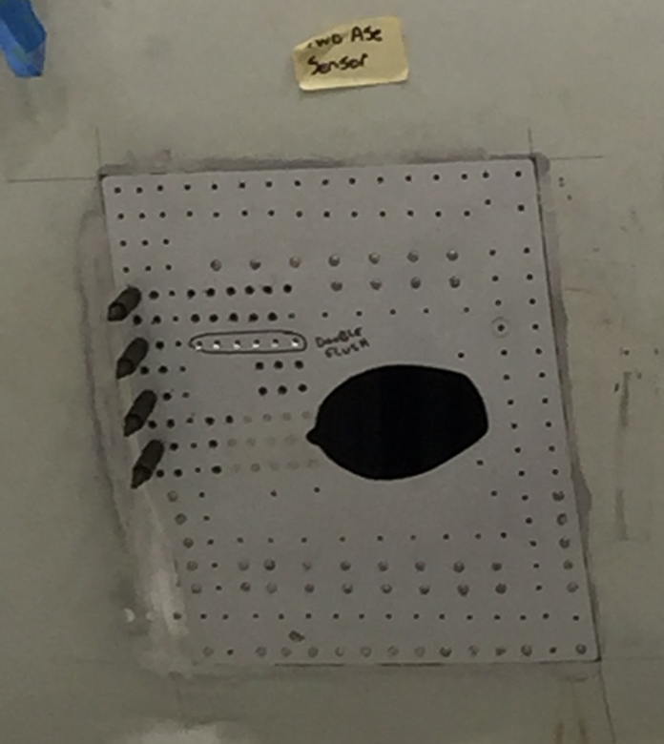
Global Discovery Program Problems, Delays, and Overages
U.S. Department of Justice Office of the Inspector General

Slide 19
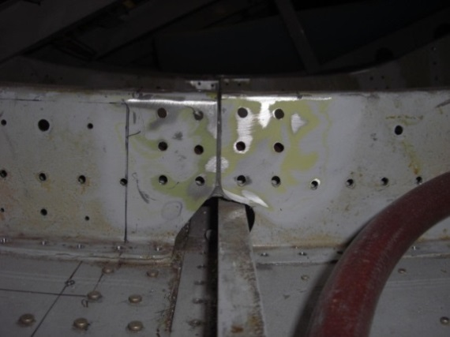
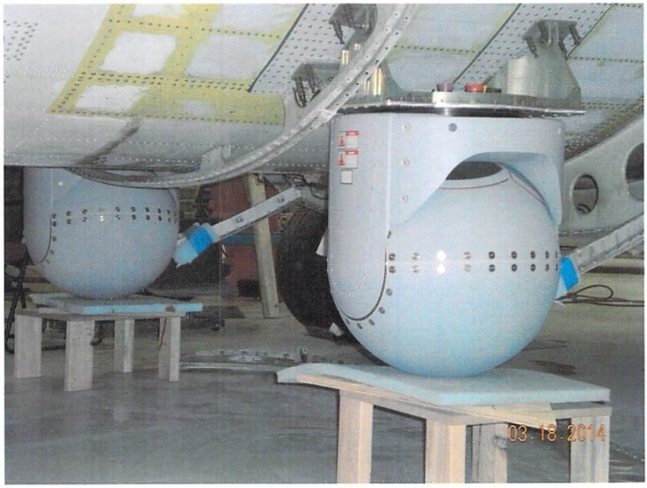
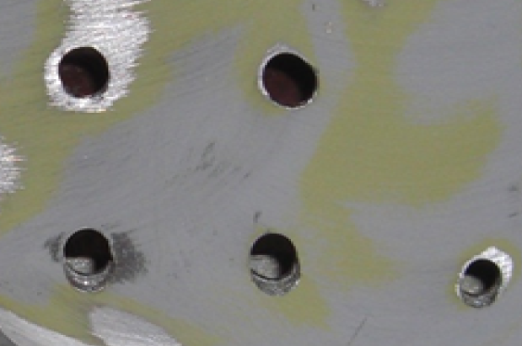
Global Discovery Program Problems, Delays, and Overages
U.S. Department of Justice Office of the Inspector General

Slide 20
Global Discovery Program Intended Delivery Dates Missed
March:
3rd Delivery
Date Missed
July:
4th Delivery Date Missed
January:
Frame Repair Completion
Missed
2012 | 2013 | 2014 | 2015 | 2016
December:
1st Delivery Date Missed
December:
2nd Delivery Date Missed
September:
5th Delivery Date Missed
June:
6th Delivery Date Missed
U.S. Department of Justice Office of the Inspector General

Slide 21
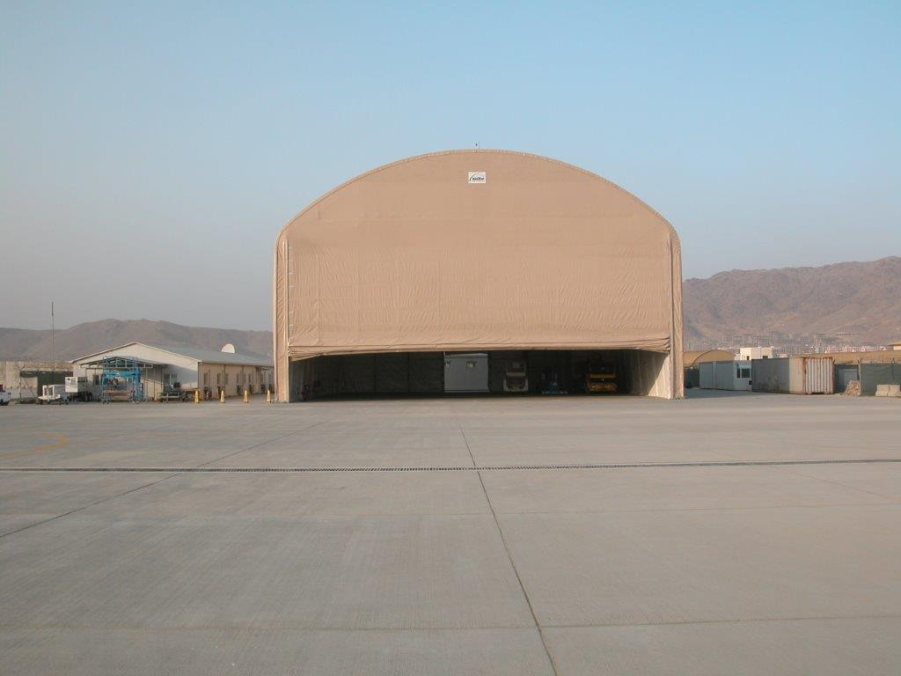
Global Discovery Program Additional Costs
U.S. Department of Justice Office of the Inspector General

Slide 22
Lack of MOU Oversight
At the onset on our audit, DEA did not provide us all the MOUs related to its aviation operations in Afghanistan.
DEA requires only MOUs with a funding element to be tracked in UFMS and reported on its annual budget.
Non-funding MOUs are informally tracked by each division, but no universal listing exists.
U.S. Department of Justice Office of the Inspector General

Slide 23
DEA MOUs with DOD
Fiscal Year | Amount
2012 | $3,255,000
2013 | $6,640,000
2014 | $6,560,000
2015 | $3,880,000
Total $20,335,000
The MOUs were intended to support the DEA’s two Beech King Air 350s operating in Afghanistan until the deployment of the Global Discovery aircraft.
U.S. Department of Justice Office of the Inspector General
Notes:
Funding was for: 1) DEA’ s contractor L-3
2) Landing fees
3) Electricity and generator services at Camp Alvarado
4) TDY for aviation detachment
5) Flares for the ALE-47 airborne countermeasures dispenser system

Slide 24
MOU Expenditure Review
Sample $8,000,964 60%
Non-Sample $5,329,483 40%
Non-Personnel
Sample $6,810,003
Personnel Sample $1,190,961
U.S. Department of Justice Office of the Inspector General

Slide 25
DEA Unallowable Global Discovery Program MOUs Costs
Expenditure | Question Cost
ATR 500 Maintenance | $1,411,611
Pilot, Mechanic, and Support Staff Training | $207,218
Travel | $45,870
Total | $1,664,699
U.S. Department of Justice Office of the Inspector General

Slide 26
DEA Unallowable MOU Costs
Expenditure/Unallowable Use | Questioned Cost
Maintenance of Aircraft not in Afghanistan | $602,196
Training (including travel to training) for DEA and L-3 employees that did not go to Afghanistan | $32,211
Camp Alvarado Generator Fuel and Service in 2011 spent outside the period of performance | $20,247
Missions in Haiti, the Bahamas, Peru, and Florida | $8,122
Duplicate Expenditures (travel-related and generator service in Kabul) | $6,776
Other (satellite phone service, room cleaning, Fed Ex charges, travel for L-3 employee unrelated to DEA’s Aviation Program) | $1,489
Total | $671,041
U.S. Department of Justice Office of the Inspector General

Slide 27
DEA Unsupported MOU Costs
Expenditure | Question Cost
Camp Alvarado Electricity and Generator Service | $51,946
Training | $12,875
Maintenance of Aircraft | $12,366
Travel | $950
Other (Communications) | $71
Total | $78,208
U.S. Department of Justice Office of the Inspector General

Slide 28
DEA’s Lack of Contractor Oversight
We reviewed 217 direct labor and 331 special pay expenditures for the 9 months between FYs 2012 and 2014 ($1,190,961).
We found initially 133 (61 percent) direct labor and 90 (27 percent) special pay expenditures could not be reconciled to L-3’s payroll reports, approved timecards, and other payroll supporting documentation provided by L‑3.
DEA approved and paid overbillings made by L-3 for $47,453.
U.S. Department of Justice Office of the Inspector General
Notes:
Personnel costs consisted of payments to contract pilots and mechanics to support the DEA’s aviation operations in Afghanistan
After more than 5 months of repeated follow-up by the OIG, L‑3 provided documentation and explanation to support the majority of direct labor expenditures. However, as of January 2016, L-3 has not responded to 84 of the 90 special pay expenditures that could not be reconciled.
we determined that the DEA’s Aviation Division does not have adequate policies or procedures for receiving, reviewing, and paying contractor invoices for personnel costs. Specifically, there is no requirement for the DEA’s CO or COTR to review supporting documentation, such as payroll reports, approved timecards, and other supporting documentation, prior to contract personnel being paid. We also determined that the DEA’s current aviation contract with L‑3 does not even specify what supporting documentation is required to be provided to the DEA for contractor personnel expenditures. Without adequate internal controls, the Aviation Division cannot determine if the personnel expenditures being claimed are accurate before payment.

Slide 29
Insufficient MOU
Reporting Requirements
MOU FY | Due By | Date Returned | Late (Months) | Amount
2012 | 09/30/12 | 02/12/15 | 28 | $28,658
2013 | 09/30/13 | 01/14/15 | 15 | $84,474
2014 | 09/30/14 | 01/14/15 | 3 | $40,000
 | Total |  |  | $153,132
We found that the DEA did not return $153,132 of unused funds to the DOD . DEA also failed to submit final accounting reports to the DOD.
U.S. Department of Justice Office of the Inspector General
Notes:
(1) properly commit and obligate funds received according to the terms and conditions of the MOUs; (2) maintain full and complete records and accounts with respect to the use of funds in accordance with generally accepted accounting principles; and (3) ensure that expenditures conform to the MOU requirements

Slide 30
Insufficient Performance Metrics
DEA entered into MOUs that lacked goals, objectives, or any other measurable performance metrics.
U.S. Department of Justice Office of the Inspector General
Notes:
Without performance metrics DEA could not determine its impact on its counternarcotics mission in Afghanistan.
In the absence of any prescribed performance measurements, we reviewed the DEA’s quarterly reports submitted to the DOD and the DEA’s mission reports to determine the number of missions flown, mission requests declined, and the availability of aircraft including downtime for maintenance

Slide 31
DEA’s Performance in Afghanistan
Missions Flown October 2011 through February 2015
U.S. Department of Justice Office of the Inspector General

Slide 32
DEA’s Afghanistan Mission Requests Declined
February 2012 through January 2015
U.S. Department of Justice Office of the Inspector General

Slide 33
DEA’s Surveillance Aircraft in Afghanistan between FYs 2011 and 2014
U.S. Department of Justice Office of the Inspector General

Slide 34
Conclusion
$86 million spent on the Global Discovery Program has been an ineffective and wasteful use of government resources.
DEA removed its aviation operations from Afghanistan in July 2015 and the latest completion date for the Global Discovery Program is now December 2016.
Lack of MOU oversight - $2,383,193 was diverted to the Global Discovery Program and spent on
non-Afghanistan operations and $78,208 could not be
supported.
U.S. Department of Justice Office of the Inspector General

Slide 35
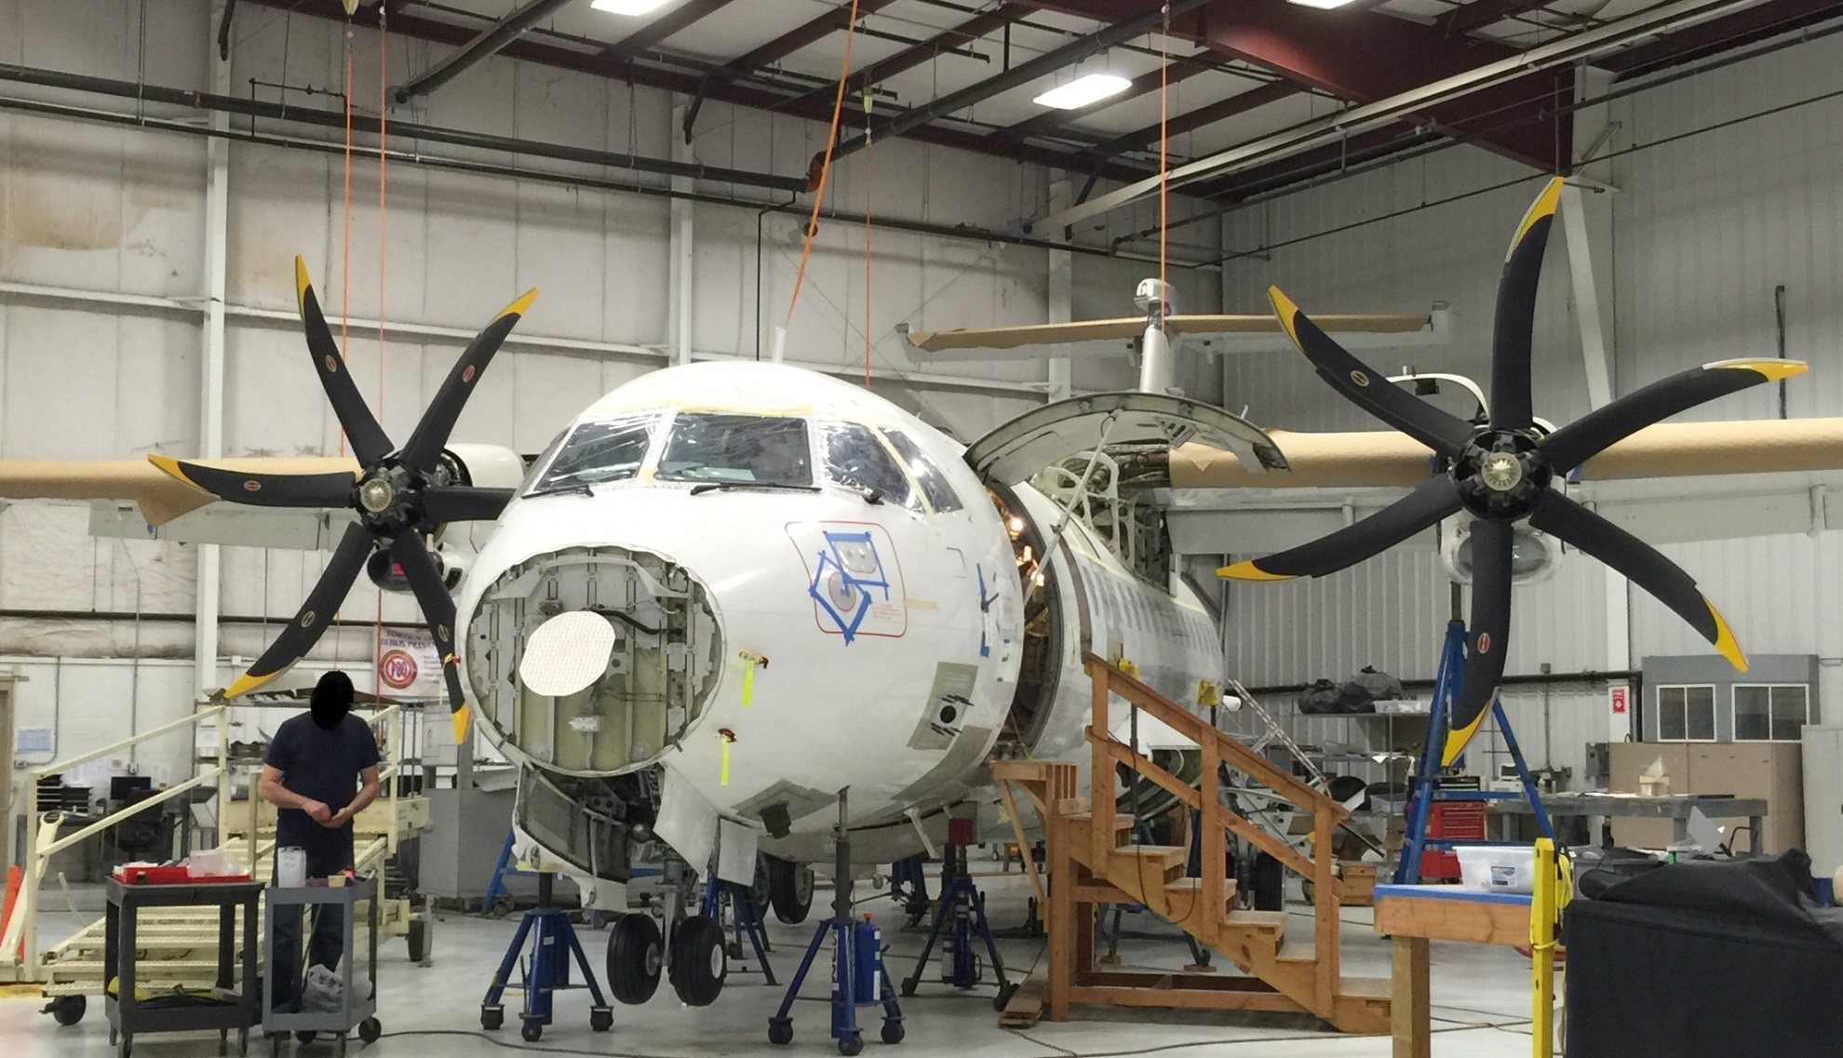
A Picture is Worth a Thousand Words…
U.S. Department of Justice Office of the Inspector General

Slide 36
Questions?
U.S. Department of Justice Office of the Inspector General

