Slide 1
“Be A Game Changer” with Arleas Upton Kea
Presented at the
2012 Annual Conference of the
Federal Audit Executive Council (FAEC)
Washington, D.C.
Wednesday, November 28, 2012

Slide 2
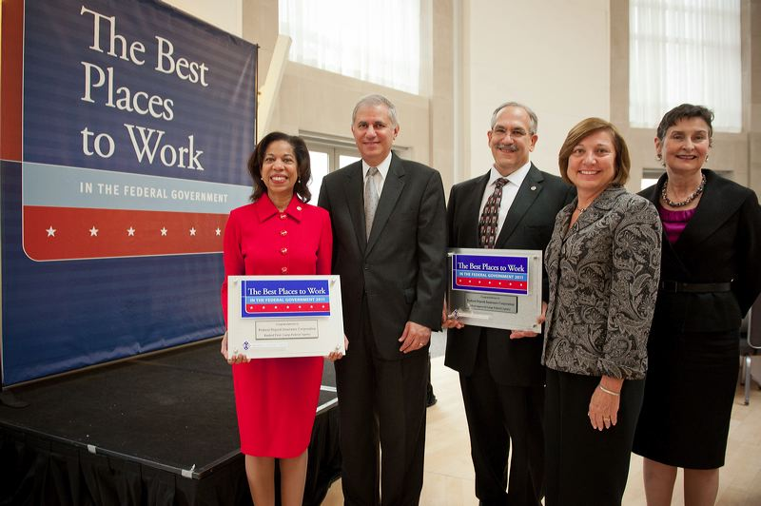
Change
2007: ranked 24.
2010: ranked 3!
2011: ranked 1!!!

Slide 3
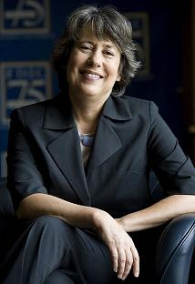
Leadership
I’m proud of the…morale accomplishments …making [FDIC] a better place to work – Former Chairman Sheila Bair

Slide 4
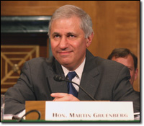
Leadership
Culture change…has proven effective and is highly valued by the employees - Acting Chairman Martin Gruenberg

Slide 5
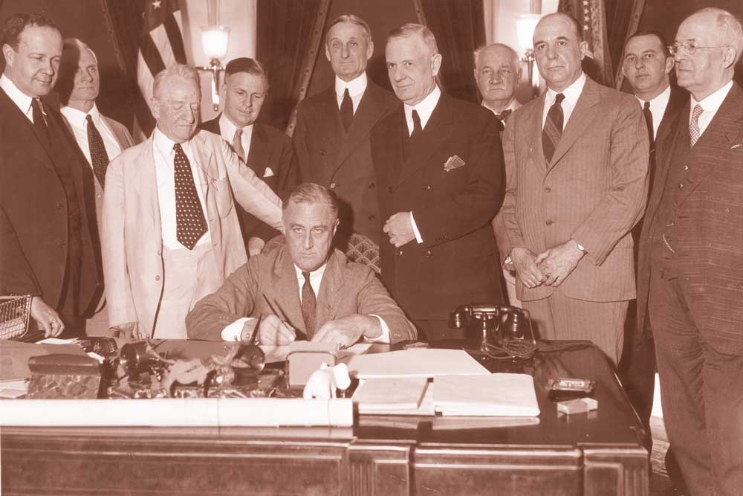
Mission, Commitment, Dedication

Slide 6
In Context
Worst financial crisis since the Great Depression
Expanded FDIC’s workforce by 4,000-doubling its size
FDIC took over and protected up to 10 banks or thrift institutions a week
New regulatory reforms; new offices
Conscious decision to continue with culture change

Slide 7
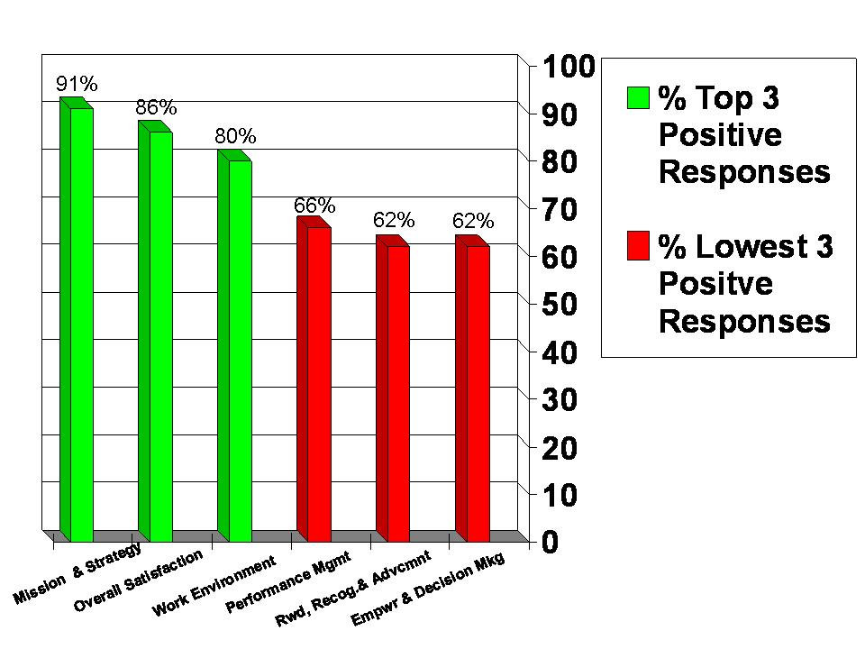
Engagement-2011 Survey
○ % Top 3
Positive
Responses
○ % Lowest 3
Positive
Responses

Slide 8
Engagement

Slide 9
Next Steps
Enhance positive change, build on successes
Institutionalize/operationalize
Employee participation, all perspectives
Commitment to workplace excellence (WE)

Slide 10
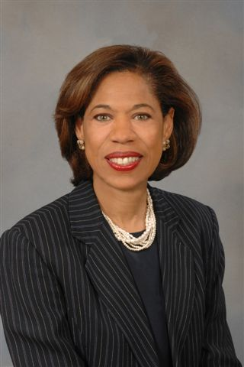
Thank You!
Arleas Upton Kea
Director, Division of Administration
Federal Deposit Insurance Corporation
703-562-2100
akea@fdic.gov

