Slide 1
Standards for Internal Control in the Government
Standards for Internal Control in the Federal Government
Going Green

Slide 2
Session Objective
To discuss GAO’s Standards for Internal Control in the Federal Government (Green Book)

Slide 3
Green Book Through the Years
1983
Present

Slide 4
What’s in Green Book for the Federal Government?
Reflects federal internal control standards required per Federal Managers’ Financial Integrity Act (FMFIA)
Serves as a base for OMB Circular A-123
Written for government
Leverages the COSO Framework
Uses government terms

Slide 5
What’s in Green Book for State and Local Governments?
May be an acceptable framework for internal control on the state and local government level under proposed OMB Uniform Guidance for Federal Awards
Written for government
Leverages the COSO Framework
Uses government terms

Slide 6
What’s in Green Book for Management and Auditors?
Provides standards for management
Provides criteria for auditors
Can be used in conjunction with other standards, e.g. Yellow Book

Slide 7
Updated COSO Framework
Released May 14, 2013

Slide 8
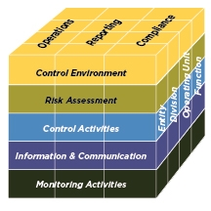
The COSO Framework
Relationship of Objectives and Components
Direct relationship between objectives (which are what an entity strives to achieve) and the components (which represent what is needed to achieve the objectives)
COSO depicts the relationship
in the form of a cube:
The three objectives are represented
by the columns
The five components are represented
by the rows
The entity’s organization structure is
represented by the third dimension
Source: COSO

Slide 9
From COSO to Green Book: Harmonization
COSO
Green Book

Slide 10
Exposure Draft Comment Process
43 comment letters from federal agencies, Inspectors General, public accounting firms, professional organizations, academia, among others
Major themes of comments included but were not limited to
Clarification of requirements (must/should)
Definition of key terms
Applicability to state, local, and not-for-profits organizations
Documentation requirements
Editorial suggestions

Slide 11
Revised Green Book: Standards for Internal Control in the Federal Government
Overview
Standards

Slide 12
Revised Green Book: Standards for Internal Control in the Federal Government
Consists of two sections:
Overview
Standards
Establishes:
Definition of internal control
Categories of objectives
Components and principles of internal control
Requirements for effectiveness

Slide 13
Revised Green Book: Overview
Overview
Explains fundamental concepts of internal control
Addresses how components, principles, and attributes relate to an entity’s objectives
Discusses management evaluation of internal control
Standards

Slide 14
Fundamental Concepts
What is internal control in Green Book?
“Internal control is a process effected by an entity’s management that provides reasonable assurance that the objectives of an entity are being achieved.”
What is an internal control system in Green Book?
“An internal control system is a continuous built-in component of operations, effected by people, that provides reasonable assurance, not absolute assurance, that an organization’s objectives will be achieved.”

Slide 15
Overview: Components, Principles, and Attributes
Overview
Achieve Objectives
Principles
Attributes
Components
Standards

Slide 16
Revised Green Book: Principles

Slide 17
Component, Principle, Attribute

Slide 18
Overview: Principles and Attributes
Overview
In general, all components and principles are required for an effective internal
control system
Principles and Attributes
Entity should implement relevant principles
If a principle is not relevant, document the rationale of how, in the absence of that principle, the associated component could be designed, implemented, and operated effectively
Attributes are considerations that can contribute to the design, implementation, and operating effectiveness of principles
Standards

Slide 19
Overview: Management Evaluation
Overview
Overview
An effective internal control system requires that each of the five components are:
Effectively designed, implemented, and operating
Operating together in an integrated manner
Management evaluates the effect of deficiencies on the internal control system
A component is not effective if related principles are not effective
Standards
Standards

Slide 20
Overview: Additional Considerations
Overview
Overview
The impact of service organizations on an entity’s internal control system
Discussion of documentation requirements in the Green Book
Applicability to state, local, and quasi-governmental entities as well as not-for-profits
Cost/Benefit and Large/Small Entity Considerations
Standards
Standards

Slide 21
Revised Green Book: Standards
Overview
Control Environment
Risk Assessment
Control Activities
Information and Communication
Monitoring
Standards

Slide 22
Revised Green Book: Standards
Overview
Explains principles for each component
Includes further discussion of considerations for principles in the form of attributes
Standards

Slide 23
Control Environment

Slide 24
Risk Assessment

Slide 25
Control Activities

Slide 26
Information & Communication

Slide 27
Monitoring

Slide 28
Controls Across Components

Slide 29
Other Key Considerations
Standards vs. Framework
Documentation Requirements
Overview lists the documentation requirements found in the principles which represent the minimum level of documentation necessary for an effective internal control system.
Consideration of Attributes
Overview discusses how management considers the design, implementation, and operating effectiveness of the attributes for each principle

Slide 30
Documentation Requirements
If management determines a principle is not relevant, management supports that determination with documentation that includes the rationale of how, in the absence of that principle, the associated component could be designed, implemented, and operated effectively.

Slide 31
Documentation Requirements (cont.)
Control Environment
Management develops and maintains documentation of its internal control system.
Control Activities
Management documents in policies the internal control responsibilities of the organization.

Slide 32
Documentation Requirements (cont.)
Monitoring
Management evaluates and documents the results of ongoing monitoring and separate evaluations to identify internal control issues.
Management evaluates and documents internal control issues and determines appropriate corrective actions for internal control deficiencies on a timely basis.
Management completes and documents corrective actions to remediate internal control deficiencies on a timely basis.

Slide 33
Accessibility of Green Book
Comments raised during exposure identified new need
How do we make the Green Book more accessible to our user community?

Slide 34
The Green Book layout
Changed the layout of the Green Book itself to make it more user friendly:
Highlights page
Facsimile page
Graphics throughout the overview
Cube throughout the standards

Slide 35
Highlights Page

Slide 36
Facsimile Page

Slide 37
The Principle Slices

Slide 38
Cube as Navigation Aid

Slide 39
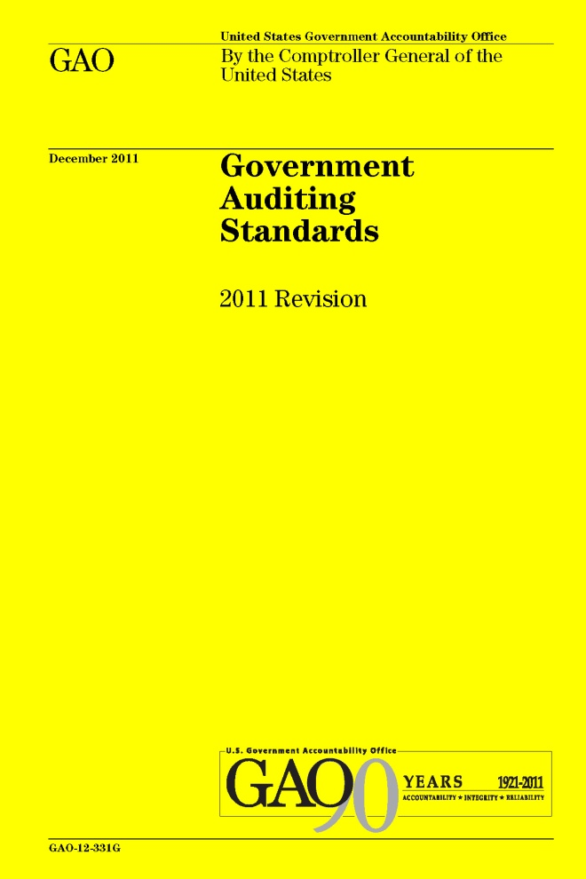
The Green Book in Action
Relationship between the Green Book and Yellow Book
Notes:
39

Slide 40
Green Book and Yellow Book
Can be used by management to understand requirements
Can be used by auditors to understand criteria

Slide 41
The Yellow Book: Framework for Audits
Findings are composed of
Condition (What is)
Criteria (What should be)
Cause
Effect (Result)
Recommendation (as applicable)

Slide 42
Linkage Between Criteria (Yellow Book) and Internal Control (Green Book)
Green Book provides criteria for the design, implementation, and operating effectiveness of an effective internal control system

Slide 43
The Yellow Book: Framework for Audits
Findings are composed of
Condition (What is)
Criteria (What should be)
Cause
Effect (Result)
Recommendation (as applicable)

Slide 44
Linkage Between Findings (Yellow Book) and Internal Control (Green Book)
Findings may have causes that relate to internal control deficiencies

Slide 45
Where to Find the Green Book
The Green Book is on GAO’s website at: www.gao.gov/greenbook
For technical assistance, contact us at: greenbook@gao.gov
Notes:
45

Slide 46
Thank You
Questions?

