Slide 1
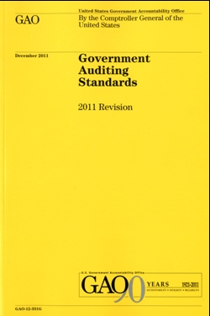
DM # 6192169H
Government Auditing Standards
Yellow Book Update

Slide 2
Yellow Book Update
New Interpretations
Conceptual Framework
Implementation Challenges
n
n
n

Slide 3
New interpretations
New Interpretations
Same authority as Yellow Book
Presented to Advisory Council
Addressed with key stakeholders
Posted to GAO website once finalized

Slide 4
New interpretations
Two new interpretations (draft-pending)
Peer Reviews
Performance/Attest Independence

Slide 5
Interpretation 1 - Peer Reviews
The peer review team uses professional judgment in deciding the type of peer
review report
Types of peer review ratings:
Pass
Pass with deficiencies
Fail
5
Notes:
5

Slide 6
Interpretation 1 - Peer Reviews
GAO is developing interpretive guidance on assessing and reporting on the results of peer reviews in government environment:
  New report ratings do not change the thresholds for deficiency reporting
  Matters identified during peer review that are not included in report may be communicated orally or in writing
6
Notes:
6

Slide 7
Interpretation 2 – Performance/
Attest Independence
Nonaudit Services and Limited-Scope Audits
GAO is developing interpretive guidance on GAGAS paragraph 3.47:
Allows – Auditors to perform some otherwise-prohibited nonaudit services
Prohibits -
Clarifies – Attest and Performance Audit independence requirements parallel
Does not apply to financial statement audits
Auditors always still required to assess independence using the Conceptual Framework

Slide 8
Conceptual Framework
Identify threats to independence
Evaluate the significance of the threats identified, both individually and in the aggregate
Apply safeguards as necessary to eliminate the threats or reduce them to an acceptable level
Evaluate whether the safeguard is effective
Documentation Requirement:
Para 3.24: When threats are not at an acceptable level and require application of safeguards, auditors should document the safeguards applied
8

Slide 9
Conceptual Framework
Applying The Framework
Threats could impair independence
  Do not necessarily result in an independence impairment
Safeguards could mitigate threats
  Eliminate or reduce to an acceptable level

Slide 10
Applying the Framework:
Categories of Threats
10
  Management participation threat
  Self-review threat
  Bias threat
  Familiarity threat
  Undue influence threat
  Self-interest threat
  Structural threat
Notes:
10

Slide 11
GAGAS Conceptual Framework for Independence

Slide 12
Additional Documentation Requirements
Auditors must document assessment of SKE
Auditors must document application of safeguards in place

Slide 13
Implementation Challenges
Nonaudit services
  Assessment of SKE (Skill, Knowledge and Experience)
SKE is assessed before conceptual framework

Slide 14
Reminder - Continuing Professional
Education (CPE)
No revision to overall requirements
Minimum of 24 hours of CPE every 2 years
  Government
  Specific or unique environment
  Auditing standards and applicable accounting principles
Additional 56 hours of CPE for auditors involved in
  Planning, directing, or reporting on GAGAS assignments; or
  Charge 20 percent or more of time annually to GAGAS assignments
Minimum of 20 hours of CPE each year
Notes:
14

Slide 15
Where to Find the Yellow Book
15
The Yellow Book is available on GAO’s website at:
www.gao.gov/yellowbook
For technical assistance, contact us at:
yellowbook@gao.gov
or call (202) 512-9535
Notes:
15
15

Slide 16
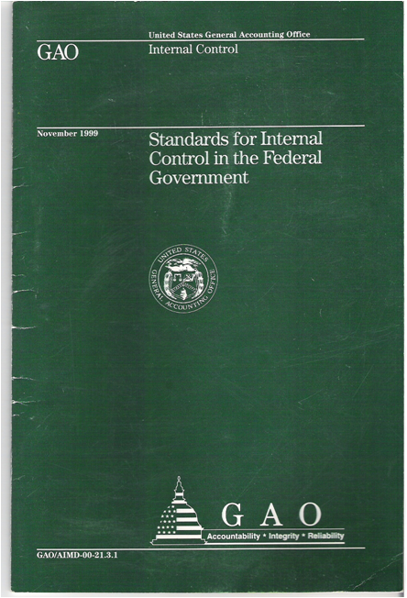
Standards for Internal Control in the Government
Standards for Internal Control
in the Federal Government
Going Green

Slide 17
Session Objective: Going Green
To discuss GAO’s plan to update the Standards for Internal Control in the Federal Government, (Green Book)
To discuss why internal controls are a key tool government managers use to
  Produce reliable financial reports
  Maintain compliance
  Achieve operational objectives and mitigate risks
To demonstrate …

Slide 18
Implications of Ineffective Internal Controls
More than $154 Million in Questioned and Unsupported Costs in [Grant Recipients] Proposed Budget
Improper Release of Personally Identifiable Information
Internal Controls Over [Entity’s] Staff Retreats Could Be Improved
More than $6.3 Million of Questioned Costs at the University of [Green’s Higher Education]
Additional Audit Work Confirms $88 Million of Unallowable Contingency Costs in Construction Budget
Notes:
The reference to the More than $154 Million in Questioned and Unsupported Costs in [Grant Recipients] Proposed Budget comes from the NSF OIG’s September 2012 Semiannual Report to Congress p.9. Replaced NEON with Grant Recipient. The same source is for the reference to more than 6.3 Million of Questioned Costs at the University of [Hard Luck]. The reference to Internal Control Over [NSF/Entities] Staff Retreats could be improved is from the NSF’s March 2012 Semiannual report to Congress p. 8. The reference to Additional Audit Work Confirms $88 Million of Unallowable Contingency Costs in Construction Budget is also from the NSF OIG’s March 2012 Semiannual report to Congress p.9. Improper Release of Personally Identifiable Information is from the HUD OIG’s list of reports titles.

Slide 19
Reasons for Green Book Revision
  Last issued in November 1999
  Adapt to a more global, complex, and technological landscape
  Maintain relevancy to changing standards
  Harmonize federal standards with the updated Committee of Sponsoring Organizations of the Treadway Commission (COSO) Framework

Slide 20
What’s in Green Book for the Federal Government?
Reflects federal internal control standards required per Federal Managers’ Financial Integrity Act (FMFIA)
Serves as a base for OMB Circular A-123
Written for government
  Leverages the COSO Framework
  Uses government terms

Slide 21
What’s in Green Book for
State and Local Governments?
May be an acceptable framework for internal control on the state and local government level under proposed OMB Uniform Guidance for Federal Awards
Written for government
  Leverages the COSO Framework
  Uses government terms

Slide 22
What’s in Green Book for Management and Auditors?
Provides a framework for management
Provides criteria for auditors
Can be used in conjunction with other standards, e.g. Yellow Book

Slide 23
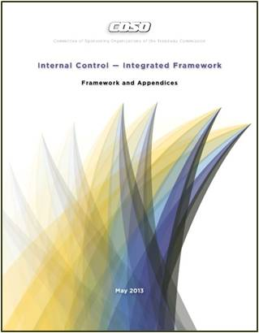
Updated COSO Framework
Released
May 14, 2013

Slide 24
Internal Control: COSO Framework
Published by COSO
  COSO is sponsored by
    American Accounting Association (AAA)
    American Institute of Certified Public Accountants (AICPA)
    Financial Executives International (FEI)
    Institute of Management Accountants (IMA)
    Institute of Internal Auditors (IIA)
Established:
  Common internal control definitions
  Internal control components
Notes:
Green Book definitions and elements are from COSO.
GAO did not “invent this” but makes this framework applicable to federal agencies in the U.S.
COSO is an internationally used, widely accepted framework.

Slide 25
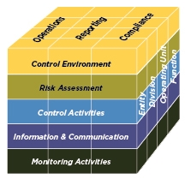
The COSO Framework
Relationship of Objectives and Components
      Direct relationship between objectives (which are what an entity strives to achieve) and the components (which represent what is needed to achieve the objectives)
COSO depicts the relationship
in the form of a cube:
  The three objectives are represented
by the columns
  The five components are represented
by the rows
  The entity’s organization structure is
represented by the third dimension
Source: COSO

Slide 26
Updated COSO Framework
Retains the five components and adds principles and points of focus
Sets out 17 principles
  Fundamental concepts associated with the components
Each principle is supported by related points of focus
  Represent characteristics associated with the principles

Slide 27
Updated COSO Framework:
Components of Internal Control
Control Environment
Demonstrates commitment to integrity and ethical values
Exercises oversight responsibility
Establishes structure, authority and responsibility
Demonstrates commitment to competence
Enforces accountability
Risk Assessment
Specifies suitable objectives
Identifies and analyzes risk
Assesses fraud risk
Identifies and analyzes significant change
Control Activities
Selects and develops control activities
11. Selects and develops general controls over technology
Deploys through policies and procedures
Information & Communication
Uses relevant information
Communicates internally
Communicates externally
Monitoring Activities
Conducts ongoing and/or separate evaluations
Evaluates and communicates deficiencies

Slide 28
From COSO to Green Book: Harmonization
COSO
Green Book

Slide 29
Green Book Revision Process
Retained five original COSO components
Adapted COSO Framework’s language
to make it appropriate for a federal
government standard
Adapted the concepts for a government environment where appropriate
Considered clarity drafting conventions
Considered INTOSAI internal control guidance

Slide 30
Revised Green Book:
Standards for Internal Control in the Federal Government
Overview
Standards

Slide 31
Revised Green Book: Overview
Overview
Explains fundamental concepts of internal control
Addresses how components, principles, and attributes relate to an entity’s objectives
Discusses management evaluation of internal control
Standards
Notes:
Definition of Internal Control
Internal control is an integral component of an entity’s management that provides reasonable assurance that the objectives of an entity are being achieved.
An Internal Control System
An internal control system is a continuous built-in component of operations, effected by people, that provides reasonable assurance, not absolute assurance, that an organization’s objectives will be met.
Evaluation of an Internal Control System
Management evaluates the effectiveness of the design, implementation, and operation of the entity’s internal control system.

Slide 32
Overview: Components, Principles, and Attributes
Overview
Achieve Objectives
Principles
Attributes
Components
Standards
Notes:
Need to add a definition next to “Principles” and “Attributes”

Slide 33
Overview: Principles and Attributes
Overview
In general, all components, principles,
and attributes are required for an
effective internal control system
Principles and Attributes
  Entity should implement relevant principles and attributes
  If a principle or attribute is not relevant, document the rationale of how, in the absence of that principle or attribute, the associated component could be designed, implemented, and operated effectively
Standards
Notes:
Need to revise to tell story of how the principles and attributes work for effective IC. Also need additional slide to explain principles, attributes how handled approached in GB
Management must comply with an unconditional requirement.
Management must comply with a presumptively mandatory requirement where such a requirement is relevant.
Application Material – Additional Information
Application material provides further explanation of the requirements using the words may, might, and could.

Slide 34
Overview: Management Evaluation
Overview
Overview
An effective internal control system requires
that each of the five components are:
Effectively designed, implemented, and operating
Operating together in an integrated manner
Management evaluates the effect of deficiencies on the internal control system
A component is not likely to be effective if related principles and attributes are not effective
Standards
Standards

Slide 35
Revised Green Book: Standards
Overview
Control Environment
Risk Assessment
Control Activities
Information and Communication
Monitoring
Standards

Slide 36
Revised Green Book: Standards
Overview
Discusses requirements of each component
Explains principles and attributes for each component
Includes application material for each attribute
Standards
Notes:
Definition of Internal Control
Internal control is an integral component of an entity’s management that provides reasonable assurance that the objectives of an entity are being achieved.
An Internal Control System
An internal control system is a continuous built-in component of operations, effected by people, that provides reasonable assurance, not absolute assurance, that an organization’s objectives will be met.
Evaluation of an Internal Control System
Management evaluates the effectiveness of the design, implementation, and operation of the entity’s internal control system.

Slide 37
Standards: COSO vs. Green Book
Component | COSO | Green Book
Control Environment | 5 Principles 20 Points of Focus | 5 Principles 13 Attributes
Risk Assessment | 4 Principles 27 Points of Focus | 4 Principles 10 Attributes
Control Activities | 3 Principles 16 Points of Focus | 3 Principles 11 Attributes
Information & Communication | 3 Principles 14 Points of Focus | 3 Principles 7 Attributes
Monitoring | 2 Principles 10 Points of Focus | 2 Principles 6 Attributes
Overview
Standards
Note: GAO combined COSO’s points of focus into attributes

Slide 38
Standards: Harmonization from COSO to Green Book
Overview
Commercial Concepts
Government Concepts
Standards
Board of Directors
Investors
Oversight Body
Stakeholders
Notes:
Need to add terms

Slide 39
Standards: Harmonization Example
Overview
  COSO (Principle 2)
  The board of directors demonstrates independence from management and exercises oversight of the development and performance of internal control.
  Green Book (Principle 2)
The oversight body should oversee the entity’s internal control system.
Standards

Slide 40
Green Book Revision
Proposed Timeline
Outreach to User Community
Green Book Advisory Council
Public Exposure (90 day comment period)
Finalize
Ongoing
May 20, 2013
Summer 2013
2014

Slide 41
Green Book Advisory Council
Representation from:
  Federal agency management (nominated by OMB)
  Inspector General
  State and local government
  Academia
  COSO
  Independent public accounting firms
  At large

Slide 42
Where to Find the Green Book
Once exposed, the Green Book will be on GAO’s website at: www.gao.gov
For technical assistance, contact us at: greenbook@gao.gov
Notes:
42

